Slide 1
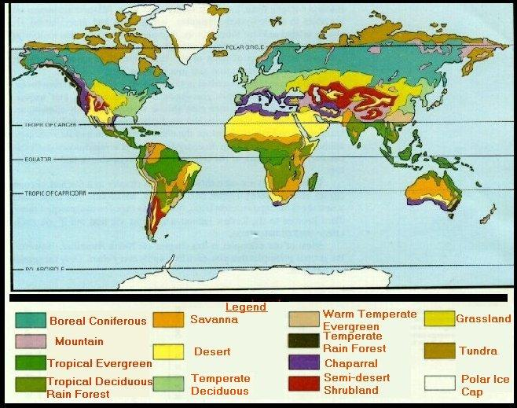
4-3 Biomes
Environments are grouped into BIOMES
group of ecosystems that have same climate & dominant communities

Slide 2
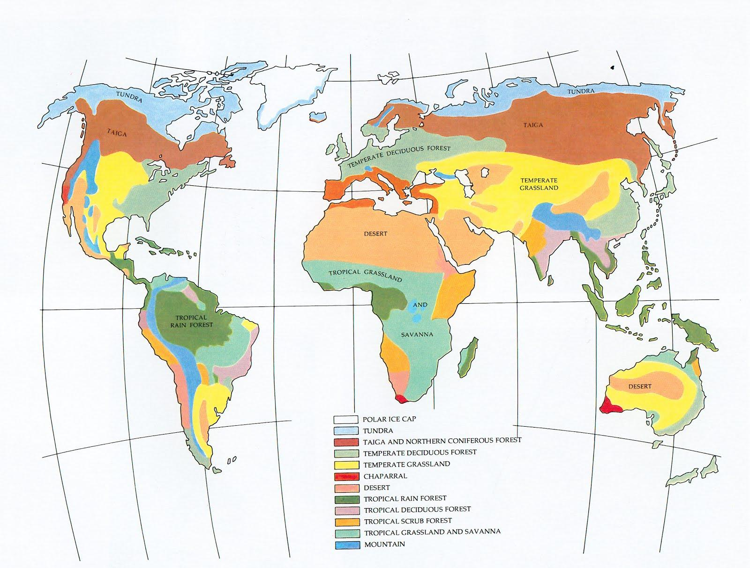

Slide 3
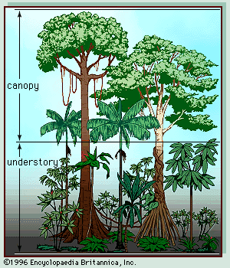
TROPICAL RAIN FOREST has most species, BIODIVERSITY canopy = top | understory = below canopy
hot & wet year round;
thin, poor soil

Slide 4
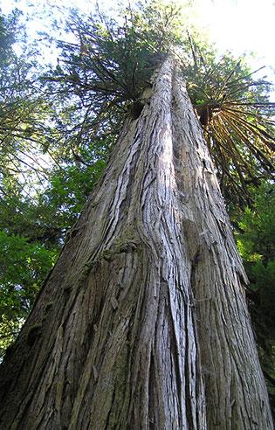
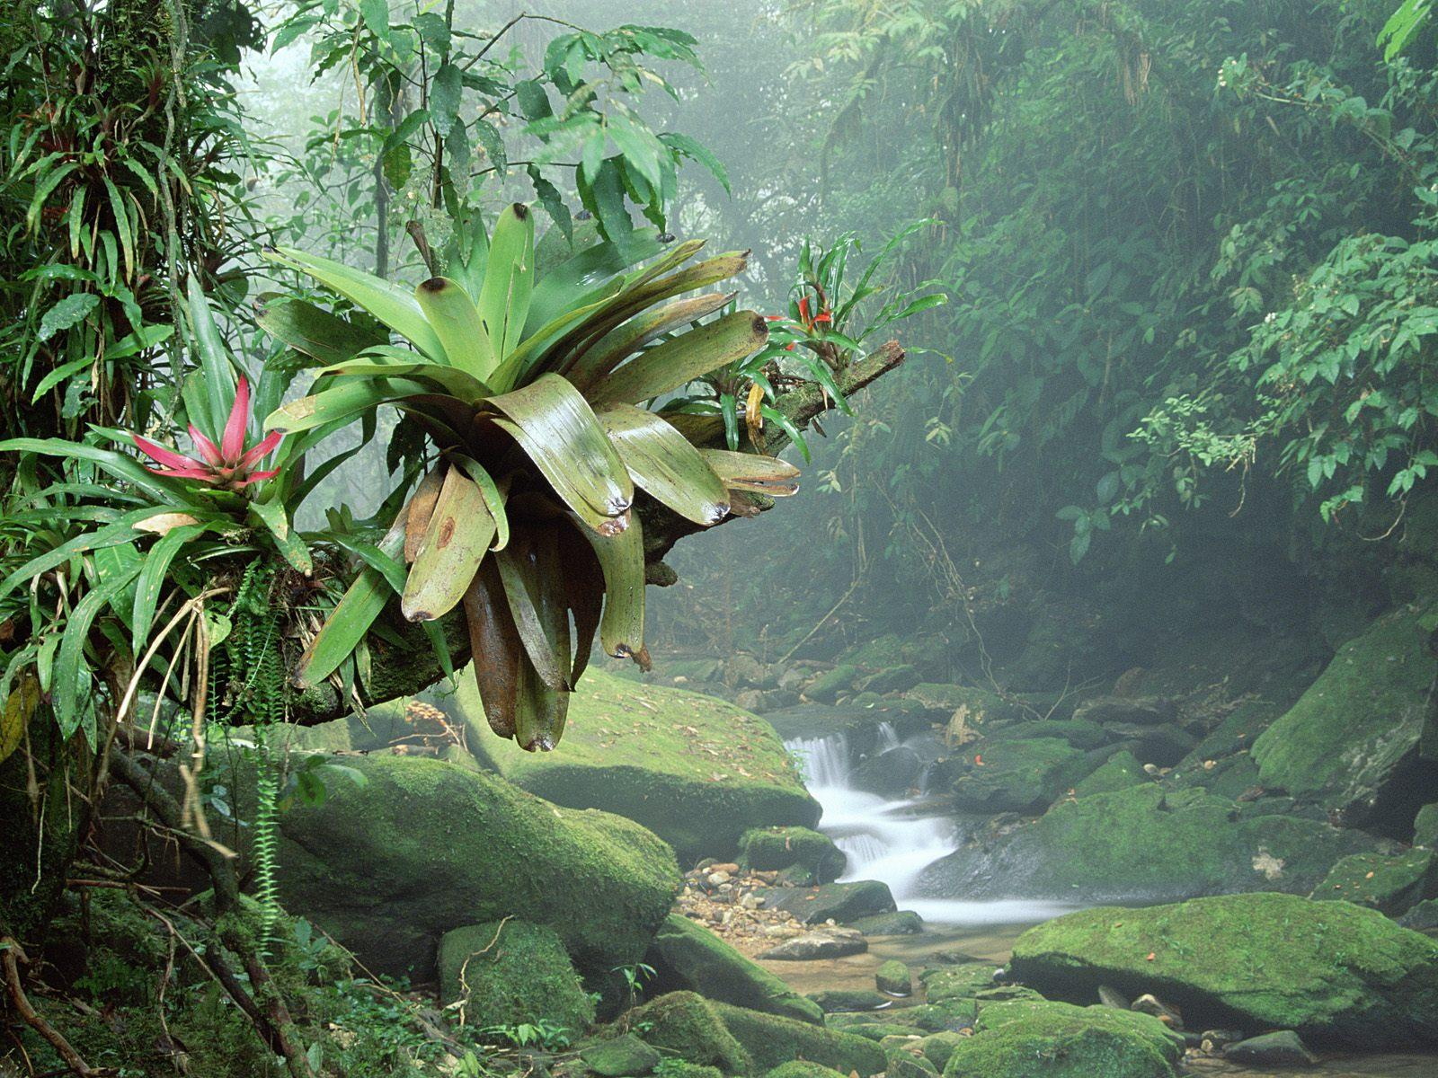
Many plants anchor themselves to the trees, like this BROMELIAD

Slide 5
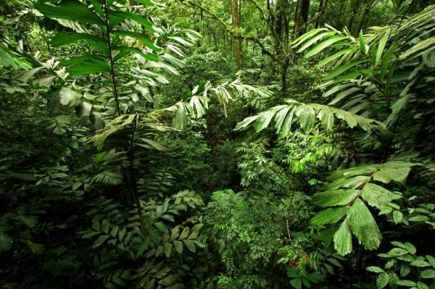
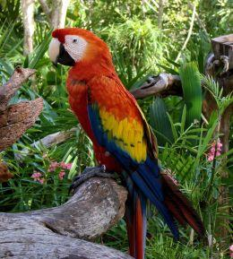
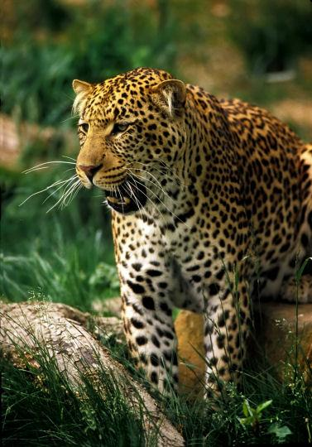
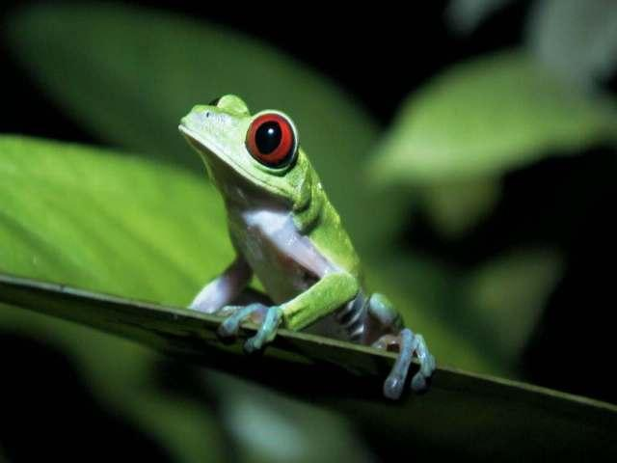
Jaguar
Parrot
Tree Frog

Slide 6
Arboreal = an animal that lives in ______________ Brachiation = movement by __________________

Slide 7
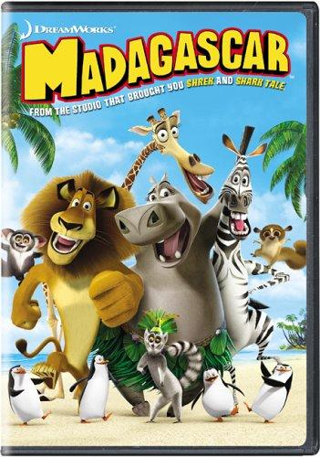
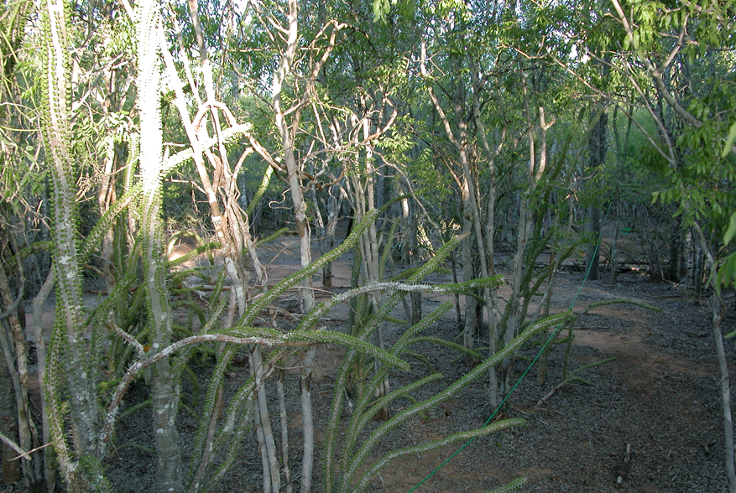
TROPICAL DRY FOREST
wet/dry seasons, warm year round trees are deciduous -lose leaves

Slide 8
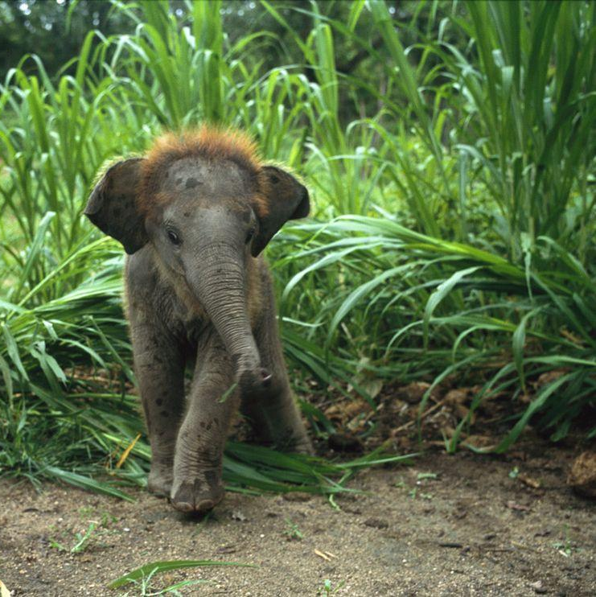
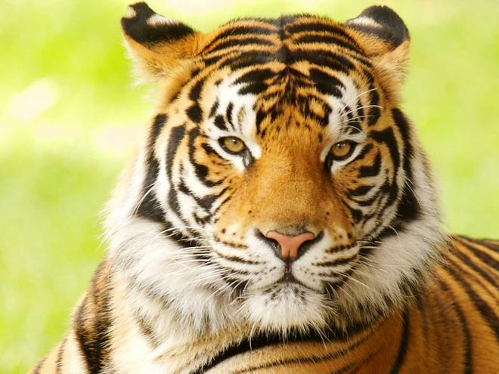
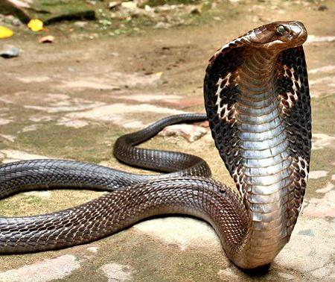
What lives in a tropical dry forest?

Slide 10
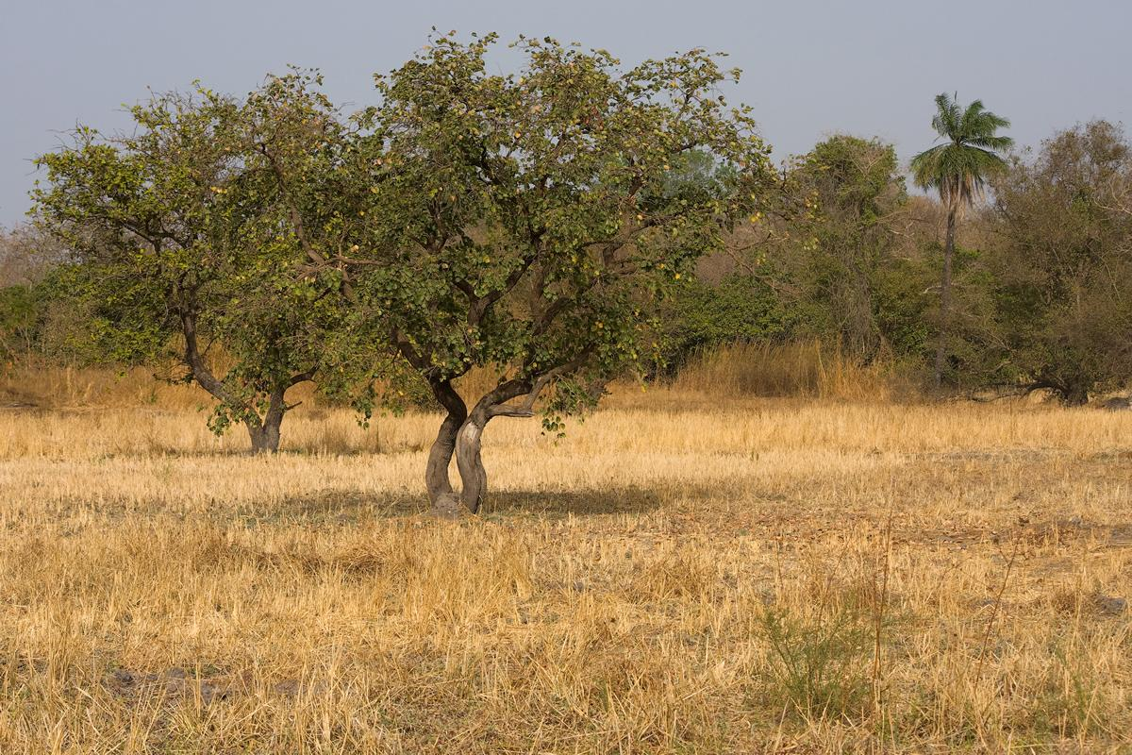
TROPICAL SAVANNA
grassland area, with a few trees
large animal herds & frequent fires
Lions
Zebra Wildebeest Gazelles
Elephants
Giraffes
Battle at Kruger

Slide 11
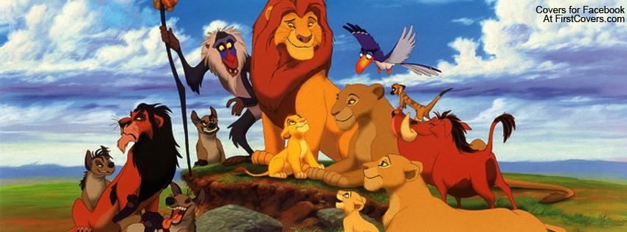
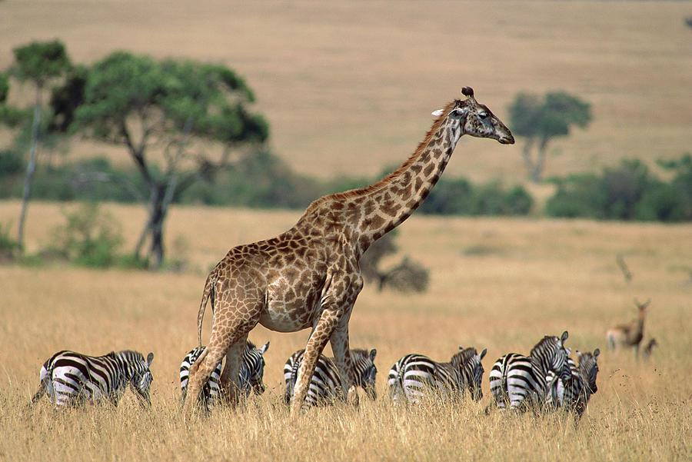
The Lion King was set in a savanna.

Slide 12
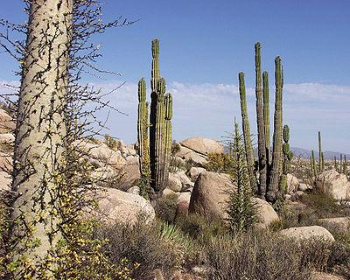
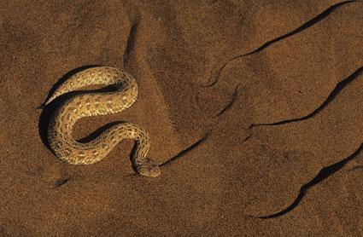
DESERT dry (less than 25 cm rainfall/year) extreme temperature changes (hot/cold) cacti/succulent plants organisms able to tolerate extreme conditions

Slide 13
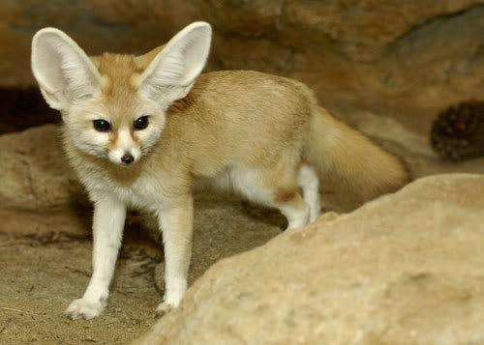
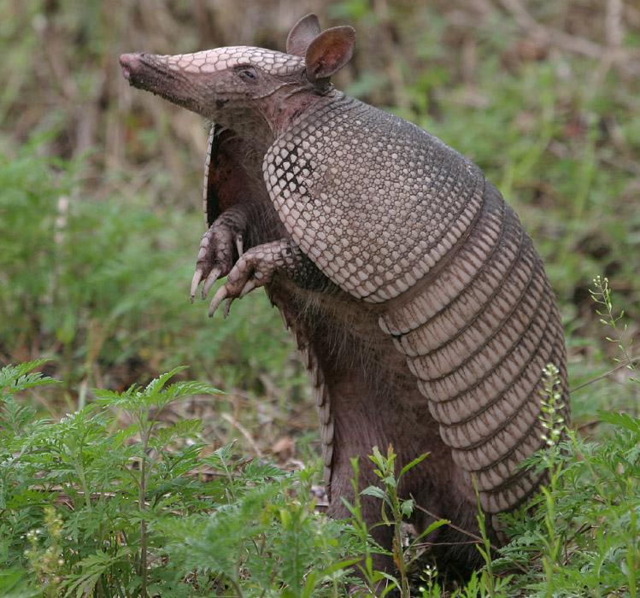
Desert Mammals
Can you name these two?

Slide 14
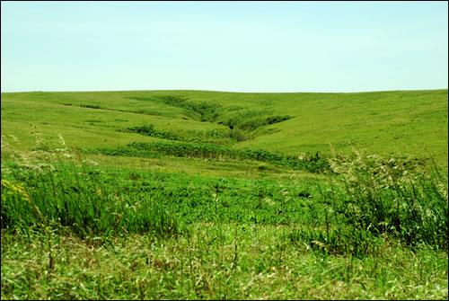
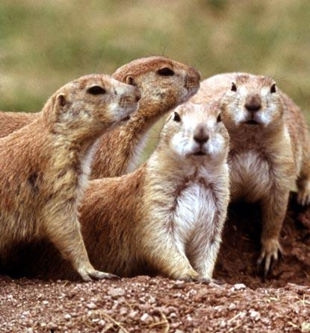
TEMPERATE GRASSLAND plains & prairies; Midwest very fertile soil
4 seasons - seasonal precipitation, less rain than temperate forest

Slide 15
Animals of the grasslands
Prairie Dogs
Hawks / Eagles
Snakes
Sometimes deer
Foxes / Coyotes
Bison / Buffalo

Slide 16
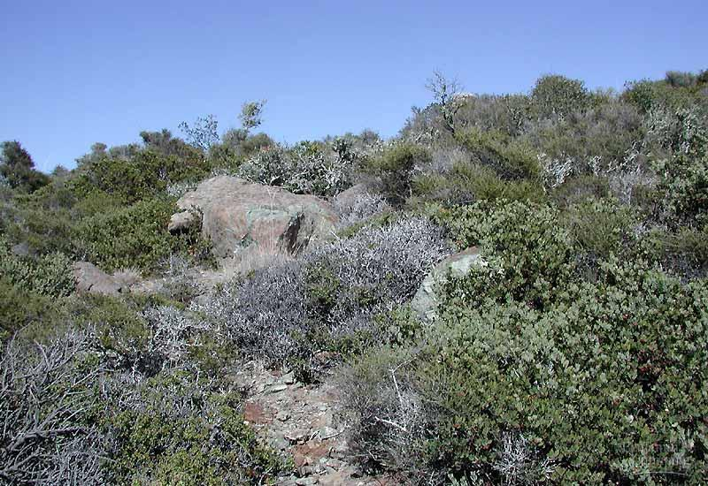
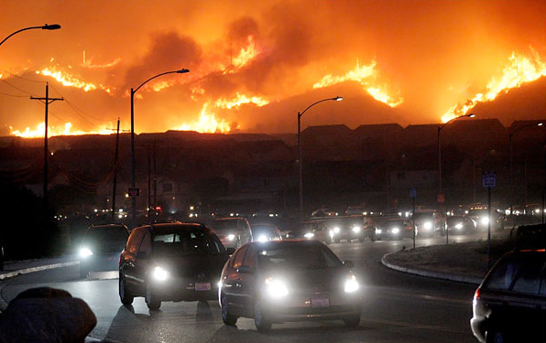
TEMPERATE WOODLAND & SHRUBLAND
Chaparral= dominated by shrubs, frequent fires
example:Los Angeles, CA

Slide 17
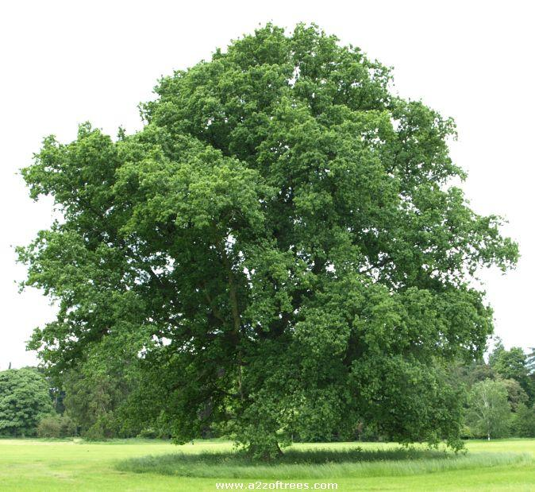
TEMPERATE FOREST
deciduous trees lose leaves rich in humus - decaying leaves 4 seasons - but more rain than grassland
Trees: Maple, elm, oak, pine
Animals: squirrel, songbirds, rabbits, owls

Slide 18
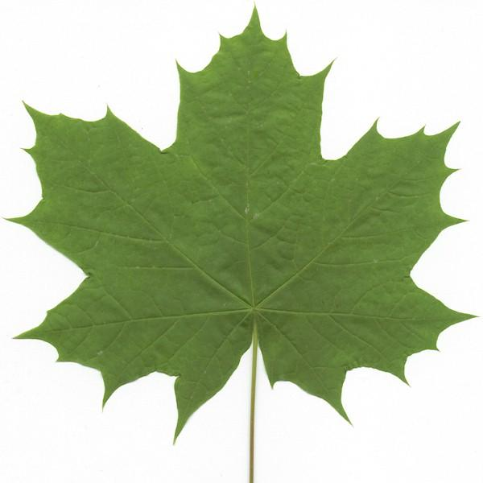
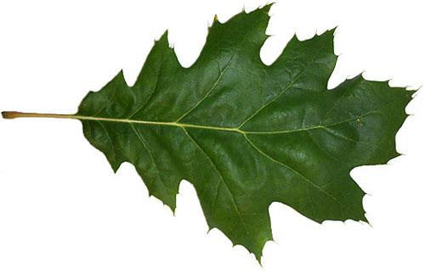
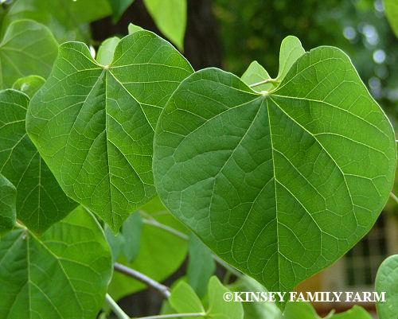
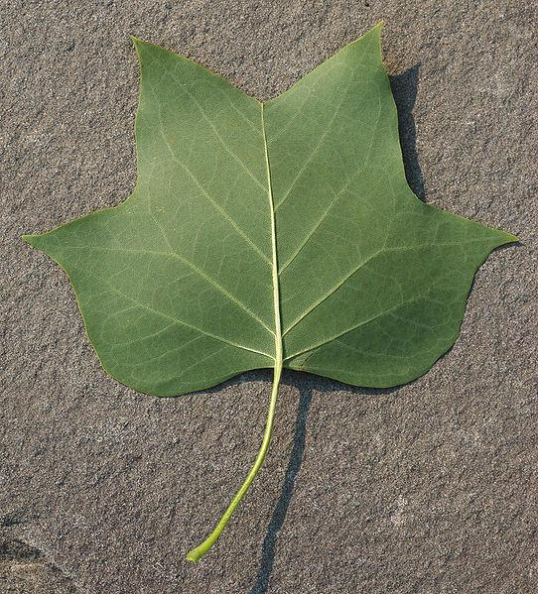
Name the trees.

Slide 19
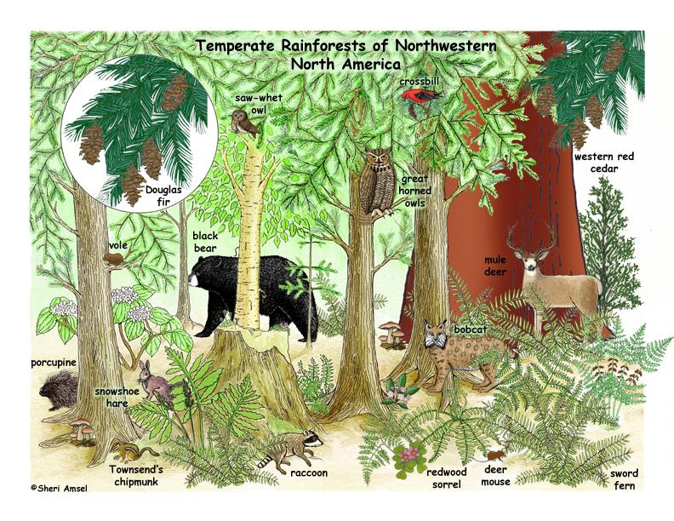
NORTHWESTERN CONIFEROUS FOREST also called a temperate rainforest
Mild temperatures Pacific NW coast of United States & Canada
Many of the same animals found in temperate deciduous forests

Slide 20
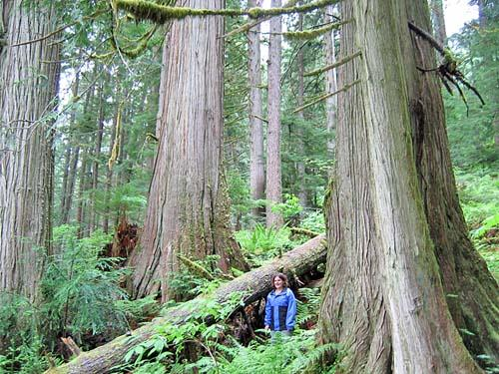

Slide 21
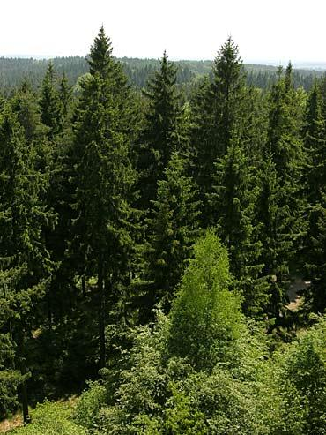
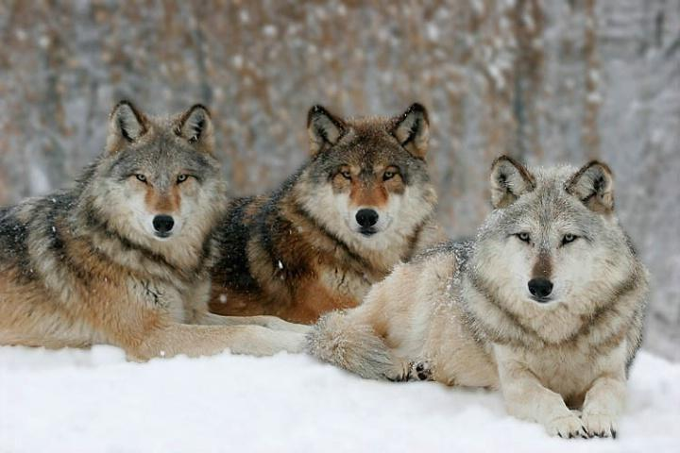
BOREAL FOREST (Taiga) Evergreen forests Bitterly long winters/ short, mild summers
Moose, black bear, wolves

Slide 22
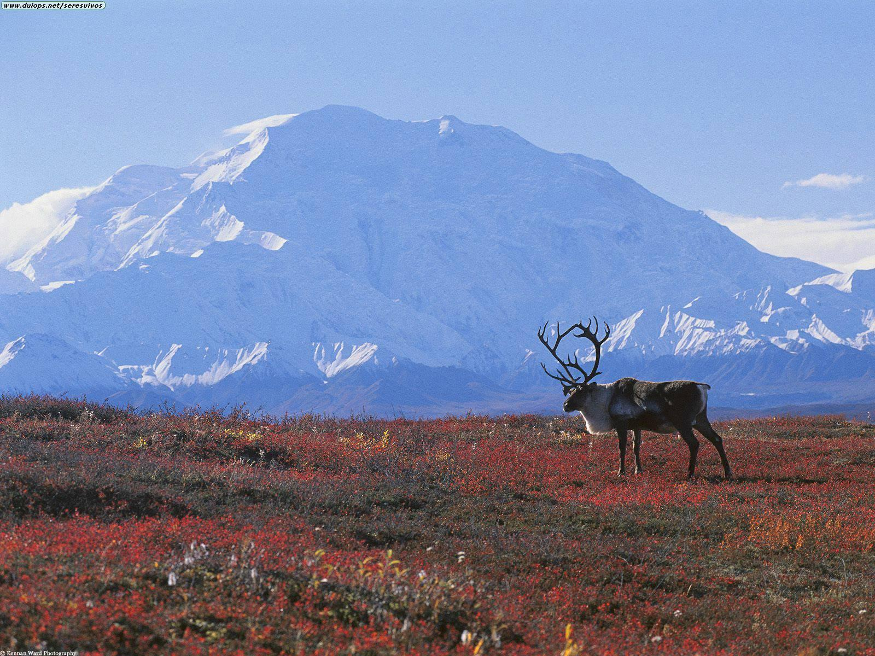
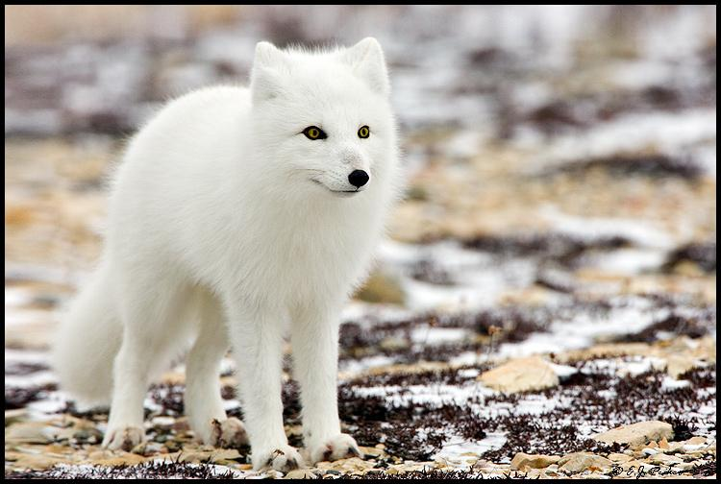
TUNDRA permafrost = layer of permanently frozen subsoil Strong winds -no trees, small plants
plants = mosses, lichens, grasses animals = arctic fox, caribou

Slide 23
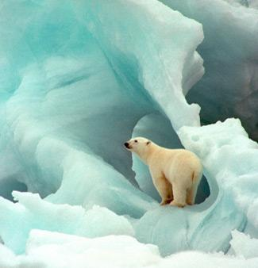
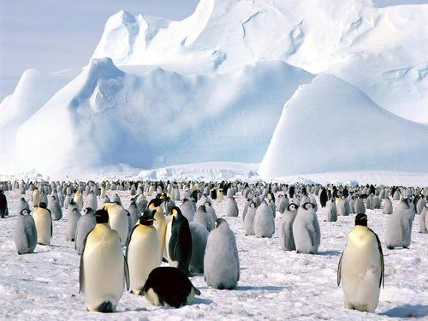
Other land areas include:
Mountain ranges Polar ice caps (Arctic)

Slide 24
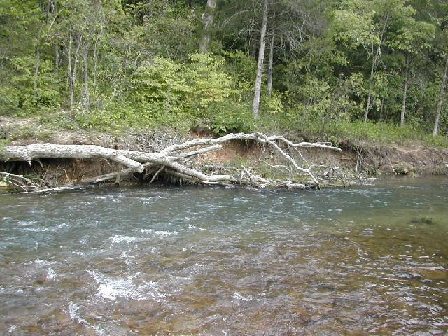
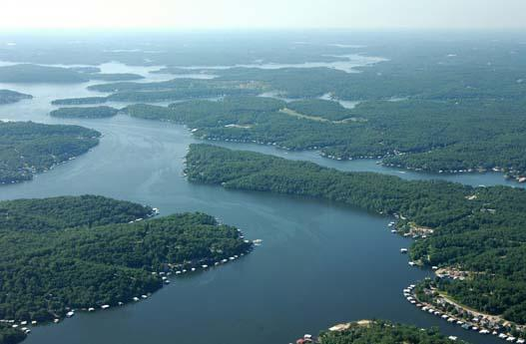
4-4 Aquatic Ecosystems
Freshwater Ecosystems
A. Flowing-water ecosystem, rivers, streams, creeks,
B. Standing- water ecosystem, lakes & ponds
Trout, herons, eagles, bass, bluegill, crayfish, water snakes, turtles

Slide 25
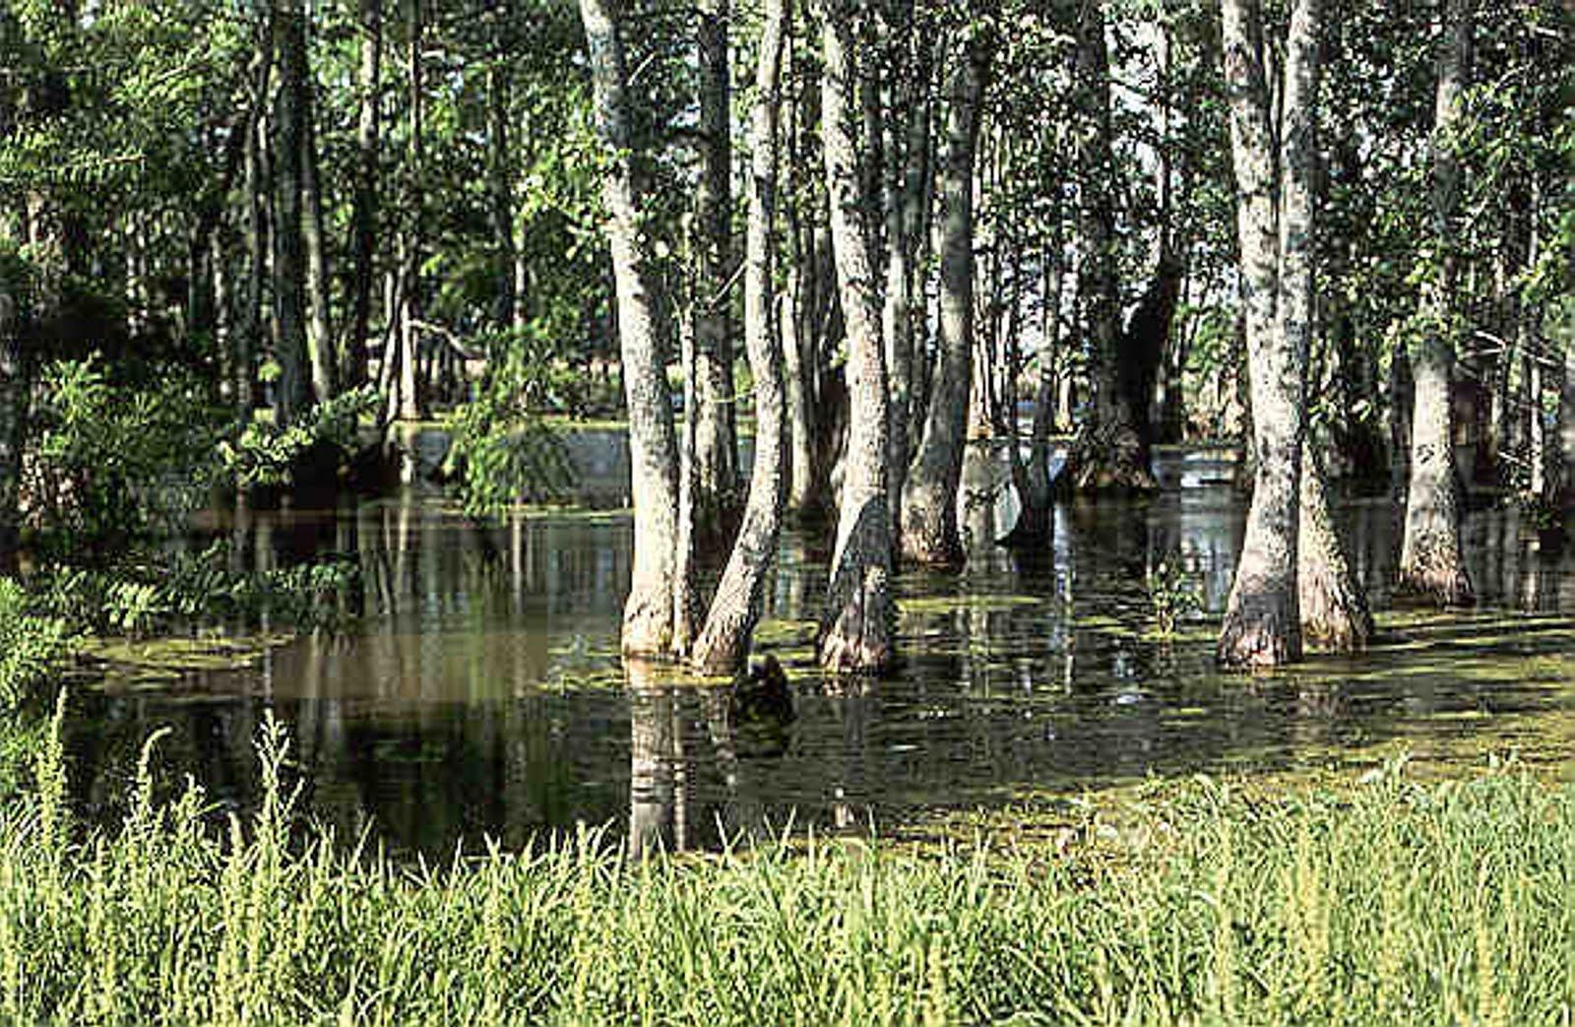
Estuary = area where freshwater meets sea
Wetlands = water covers soil

Slide 26
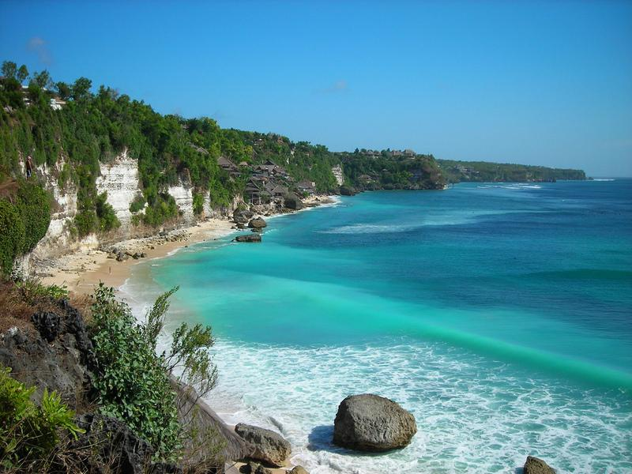
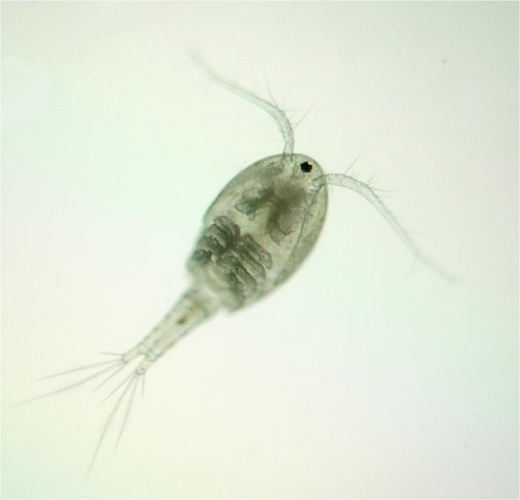
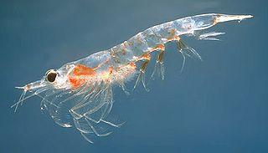
Marine Ecosystem
A. Photic zone - area sunlight reaches
B. Aphotic zone- permanently dark
*Plankton - microscopic organisms found in water
Sharks, whales, dolphins, fish, anemones, squid, sea gulls, pelicans, crabs, shrimp

Slide 27
Match the description or organism to its biome.
1. Monkeys & bromeliads
2. Caribou
3. Penguins
4. Low amount of rainfall (less than 25 cm), extreme temperatures
5. Also called a prairie
6. Has aphotic and photic layer
7. Maples, oaks, and red buds
8. Wildfires in California
9. Permafrost
10. Lions, zebras, giraffes
11. Cactus and succulent plants
12. Swamps and bogs and flooded areas
13. Canopy & Understory
14. Trout, Bass, Snapping Turtles
15. Pine trees, moose and wolves

Slide 28
Match the description or organism to its biome.
1. Monkeys & bromeliads - Tropical Rainforest
2. Caribou - Taiga (Coniferous Forest)
3. Penguins - Polar
4. Low amount of rainfall, extreme temperatures - Desert
5. Also called a prairie - Temperate Grassland
6. Has aphotic and photic layer - Ocean
7. Maples, oaks, and red buds - Temperate Deciduous Forest
8. Wildfires in California - Chaparral
9. Permafrost - Tundra
10. Lions, zebras, giraffes - Savanna
11. Cactus and succulent plants - Desert
12. Swamps and bogs and flooded areas - Wetlands
13. Canopy & Understory - Tropical Rainforest
14. Trout, Bass, Snapping Turtles - Freshwater (Lake, River)
15. Pine trees, moose and wolves - Taiga (coniferous)

Slide 29
1. Rainforests receive more [ light / rain / wind ] than other biomes.
2. Areas where the river meets the ocean: _________________
3. Freshwater ecosystems are classified as
a. salt or fresh b. flowing or standing
c. deep or shallow d. tropical or temperate
4. Natural disturbances, such as fire, can result in [ succession / commensalism ]
5. Maple trees, oak trees and red buds are found in what biome? ___
6. The prairie and the savanna are both types of ______
7. When two organisms live in close association, it is called [ succession / symbiosis / competitive exclusion
8. Where is plankton found? ________________
9. Temperate zones have [ extreme / mild ] temperatures.
10. The first species to enter a new ecosystem is called a [opportunist / pioneer / successor ]

Slide 30
11. Two microscopic organisms are placed in a container with a limited amount of resources. One species (X) lives in the bottom of the container near the soil and sand and feeds from the scraps that fall to the bottom. The other species (Y) spends its time swimming in the open water and feeds from the food at the surface. Each species therefore has a separate: a. habitat b. ecosystem
c. community d. niche
12. In the container above, a third species is added (Z). This organism also lives in the soil at the bottom and feeds from the same things as Species X. After a period of time, scientists noted that species X had disappeared from the container. This illustrates: a. competitive exclusion b. symbiosis c. parasitism d. mutualism

