Slide 1
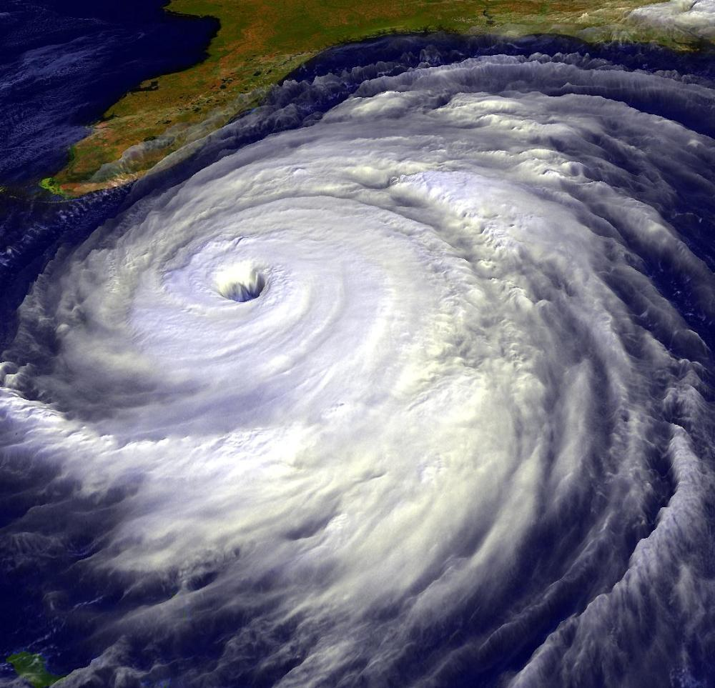
Climate and Ecosystems

Slide 2
4-1 The Role of Climate
Weather: day-to-day condition at a particular place and time
Climate: average, year-after-year conditions in a region

Slide 3
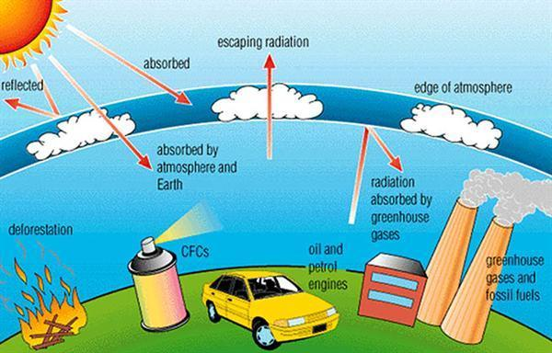
Green House Effect: CO₂, Methane, H₂O vapor and other gases trap heat energy in the atmosphere.
This keeps the surface of the earth warm.
Think of how a car heats up in the sunlight.

Slide 4
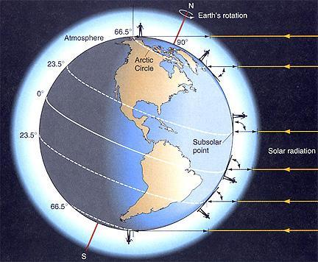
The Effect of Latitude on Climate: Solar radiation strikes different parts of the
Earth’s surfaces at different angles.
This also causes SEASONS

Slide 5
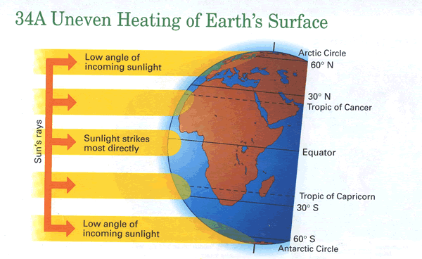

Slide 6
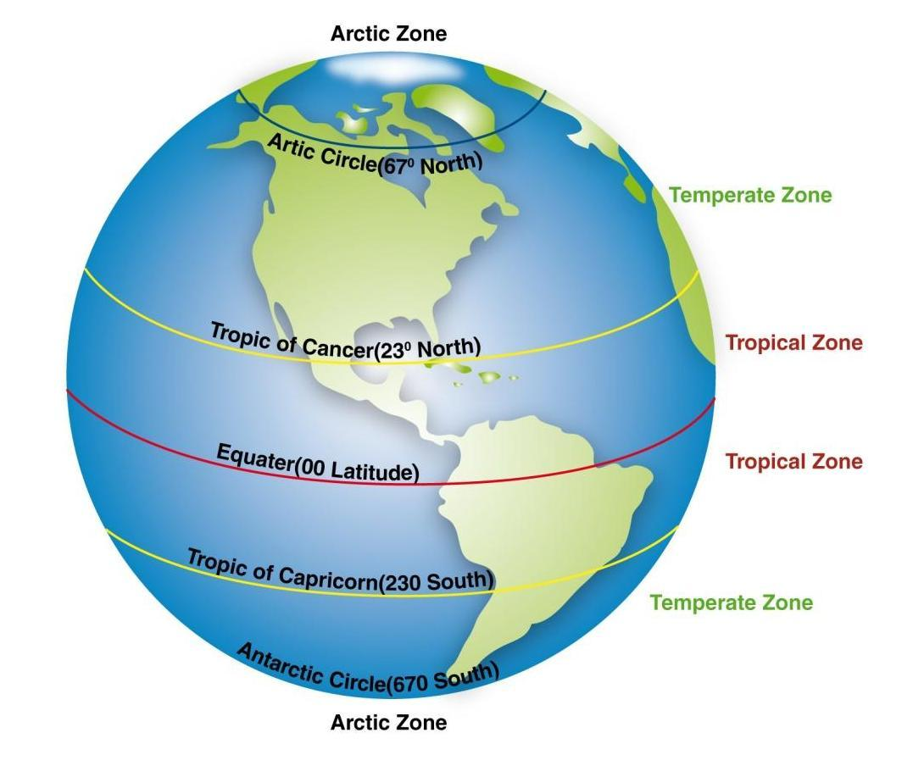
3 main climate zones:
Polar = cold areas
Temperate = hot to cold seasons
Tropical = direct sunlight, always warm

Slide 7
Quick Check
1. Which zone has obvious seasons?
a) polar b) temperate c) tropical
2. What causes the seasons?
a) tilt of the earth
b) distance of the earth from the sun c) the path the earth takes around the sun
3. Latitude is a measure of how far a place is from the: a) sun b) poles c) equator
4. The Greenhouse Effect is caused by:
a) trapped gasses b) sun flares c) weather
5. Average year round conditions is ________________

Slide 8
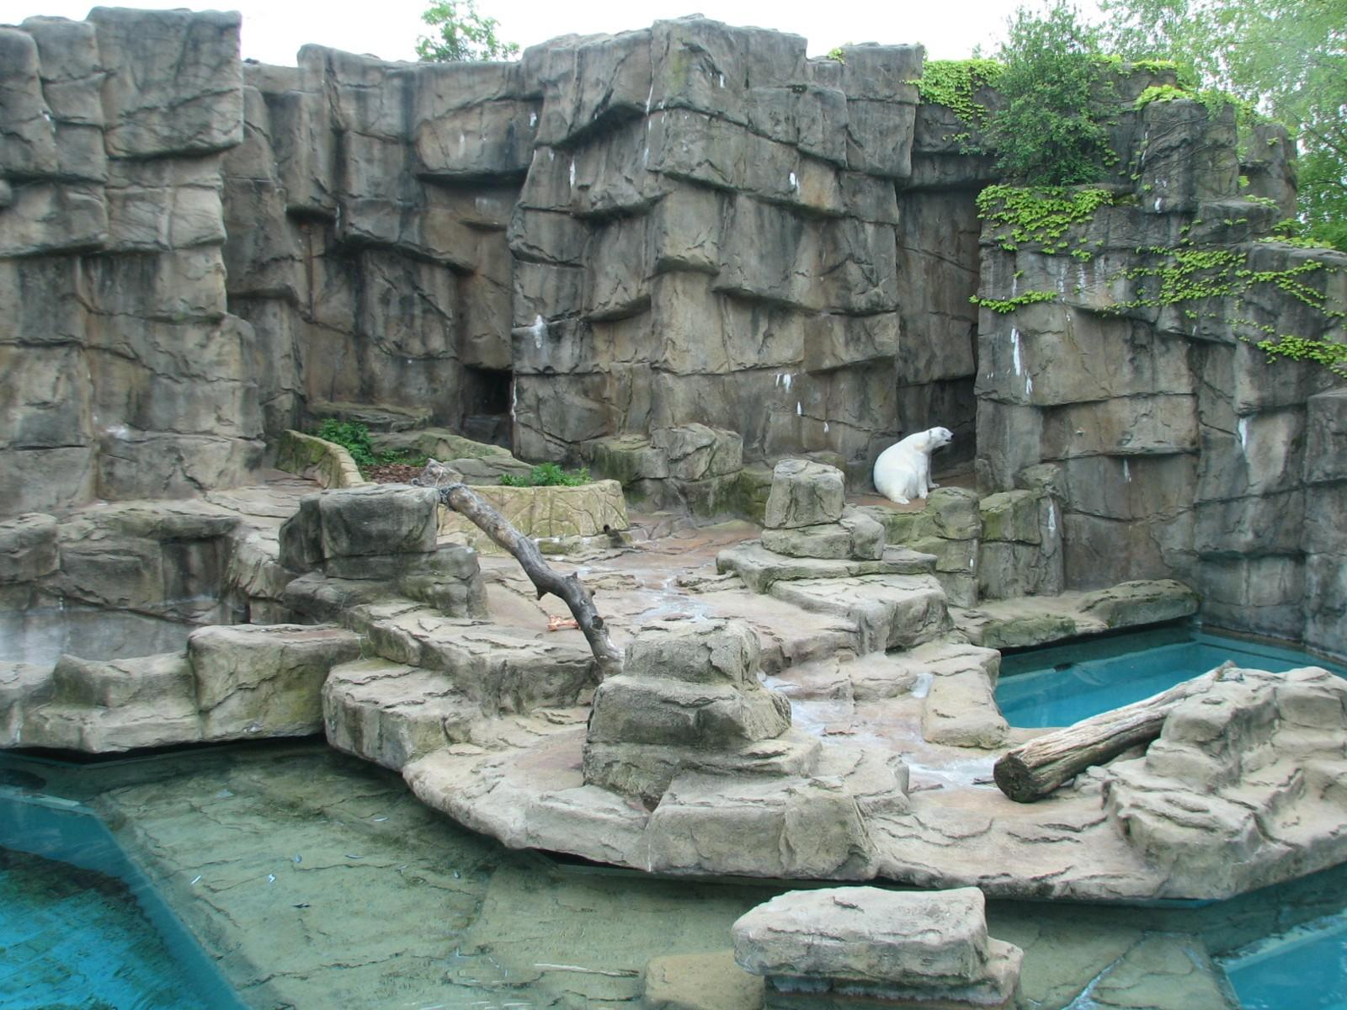
4-2 What shapes an Ecosystem?
Biotic - ALL living organisms
Abiotic – non-living components (soil, rocks, sunlight, wind, rain)
Habitat – The place where a population lives
Zoo exhibits often try to recreate habitats so that the animals are comfortable.

Slide 9
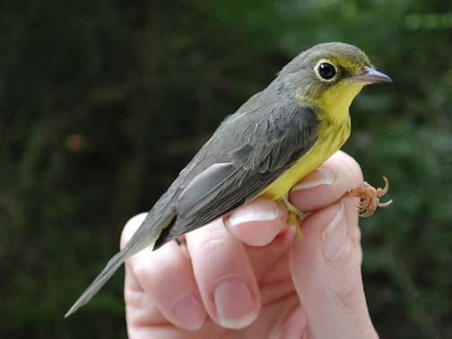
Niche – The physical and biological conditions in which an organism lives and the way in which the organism uses those conditions.
No two species can share the same niche in the same habitat.
Many types of warblers live in the same tree, but they do not occupy the same niche. How can this be?

Slide 10
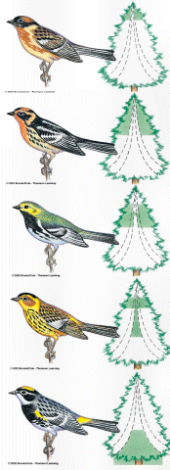
Each warbler lives in a different section of the tree.
In short, a “NICHE” is a way of life, and includes all aspects
-where it lives
-how it builds a nest -when it mates -what it eats
-how it hunts

Slide 11
And NUH is the letter I use to spell Nutches, Who live in small caves, known as Niches, for hutches.
These Nutches have troubles, the biggest of which is The fact there are many more Nutches than Niches.
Each Nutch in a Nich knows that some other Nutch Would like to move into his Nich very much.
So each Nutch in a Nich has to watch that small Nich Or Nutches who haven't got Niches will snitch.

Slide 12
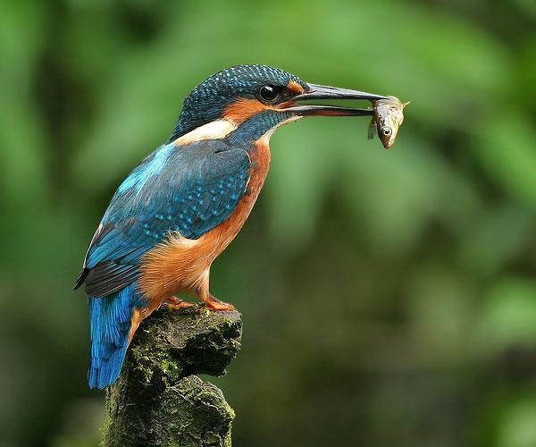
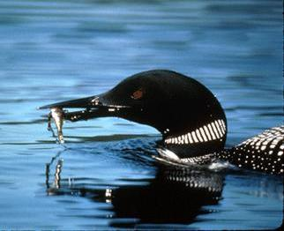
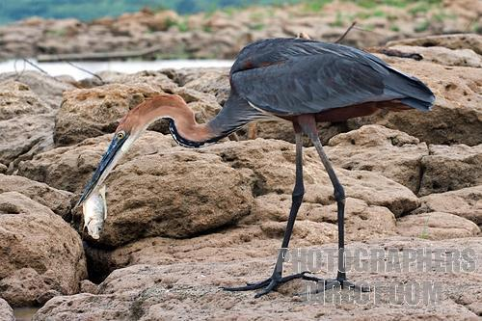
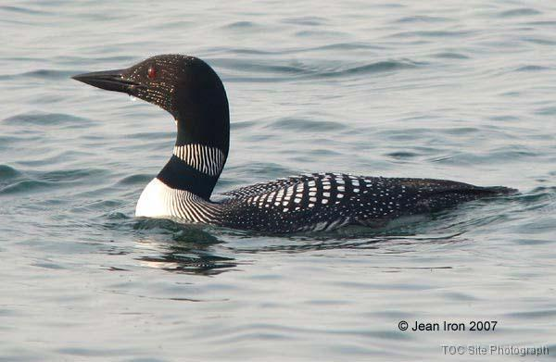
What about these 3 birds:
Kingfisher
Heron
Loon
*All live on lakes and eat fish. How are they not in the same niche?

Slide 13
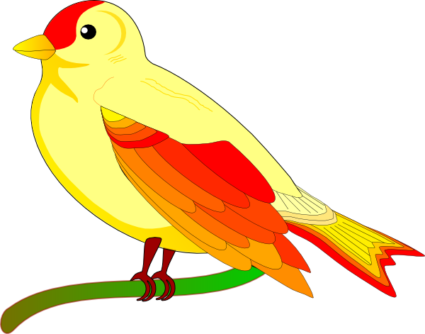
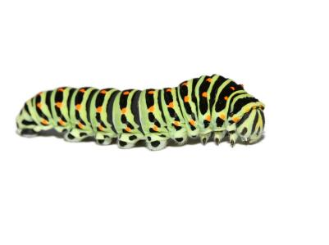
Community Interactions
Competition –compete for resources
Competitive Exclusion Principle – no two species can occupy the same niche

Slide 14
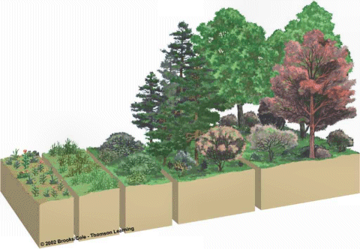
Ecological Succession – predictable changes that occurs in a community over time
Primary Succession – occurs on land where no soil exists (ex; volcanic eruptions)
Pioneer species – the first species to populate this area

Slide 15
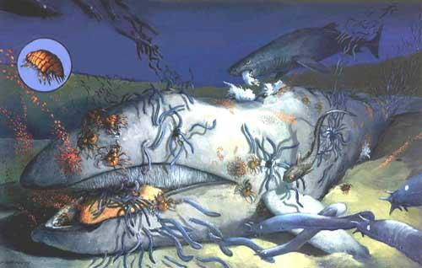
Secondary Succession – occurs in areas where there has been previous growth (ex: fires, abandoned fields)
*Climax Community*
Marine Succession – “whale-fall”

Slide 16
Predation – one organism captures and feeds on another organism (prey)
Symbiosis – two species live closely together
Mutualism – both species benefit (insects pollinate flowers)
Commensalism – only one member benefits and the other is neither helped or harmed
Parasitism – one organism lives in or on another and harms it (blood sucking tick)

Slide 17
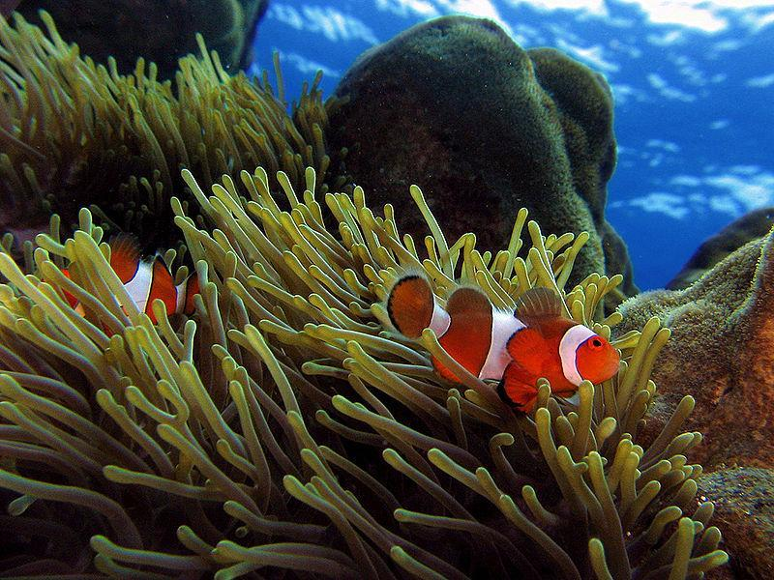

Slide 18
Quick Check
1. When two organisms live in close association with one another, it is called:
a) symbiosis b) succession c) exclusion d) latitude
2. Two organisms are placed in an aquarium. Animal A stays mostly at the top of the aquarium and eats food that floats. Animal B stays on the bottom and eats food that sinks. This illustrates:
a) symbiosis b) competitive exclusion c) mutualism d) succession
3. The competitive exclusion principle states: No two species can occupy the same _________.
4. The first species to enter an ecosystem after it has been destroyed by a fire is called a(n):
a. opportunist b) successor c) technician d) pioneer
5. What is an example of an ABIOTIC factor?

