Slide 1
Asexual Cell Reproduction
Asexual Cell Reproduction
Called asexual because no combination of cellular material occurs – all new cells produced contain the same genetic material as the original cell.
Why do cells reproduce?
Growth
Repair
Differentiation

Slide 2
Genetic Material
The genetic material in a cell is DNA (deoxyribonucleic acid)
It is found in a different form depending on the stage of the cell cycle
Chromatin – long, thin threadlike material - present in this state during interphase
Chromosomes – small, sausage-like, may be found as a individual chromatids (late stages of cell division) or as paired chromatids (sisters) connected at the centromere.

Slide 3
All somatic cells contain homologous pairs of chromosomes - one from the mother’s egg (maternal chromosome) and one from the father’s sperm (paternal chromosome) – in the human, 23 sets (46 chromosomes total)
Each homologous pair is similar in shape and length and is responsible for the same types of characteristics
Sister chromatids are IDENTICAL to each other (exact copies)

Slide 6
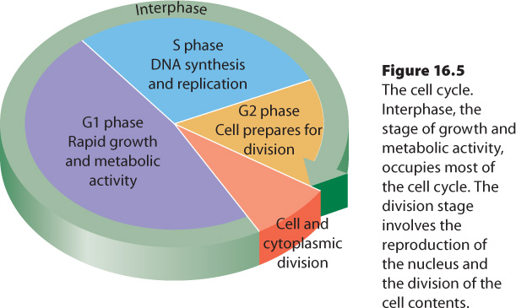

Slide 7
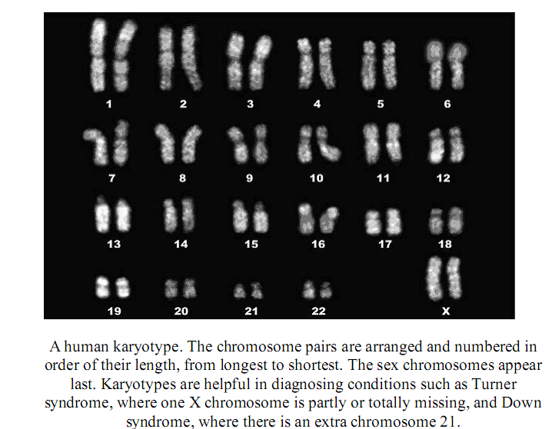

Slide 8
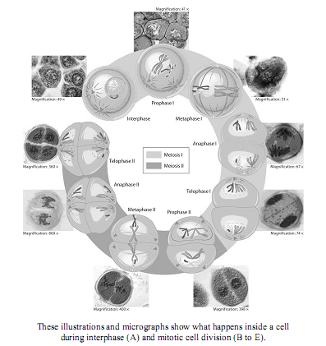

Slide 9
Mitosis:
Process by which cells divide
Occurs in all somatic (non-sex cells) in the body
All of the cells produced by mitosis are IDENTICAL in genetic makeup to the original cells (particularly important is that the chromosome # doesn’t change)
The unique appearance and functionality found in different cells of the body (excepting the sex cells) is NOT due to difference in cellular content, but a difference in the way that content is expressed (differentiation)

Slide 10
Cell Cycle
The cell cycle does not start and stop, but continues – different cells may go through the cycle at a different pace.
Overall Cycle
consists of Interphase (time for growth, synthesis of DNA and organelles) & cell division (mitosis & cytokinesis)

Slide 11
Interphase
(up to 90% of the cell cycle) – divided into three separate phases
G1 phase – (growth 1) – general growth & organelle replication, DNA consists of a single (unreplicated) chromatin molecule (46 strands)
S phase – (synthesis) – replication of chromosomal material (DNA) → 2 copies of each chromosome (23 pairs in humans), can be identified by the uptake of a radioactive base
G2 phase (growth 2) – structures associated with mitosis & cytokinesis are replicated (cell membrane proteins, centrioles)

Slide 12
Mitosis (cell division) – divided into four separate phases
1. Prophase
– contents of the nucleus become visible (DNA strands shorten & thicken; chromatin → chromosomes) (supercoiling)
centrioles separate & move to opposite poles of the cell, spindle fibres start to appear (fibres that don’t extend as far as the chromosomes called asters)
nuclear envelope disappears
nucleolus becomes invisible

Slide 13
2. Metaphase
– chromosomes move to the center of the cell,
centromeres on the equator
Spindle fibres attach to the centromeres
3. Anaphase
chromatids separate at the centromeres
Chromatids move to opposite poles of the cell
The same number of single-copy chromosomes should be at each pole

Slide 14
4. Telophase
chromosomes at opposite ends of the cell
Uncondense to form chromatin
Nuclear envelope reappears
Cytokinesis
(cytoplasm division) – cell membrane pinches in to form two distinct cells
in plant cells, a cell-plate forms first, separating the two cells by the forming cell wall
in animal cells, the cell membrane pinches in at the cleavage furrow

Slide 16
FYI
Some very specialized cells – mature muscle, red blood cells, nerve cells no longer divide and remain in G1
DNA exists as chromatin during growth – uncoiled DNA is easier to interpret to synthesize proteins
DNA exists as chromosomes during mitosis – coiled & condensed, chromosomes are more easily moved around and separated equally
Overall result – more cells, smaller SA:VOL

Slide 17
Sexual Cell Reproduction – Chapter 16.3
Called sexual because a combination of cellular material occurs –new cells produced contain genetic material from two combining cells.
Takes place in both plants and animal cells (in animals – ova and sperm, in plants, pollen)
Why sexual reproduction?
Genetic variation!!!!!

Slide 18
Asexual reproduction is faster and more foolproof but does not provide genetic variation. Dogs, although they reproduce sexually introduce some of the problems of asexual reproduction when they are bred to pure lines – some breeds of dogs have inbred weaknesses due to a lack of genetic variation

Slide 19
For cells to join to form new cells with the correct # of chromosomes, the chromosome # must first be decreased by ½ to maintain the correct # of chromosomes in the adult
Meiosis: process by which gametes (sex cells) are produced which are combined during sexual reproduction
Every human cell (except the sex cells) have 46 chromosomes (23 homologous pairs) → diploid number (2n)

Slide 20
Each pair of chromosomes 1-22 contain genes for the same type of characteristics and are similar in size and shape → homologous chromosomes (the autosomes)
Which of your parents’ traits you show depends on the interaction between the genes on the homologous pair

Slide 21
The last “pair” of chromosomes #23, determines gender (sex chromosomes)
if it is a homologous pair → 2X chromosomes, female
if the pair is made of one rod shaped and one hook shaped, male
Gametes (sex cells) have 23 single chromosomes → haploid number (n)

Slide 22
When the ova is fertilized by the sperm, the original number of chromosomes (46 = 2n) is restored → zygote
The life cycle of all sexually reproducing organisms alternates between haploid and diploid cells

Slide 23
Meiosis (see diagrams : Stages of Meiosis, Meiosis stages: Nelson pp.450-451)
Meiosis – special form of cell division occurring only in the reproductive tissue of sexually reproducing organisms where n (haploid) gametes are formed, having half the DNA content of the original sex-forming cell.
Occurs only in the sex cells!
Involves two cell divisions (instead of the one in mitosis) leading to four haploid cells formed (instead of two diploid in mitosis)

Slide 24
Stages of Meiosis
Meiosis I (Reduction Division) - during this division, the chromosome # is reduced from 2n → n
1. Prophase I*
contents of the nucleus become visible (DNA strands shorten & thicken; chromatin → chromosomes)
centrioles separate & move to opposite poles of the cell, spindle fibres start to appear (fibres that don’t extend as far as the chromosomes called asters)
* all of the information in italics is identical for meiosis and mitosis

Slide 25
homologous chromosomes pair up side by side (synapsis) so that corresponding genes are lined up side by side forming a tetrad (4 chromatids)
the homologous chromosomes will cris-cross over each other, and occasionally break and exchange segments → crossing over (provides even more genetic variation) – identical segment sizes are exchanged
nuclear envelope disappears
nucleolus becomes invisible

Slide 26
2. Metaphase I
chromosomes move to the center of the cell, centromeres on the equator
Spindle fibres attach to the centromeres
Random Orientation of Chromosomes
3. Anaphase I
homologous pairs separate (not sister chromatids separating at the centromere)
Chromosomes move to opposite poles of the cell → segregation
There should be 23 doubled chromosomes at each pole (each chromosome remains double stranded)

Slide 27
4. Telophase I
chromosomes at opposite ends of the cell
Chromosomes don’t uncondense to form chromatin
Nuclear envelope occasionally reappears (in some cells)
Cytokinesis occurs
5. Prophase II

Slide 28
6. Metaphase II
the cell moves directly to metaphase since there is no DNA replication and there is no formal organization of the nucleus
chromosomes move to the center of the cell, centromeres on the equator
Spindle fibres attach to the centromeres

Slide 29
7. Anaphase II
chromatids separate at the centromeres
Chromatids move to opposite poles of the cell
There should be 23 single stranded chromosomes at each pole
8. Telophase II
chromosomes at opposite ends of the cell
Uncondense to form chromatin
Nuclear envelope reappears

Slide 30
8. Telophase II
chromosomes at opposite ends of the cell
Uncondense to form chromatin
Nuclear envelope reappears
9. Cytokinesis
the separation of cytoplasm and organelles
Comparison of Mitosis and Meiosis
Unique Features of Meiosis

Slide 31
FYI
in oocytes, meiosis I is put on hold at the end of prophase I until the girl reaches puberty, when meiosis I will complete
once meiosis is complete, the gametes produced cannot undergo any further division, only specialization
for organisms with just 3 chromosomes (2n=6) (omitting the increased variation because of crossing-over), there are 8 possible assortments of chromosomes (23), in humans, with 23 pairs of chromosomes, 8 388 608 different gametes could be formed due to the random assortment of genes during meiosis

Slide 32
Gametogenesis
The formation of ova and sperm follow the process of meiosis, specializations dependent on their function
Sperm are designed for movement (little cytoplasm), lots of cell division, 4 small sperm produced
Eggs are designed to nourish the zygote – only one ovum is produced per oocyte → the other 3 polar bodies sacrifice their cytoplasm to produce one large egg

Slide 33
Since males contain the chromosome that determines gender, their sperm determine the gender of the child
Mules are sterile because they cannot form gametes- there are no homologus pairs to synapse during prophase I (horse 2n=64, donkey 2n=62, mule 2n=63)

Slide 34
Problems During Cell Division (Meiosis or Mitosis)
Nondisjunction – when chromosomes don’t separate during anaphase – one of the daughter cells produced during that separation will be lacking information, one will have too much
the daughter cell will either have one too many chromosomes → 24 or one too few → 22
when the ovum or sperm fuse with the abnormal gamete, the zygote will have either 47 or 45 chromosomes instead of 46
if there is one too many chromosomes, one pair will be a triplet → trisomy
if there is one too few chromosomes, one pair will be a singlet → monosomy

Slide 35
although nondisjunction may occur in any cells of the body, it is much more devastating in a gamete (all cells in the body of the fetus will be short/extra chromosomes)
nondisjunction is actually a desired characteristic in the development of large luscious fruit – big strawberries might be 4n or even 6n (polyploidy)

Slide 36
Karyotyping (see diagram p.455, Nelson Biology)
To evaluate the chormosomal composition of cells in an embryo, fetus or full-grown organism, a karyotype is made – rapidly dividing cells are isolated and stained, then the chromosomes from cells in metaphase are analyzed
Chromosomes are cut out and matched according to the banding patterns (grey bands with Giemsa dye, or coloured chromosomes with spectral analysis)
The new spectral analysis shows more than just gross chromosomal abnormalities

Slide 37
Abnormal karyotyping will show the result of non-disjunction during meiosis or mitosis (important in cancer research and diagnosis)
Karyotyping will also determine gender – 23 pairs, one pair (#23, the sex chromosomes – if XY male, if XX female)

Slide 38
Nondisjunction Disorders (Meiosis)
Most nondisjunctions during gametogenesis will produce sperm/ova resulting in a nonviable fetus that will spontaneously abort during early development
If the nondisjunction still allows the fetus to develop to term, a number of specific syndromes (groups of disorders) may result:
Down syndrome (trisomy 21) – mental retardation, webbed fingers & toes, slanted eyes, short stature

Slide 39
Turner syndrome (XO, monosomy), the fertilized egg is missing the X chromosome, short statured, wide neck, many are miscarried before birth
Klinefelter syndrome (XXY, trisomy) – the presence of a Y indicates a male, but at puberty, the XX leads to a lot of female hormones produced resulting in a sterile male
“Supermale” (XYY, trisomy) – tendency to be taller, but many “characteristics” associated with increased aggression, etc. have not been proven

Slide 40
FYI
Down syndrome is much more common in babies born to mothers over age 35 (see p.456) – hypothesized that may be due to older ova that have been present since the woman’s birth in combination with increased exposure to radiation

Slide 41
Mitosis as a method of cell reproduction (Cloning)
Cloning – process in which identical offspring are formed from a single cell or tissue (clone = cutting)
all cells formed in this manner are identical (or almost – some small variations due to mutation are expected)
used in some plants and animals for reproduction

Slide 42
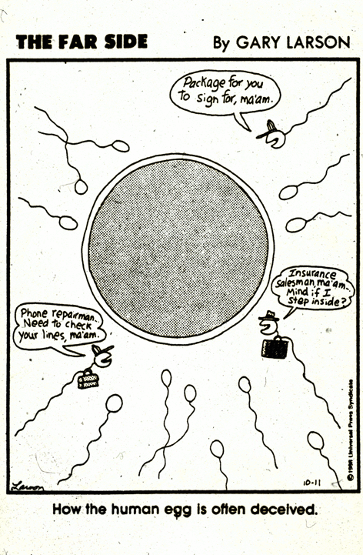
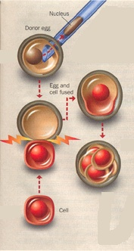

Slide 43
Asexual Reproductive Strategies
binary fission: equal division of the cytoplasm and nucleus of an organism resulting in two new organisms exs. ameba, paramecium, euglena
budding: nucleus of an organism's cell divides equally but the cytoplasm divides unequally -- the new cells formed may live as individuals or as colonies exs. yeast, hydra
sporulation: the production of spores ex. molds spores: single, specialized cells which are released from the parent -- they are enclosed in a protective case and develop when environmental conditions are favorable

Slide 44
regeneration: the development of an entire new organism from part of an original organism ex. starfish -- one ray and part of central body can develop into an entire new organism
may also involve the restoration of lost body parts
invertebrates have greater powers of regeneration than do vertebrates

Slide 45
vegetative propagation: regeneration in plants
Complete new plants develop from part of the original plant.
bulbs: enlarged underground stems surrounded by leaves and containing stored food exs. onions, tulips
tubers: enlarged underground stem with buds or "eyes" that contain stored food -- new plants develop from the bud ex. potato
runners: stems that grow along the ground -- at intervals roots form and penetrate the soil and new plants develop at these points (ex. strawberries)
rhizomes: underground stems from which new plants develop at intervals ex. quackgrass
natural

Slide 46
layering: occurs when part of an old plant is bent and covered with soil -- a new plant develops from the covered plant ex. blackberry
cuttings (slips): a piece of a plant is placed in moist soil or water and a complete plant develops from it
grafting: the stem of one plant to be propagated is attached to the cut end of another growing plant
embryo splitting

Slide 47
FYI
cloning may be used on plants that normally reproduce sexually to produce genetically “superior” plants
even though all of the cells are identical to the parents’, they differentiate to perform separate duties
to make cloning work, scientists must delay differentiation
organisms (cells) that are able to produce an adult from one cell are called TOTIPOTENT

Slide 48
although until recently (p.438) cloning of mammals was only achievable by taking a fertilized egg’s nucleus and placing it in another egg cell, Dolly the sheep was cloned from an ADULT cell’s nucleus
cloning may find a use in “transplants” – if the cells transplanted are regenerative, they will reproduce and grow into a working organ (liver)
identical twins are nature’s clones – how much of their lives is dictated by their genes?

Slide 49
Cell Death and the Aging Process
Cells in the body divide at different rates, and have different life spans
Only spermatocytes & cancerous cells appear to have no defined life span (although mature sperm do not have an infinite life span)
All other cells appear to have a finite # of cell divisions built in – maximum life span remains at ~115 yrs
Reproductive ability appears to ⬇ as specialization ⬆

Slide 50
WHY?
maybe spontaneous mutations cause the cells to be declared incompetent & shuts them down (no)
maybe aging genes shut the cells down (ex. graying of hair – but at different ages)
maybe cell lineages die → no longer able to divide, so worn-out cells are not replaced

Slide 51
Cancer
Defined as the rapid, uncontrolled growth of cells → too much life
Tumors are believed to be monoclonal (the result of one transformed cell dividing rapidly)
Abnormal growth (unlike normal controlled growth replacing dying & dead cells), without the signals of the body directing growth.
Outside of the human body, cancer cells show growth more rapid than fetal growth (10kg mass in 6 weeks)

Slide 52
Metastasis (the spreading of cancer cells through the body) caused by the fact that cancerous cells have lost the attraction to each other that other cells have
Cancer cells have lost the ability to differentiate and carry out cell processes
Prevention focuses on the elimination of carcinogenic/teratogenic/mutagenic substances – diet, tobacco, sun
Treatments are focused on processes that affect rapidly growing cells, stopping their mitosis, gene therapy that “turn on” the immune system and removal of the cancer
All cancers are different and require different treatments

Slide 53
Alternation of Generation & Other Reproductive Strategies
When organisms may use both sexual and asexual reproductive strategies at different stages during their life cycle, it is called “alternation of generation” (see diagram life cycle of moss/fern)
Best of both worlds – the plant (animal) may reproduce rapidly using asexual techniques, but may benefit from the genetic variation provided by sexual reproduction
Plants (animals) that use this strategy may exist primarily as diploid (higher plants & animals) or haploid (primitive plants) – but unlike most animals, both the haploid and diploid organisms are multicellular

Slide 54
Spores (n) are the most common source of haploid plants, are produced by the sporophyte generation (2n) by meiosis
The spores produce multicellular plants (haploid) which divide mitotically and produce gametes mitotically. These haploid plants are called the gametophyte generation.
These gametes will fuse to form the diploid form of the plant, which is capable of producing the spores (called the sporophyte generation)
In the fern, the gametophyte generation (n) is the predominant form of the plant
In the moss, the sporophyte generation (2n) is the predominant form of the plant

Slide 56
In the pine, the sporophyte is the most common – in fact, the cone produced is also diploid, undergoing meiosis after the cone is formed – the gametes from male cones (the spores or pollen) are carried by the wind to the female cones – final differentiation and fertilization occurs in the female cone, then forming a seed, transported by the wind

Slide 57
Very few animals show alternation of generation – the water flea, displays a form of this
In the spring, all diploid eggs hatch into females
These females lay diploid eggs and hatch diploid females all summer (asexual reproduction)
Cold temperatures stimulate females to lay haploid eggs, which hatch into haploid males, which mate with the females and to fertilize their haploid eggs (which survive until the next summer)

Slide 58
The housefly (see Nelson p.449), although not alternation of generation, is capable of reproducing asexually
Some animals are hermaphroditic (have both male and female sex organs) – they may self-fertilize or cross-fertilize when other worms are around. (ex. worms)

