Slide 1
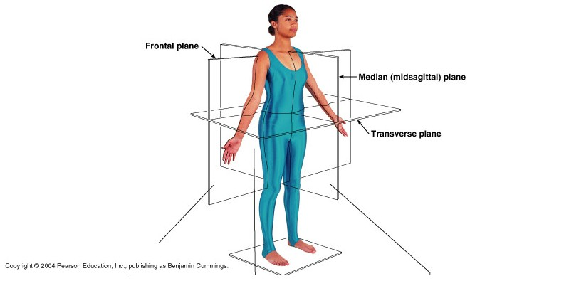
Body Planes, Directions, and Cavities

Slide 2
Basic Terms to Know…
Anatomy- study of the structure and shape of the body and its parts
Physiology-study of how the body and its parts work or function
Gross anatomy- large structures, easily observable
Microanatomy- very small structures, can only be viewed with a microscope

Slide 3
Body Planes
There are three body planes:
Transverse or Horizontal- divides the body into a top and bottom.
Mid-Sagittal or Median- divides the body into an equal right and left side.
Frontal or Coronal- divides the body into a front and a back side.

Slide 4
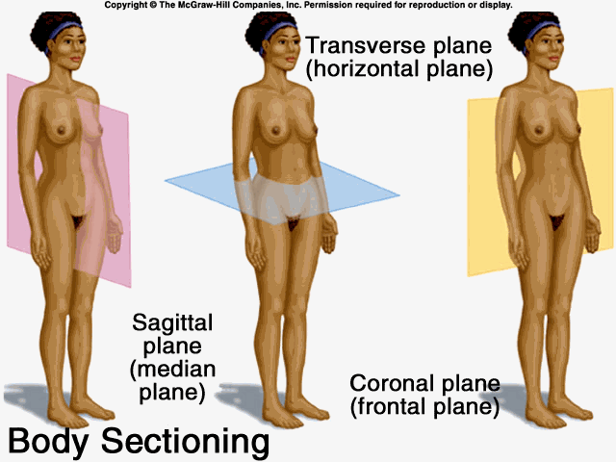
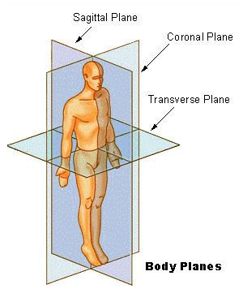
What They Look Like

Slide 5
Body Planes

Slide 6
Sooooooo…….What if….
You are a surgeon and planning to do open heart surgery…. you would need to make a ________________ cut into the chest cavity.
You have a patient that has gangrene in the lower portion of their leg and you need to amputate….. You would make a ________________ cut through the leg.
The abdominal muscles and muscles of the back are separated by the _______________ plane.

Slide 7
Body Cavities
There are two main body cavities:
Ventral: (Belly) Which is subdivided into…….
a) Abdominopelvic- which consists of
the abdominal and pelvic regions, and
contains the digestive and reproductive organs.
b) Thoracic- which is the upper torso or chest
region, and contains the heart and lungs.
Dorsal: (Back) Which is subdivided into……..
Cranial- which contains the head and includes the brain.
Vertebral- which includes the spinal column.

Slide 8
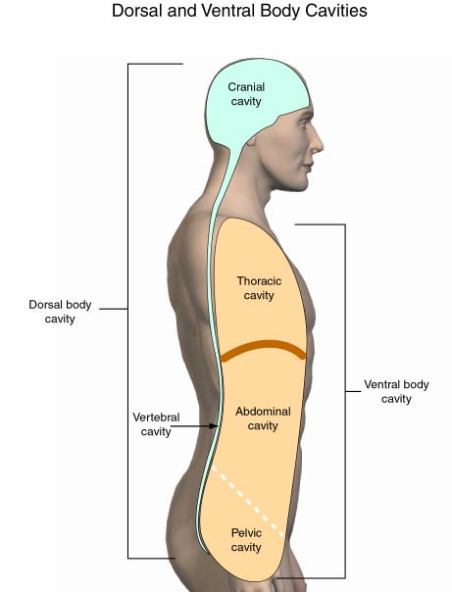
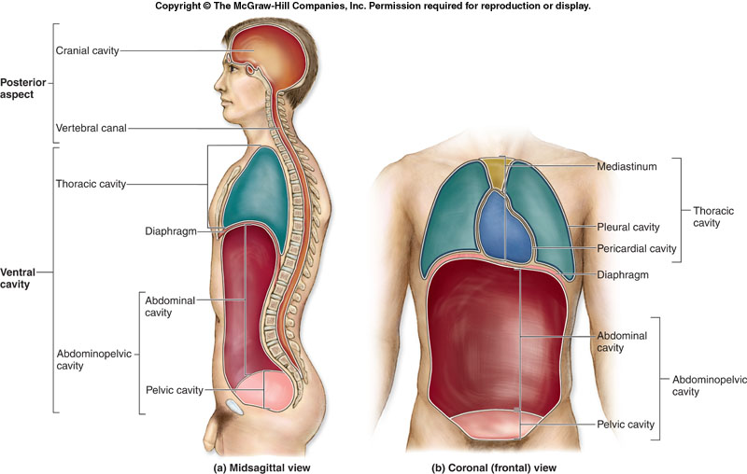
Body Cavities

Slide 9
Body Cavities

Slide 10
OK, sooooo…….
Which cavity is the heart found in?
Which cavity contains the spinal cord?
Which cavity contains the ovaries?
Which cavity contains the stomach?
Which cavity contains the lungs?
Which cavity consists of the abdominopelvic and thoracic cavities?

Slide 11
Table 1.1 (1 of 3)

Slide 12
Table 1.1 (2 of 3)

Slide 13
Table 1.1 (3 of 3)

Slide 14
The Amazing Human Body

Slide 15
Fun Facts……

