Slide 1
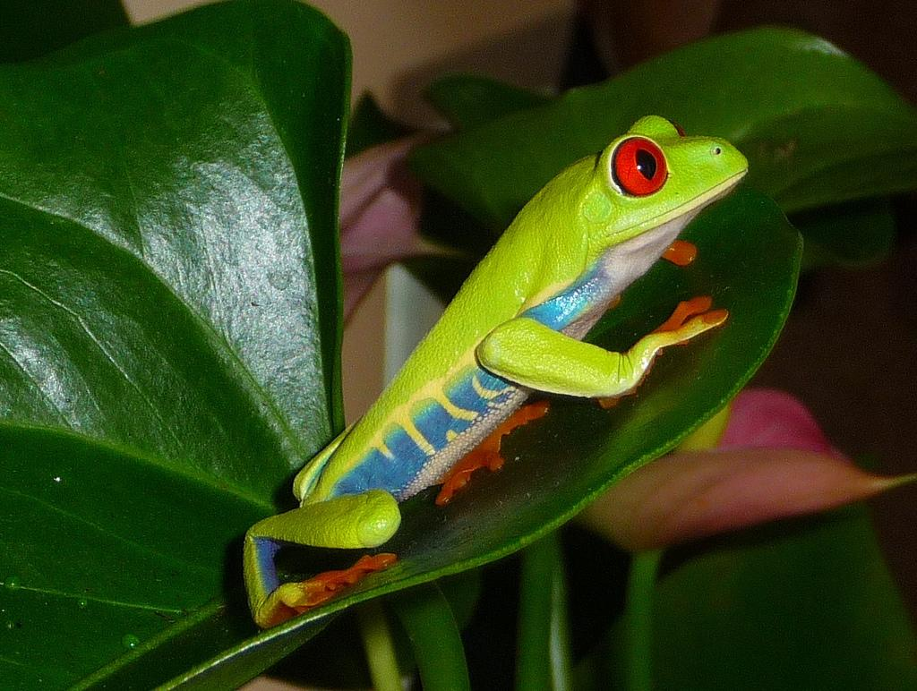
Chapter 46 - The Scope of Ecology
Photo Credit: http://www.flickr.com/photos/dotlizard/3523774458/

Slide 2
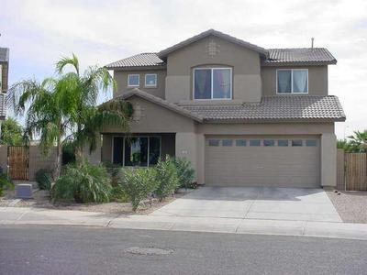
Ecology: the study of interactions of organisms with other organisms and with the physical environment
(word means "study of house")

Slide 3
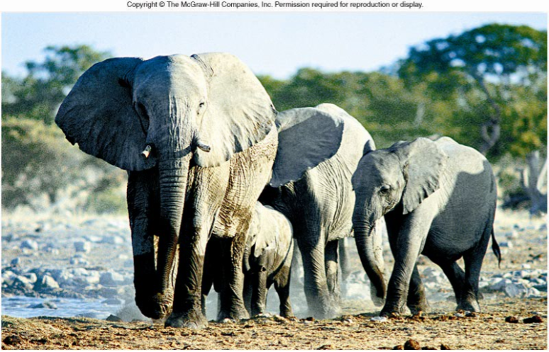
CO 46
Population: members of the same species living in the same area

Slide 4
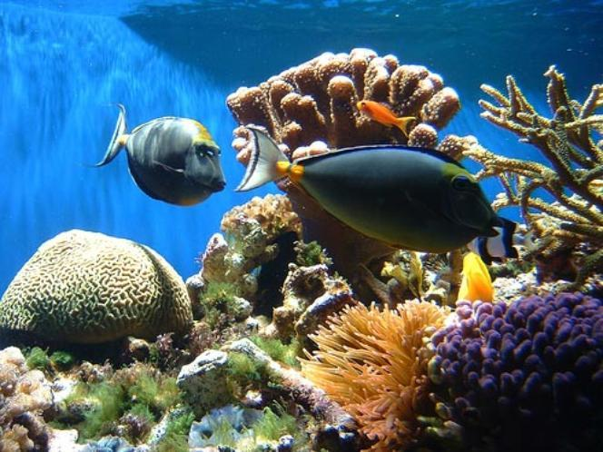
Community: all the different populations in an area

Slide 5
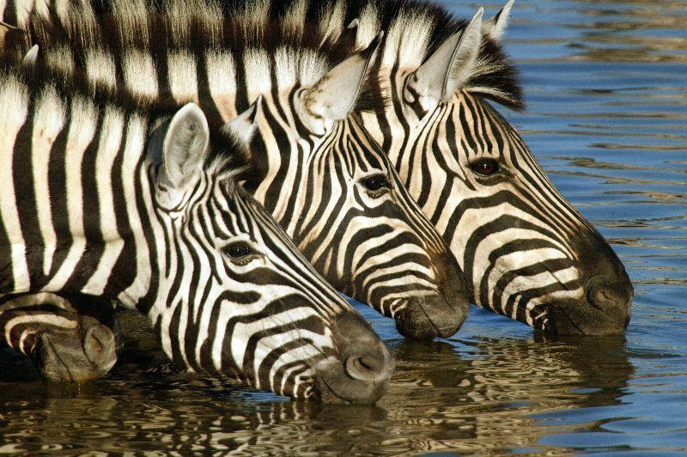
Population or Community?

Slide 6
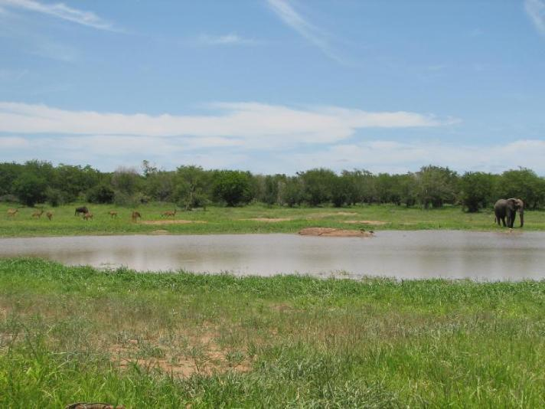
Ecosystem: the community plus the nonliving factors

Slide 7
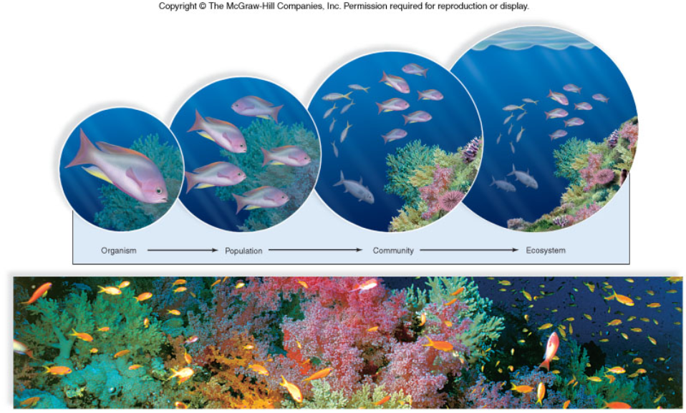
Figure 46.1

Slide 8
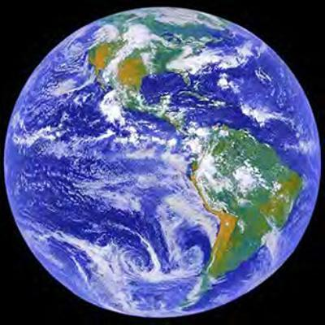
Biosphere: all the areas of the earth that supports life

Slide 9
46.2 Demography - the statistical study of a population (density, distribution, rate of growth)
Population density: number of individuals per unit area
Population distribution: pattern of dispersal of individuals (random, clumped, uniform)

Slide 10
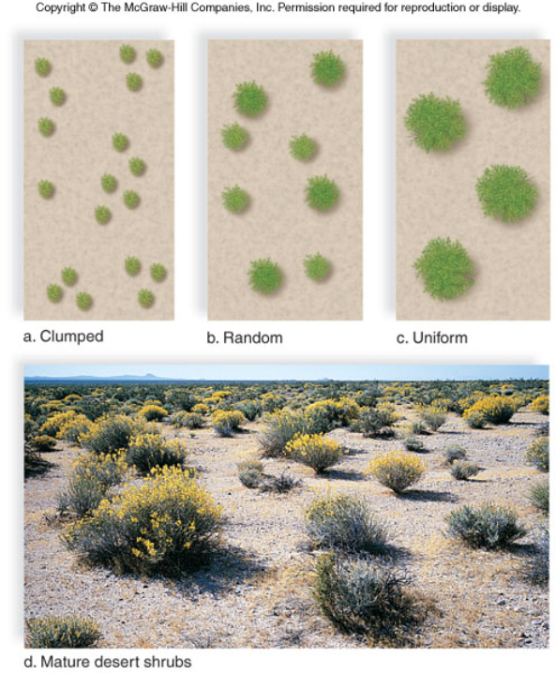
Figure 46.2

Slide 11
How Populations Grow
1. births 2. deaths 3. migration
Stable populations occur when as many individuals join (birth or immigration)
as leave (death or emigration)

Slide 12
Population change (r) =
(birth - deaths) + (immigrants - emigrants)
Biotic Potential: maximum rate at which a population could grow given optimal conditions (food, water, space)
Factors that influence biotic potential:
1. age of reproduction 2. frequency of reproduction 3. number of offspring produced 4. reproductive life span 5. average death rate under ideal conditions

Slide 13
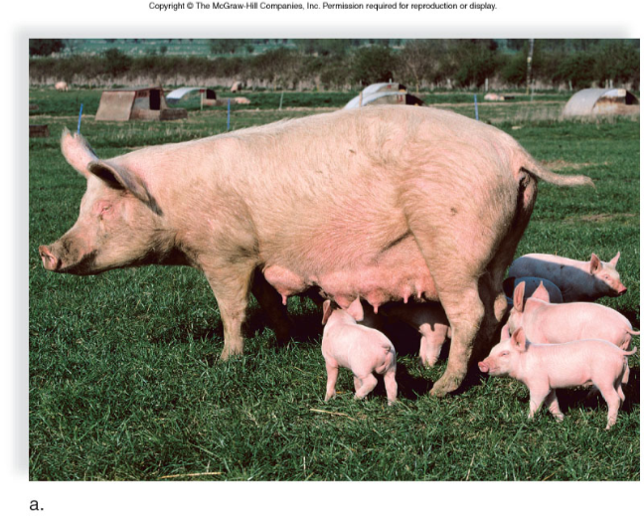
BIOTIC POTENTIAL - population’s maximum growth rate under ideal conditions

Slide 14
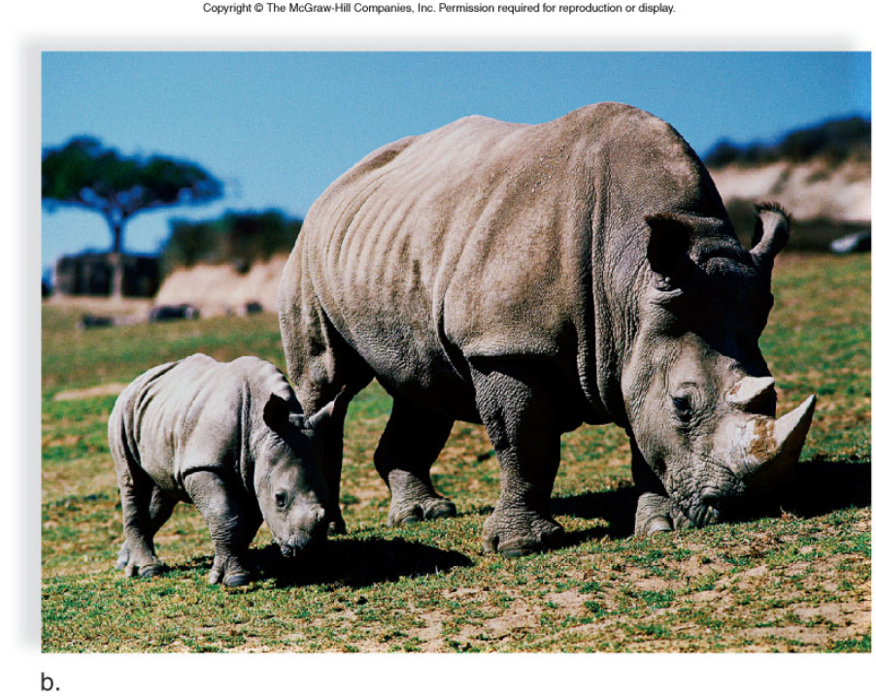
Figure 46.3b

Slide 15
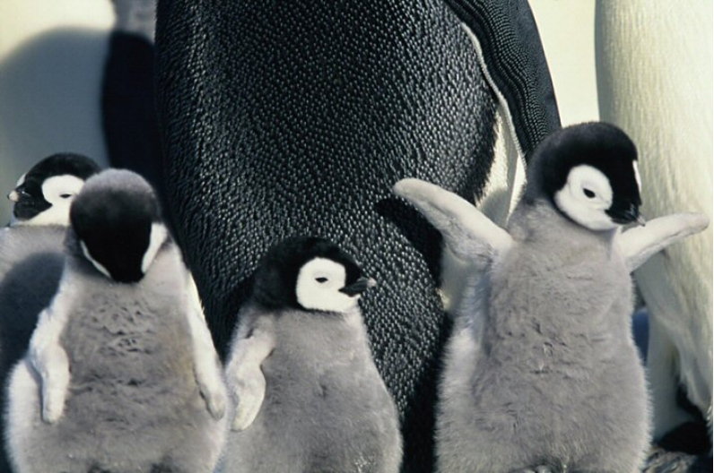

Slide 16
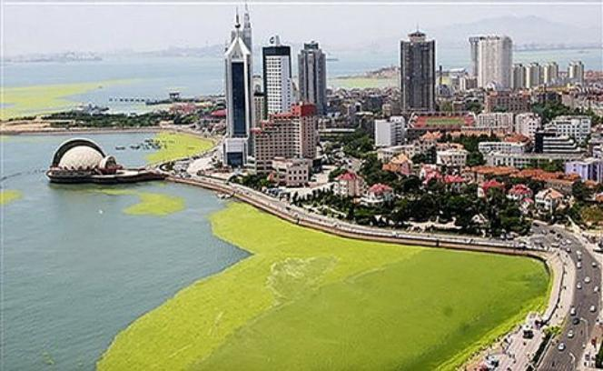
Don't forget, a population can refer to plants, fungi and bacteria…..
Algae bloom

Slide 17
SURVIVORSHIP CURVES
Survivorship curve - probability of newborn individuals surviving to a particular age
Late Loss (Type I) Constant loss (Type II) - death is often unrelated to age Early loss (Type III)

Slide 18
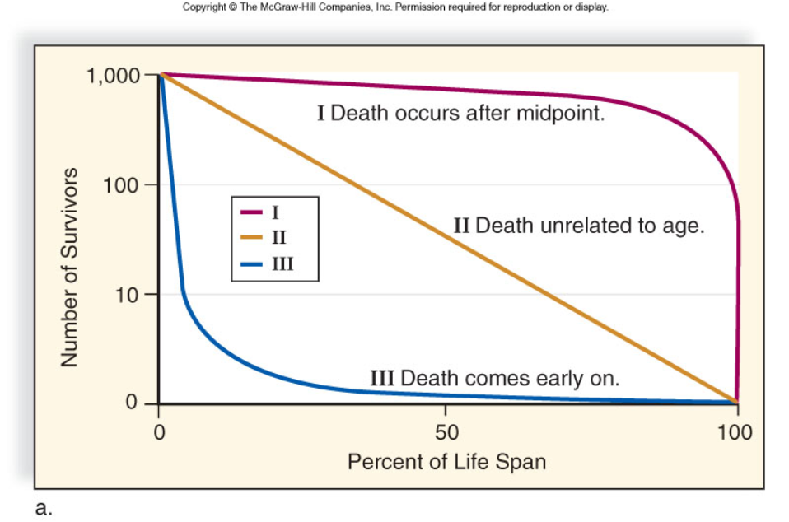
Figure 46.4a

Slide 19
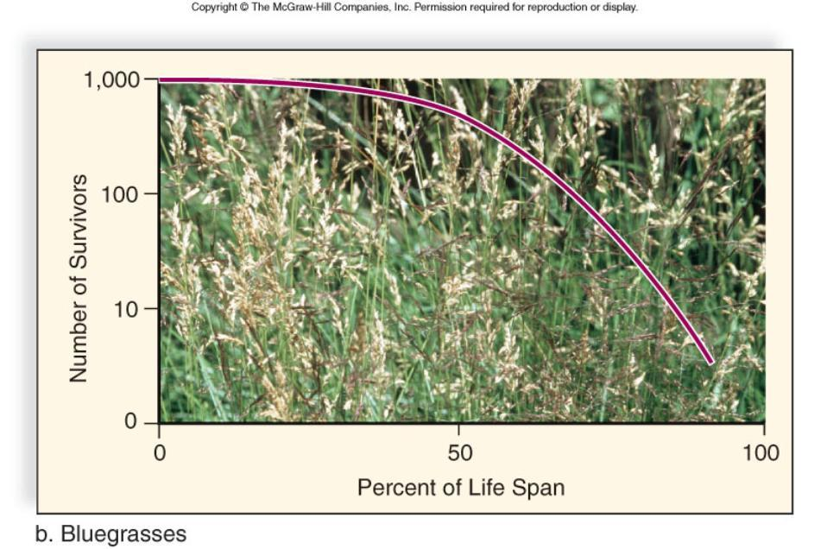
Figure 46.4b

Slide 20
Figure 46.4c

Slide 21
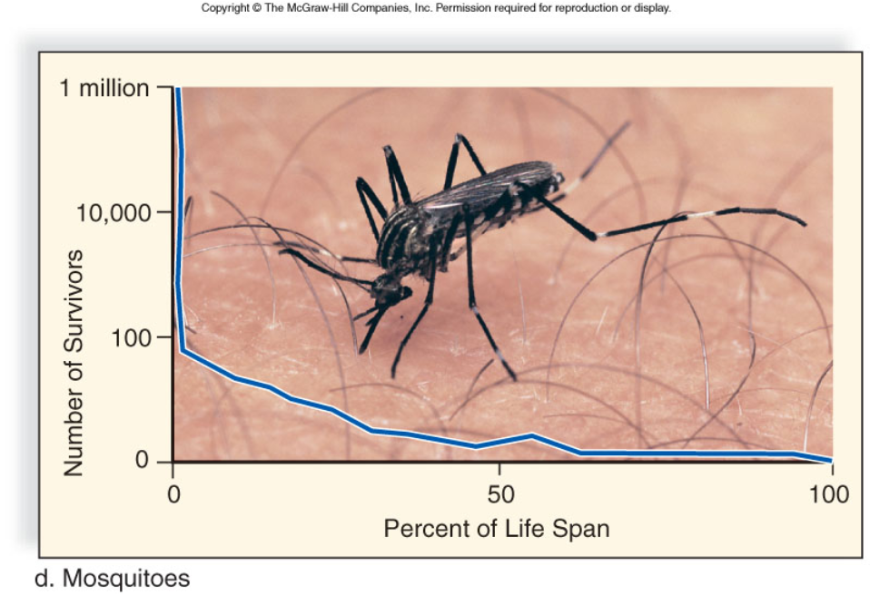
Figure 46.4d

Slide 22
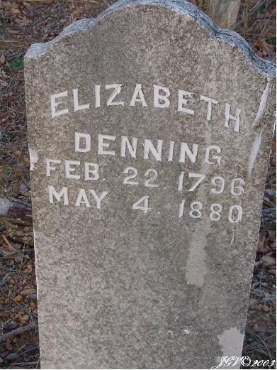
DEMOGRAPHICS - statistical study of a population’s density, distribution and growth rate
You will create a survivorship curve of a human population by studying cemetery data
(lab later this week)

Slide 23
46.3 Population Growth Models
Discrete Breeding: Reproduction occurs once in life (followed by death) - this is also called a Boom and Bust Cycle
Continuous Breeding: occurs throughout lifetime

Slide 24
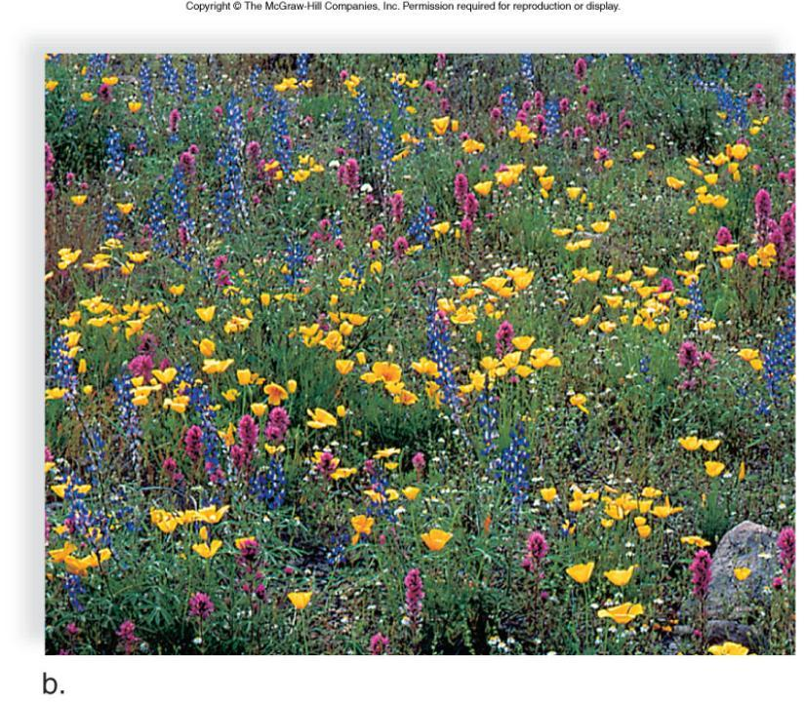
Figure 46.6b

Slide 25
AGE STRUCTURE DIAGRAMS
1. Which one shows a declining birth rate?
2. Which one shows a growing population?
3. Which one might indicate a situation where males are not as likely to survive? Suggest a reason why this might happen in some cultures?

Slide 26
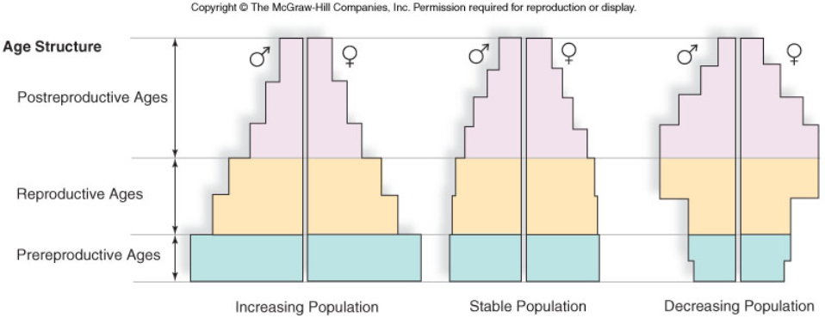
AGE STRUCTURE DIAGRAMS

Slide 27
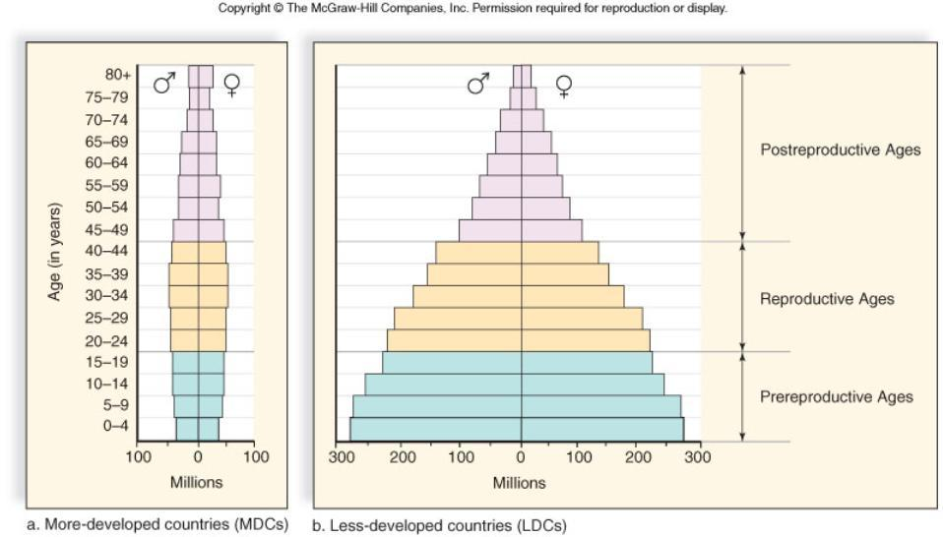
Figure 46.16

Slide 28
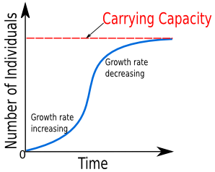
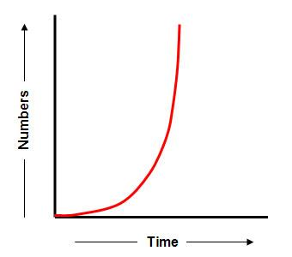
Exponential vs Logistic Growth
S-shaped Curve
Lag Phase, exp growth phase, Deceleration, Stable Equilibrium Phase
Carrying Capacity: the maximum size of a population that an area can support
J-shaped curve
Lag Phase then Exponential Growth
This population has not yet reached its carrying capacity.
Requires unlimited resources

Slide 29
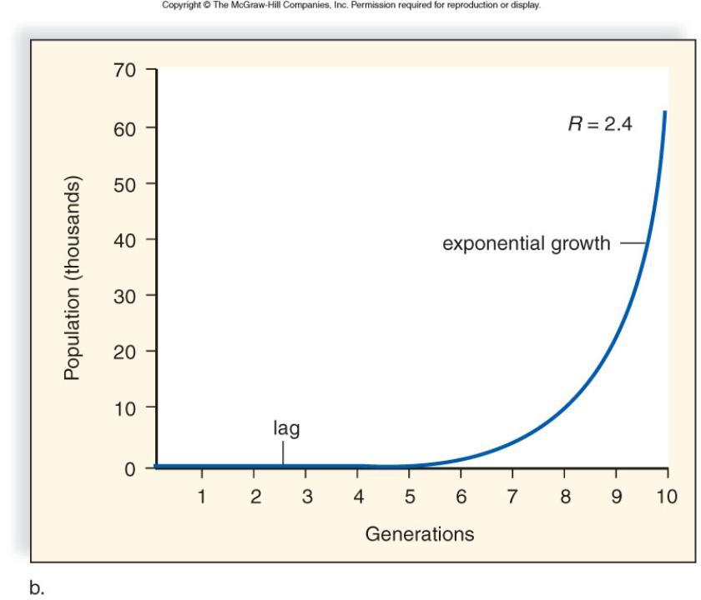
Figure 46.7b

Slide 30
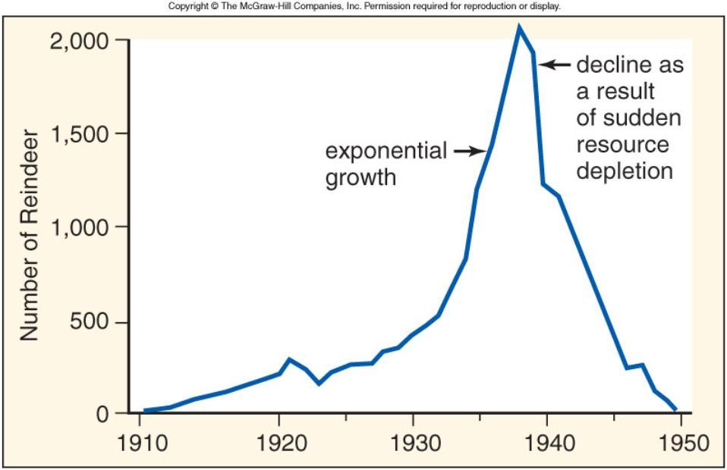
If the carrying capacity is exceeded, the population can decline fast due to resource depletion.

Slide 31
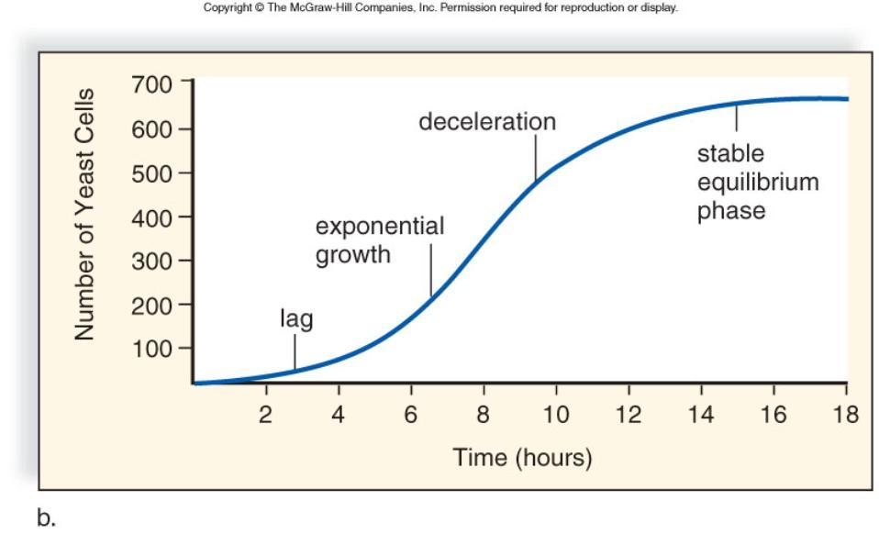
Figure 46.8b

Slide 32
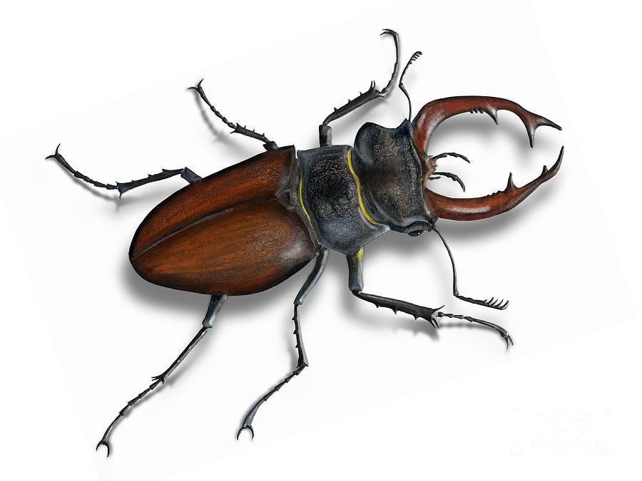
Formulas related to population growth
Growth rate (r) = birth rate (b) - death rate (d)
# of births / total # of deaths / total
Practice Problem: In research on beetles, you estimate that the populations size is 3000. Over the course of a month, you record 400 births and 150 deaths.
What is the growth rate (r)?
Population growth = rN
(r = growth rate, N = original population size)
Calculate the population growth of the beetle population.

Slide 33
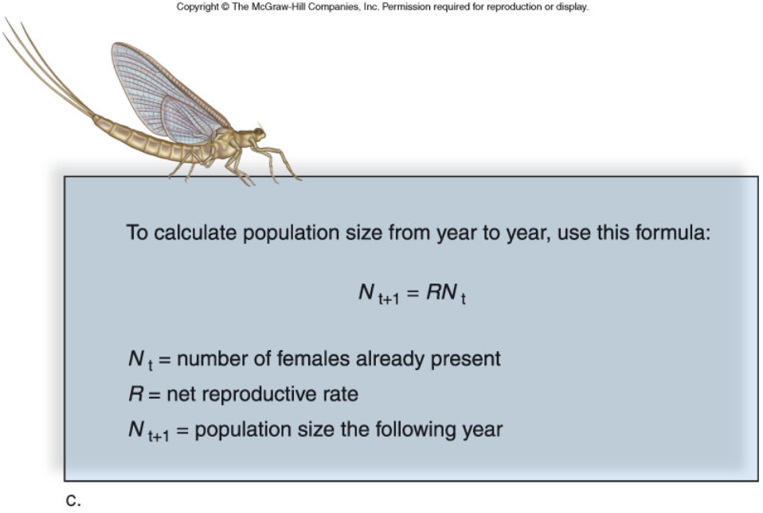
Consider that you have 10 females in a population that have a reproductive rate of 8, what will be the population in the subsequent years. Assume offspring are equally male and female.
Year 1 =
Year 2 =
Year 3 =
Year 4 =

Slide 34
The logistic growth equation takes into account the carrying capacity (K).
*And you thought you’d never use a differential equation in real life!

Slide 35
46.4 Regulation of Population Size
Density Independent Factors: weather and other natural disasters
Density Dependent Factors: food, space, water, parasitism, competition

Slide 36
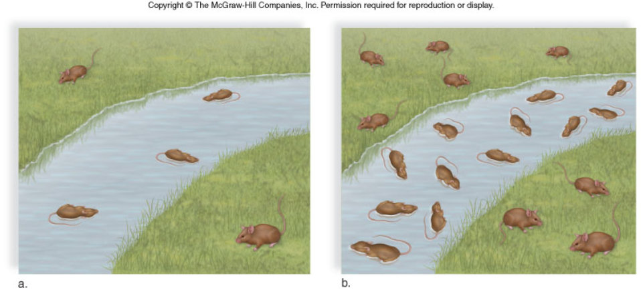
Figure 46.10
Density Independent Factor (Flash Flood) – it will have the same impact on a small pop as it does on a large pop.
60% loss for both

Slide 37
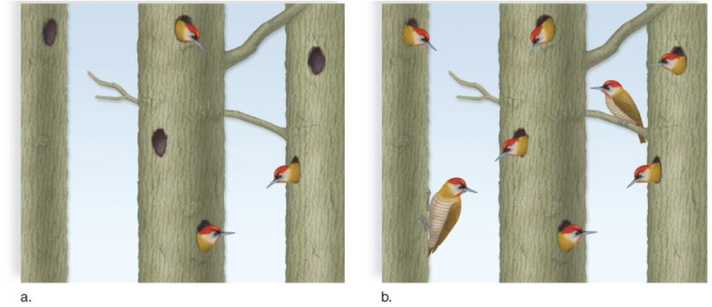
Figure 46.11
Density Dependent Factor – as number increases, not all of them will have access to resources

Slide 38
46.5 Life History Patterns
K-strategists - small numbers of offspring, usually parental care (Kangaroo)
R-strategists - large numbers of offspring, no care, low survivability (Roaches)

Slide 39
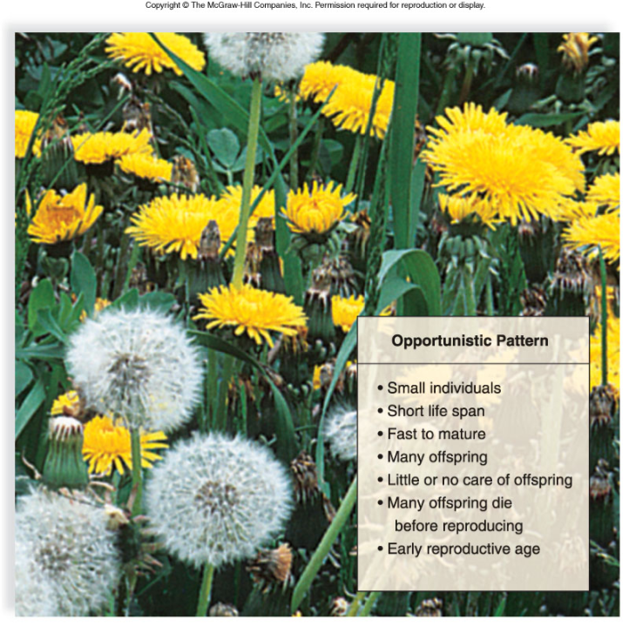
Figure 46.14a

Slide 40
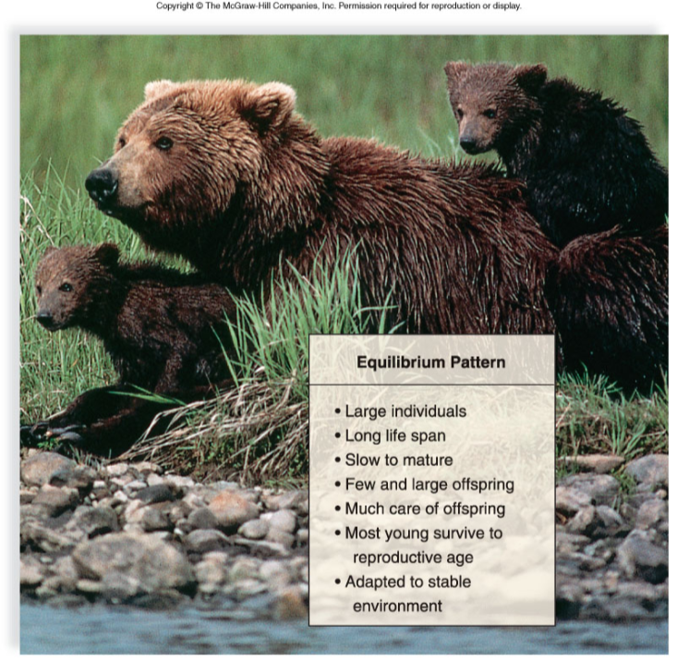

Slide 41
HUMAN POPULATION GROWTH
Current World Population: 6.6 billion (and growing)
The human population is now in an exponential part of a J-shaped growth curve.
World population increases the equivalent of one medium-sized city (216,000) per day and 79 million per year.
The doubling time is the length of time for a population size to double, now 53 years.
Zero population growth is when the birthrate equals the death rate and the population size remains steady.
The world population may level off at 8, 10.5 or 14.2 billion, depending on the decline in net reproductive rate.

Slide 42
DEMOGRAPHY – the study of human populations
LDC = less developed country MDC = more developed country
DEMOGRAPHIC TRANSITION - a decline in death rate followed by declining birthrate; it results in slower growth, about 0.1%.

Slide 43
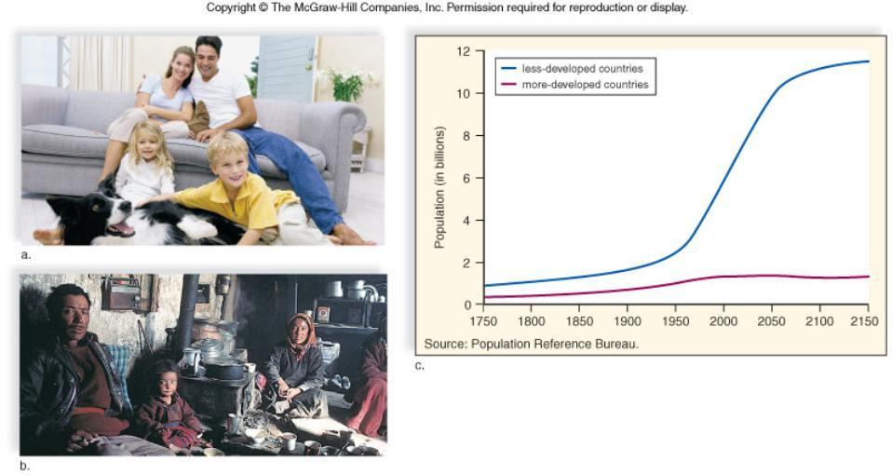
Figure 46.15
LDC’s vs MDCs

Slide 44
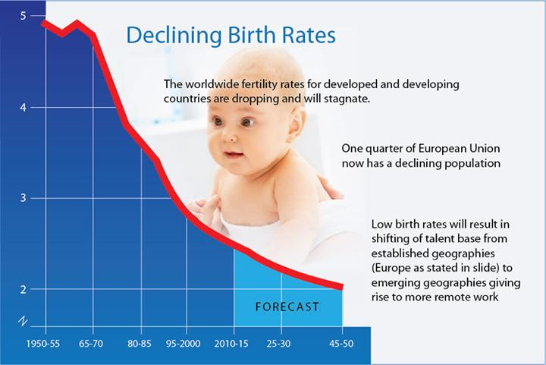
Zero Population Growth - same number enters as leaves the population

Slide 45
Human Population Issues
How does overpopulation affect the quality of life of an individual?
Should MDC’s help LDC’s achieve slower population growth?
Should countries send aid to places experiencing famine?
What about countries with a declining birth rate? What are possible consequences for them?
Do MDC’s have an obligation to reduce their consumption and pollution?
* Cap and Trade
* Higher taxes on emissions

