Slide 1
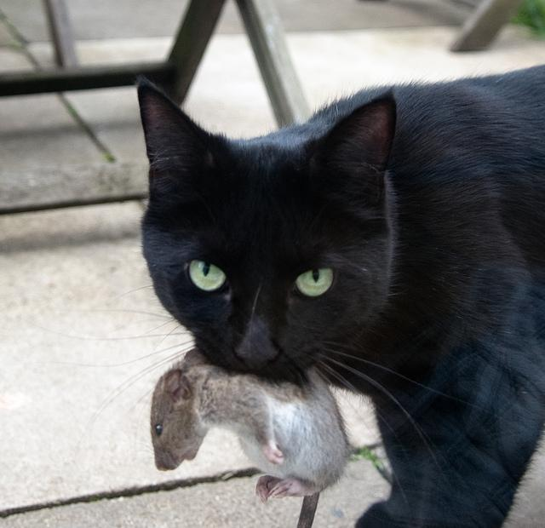
Community Ecology
Feral cat populations can be damaging to ecosystems.
Why?
Photo Credit: http://www.flickr.com/photos/daveograve/4562537127/

Slide 2
47.1 Concept of the Community
Community = assemblage of populations interacting with one another
Example: squirrel, moose, bear, fox, wolf, pine tree, termites, bacteria....etc
Videos: Monkey vs Tiger | Cobra vs Mongoose | Sea Lion vs Whale

Slide 3
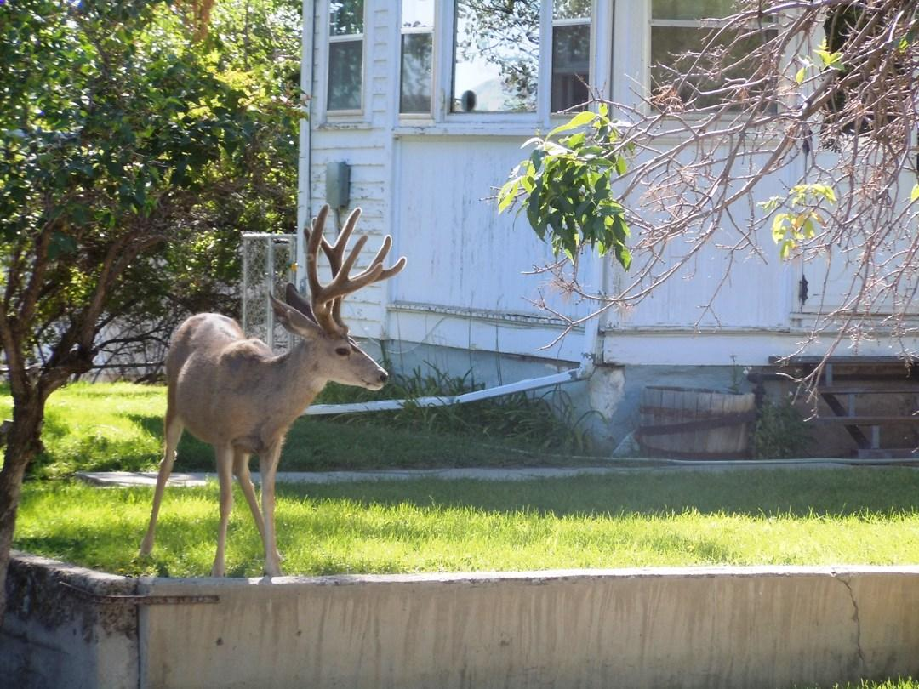
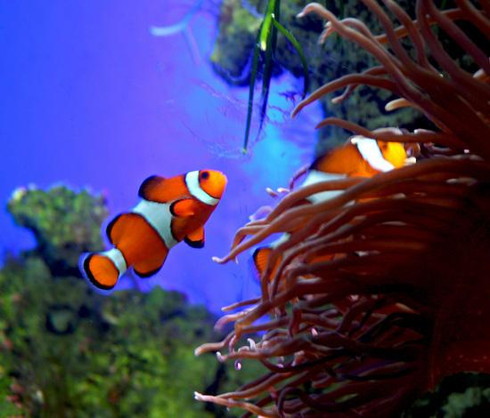
47.2 Structure of the Community
Habitat = particular place an organism lives
Ecological Niche: the role it plays in the community (includes food sources, reproduction, placement)
Fundamental Niche - all the conditions that an organism can survive
Realized niche - where it actually exists in nature

Slide 4
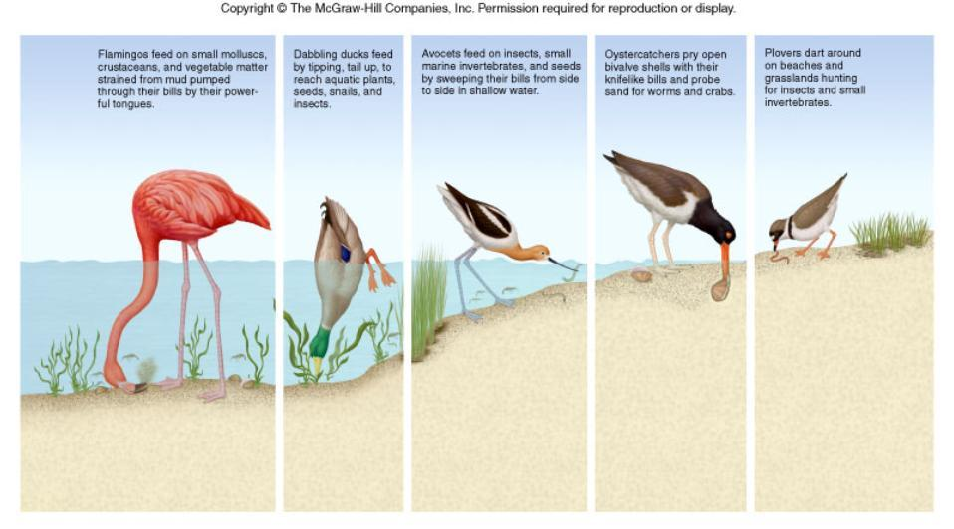
Niche – each member of this community gathers food in a unique way

Slide 5
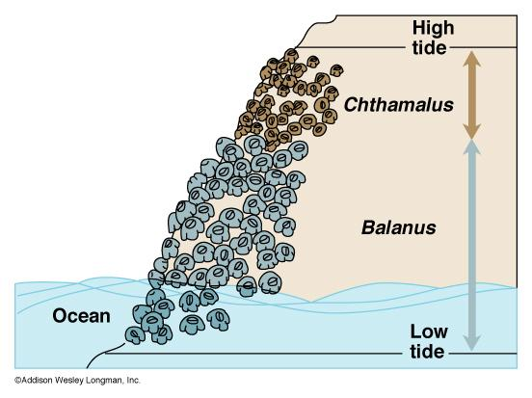
Realized vs Fundamental NicheInterspecific Competition: competition between different species
Competitive Exclusion Principle - no two species can occupy the same niche Resource Partitioning - species with niche overlap, share/partition resources (see balanus)

Slide 6
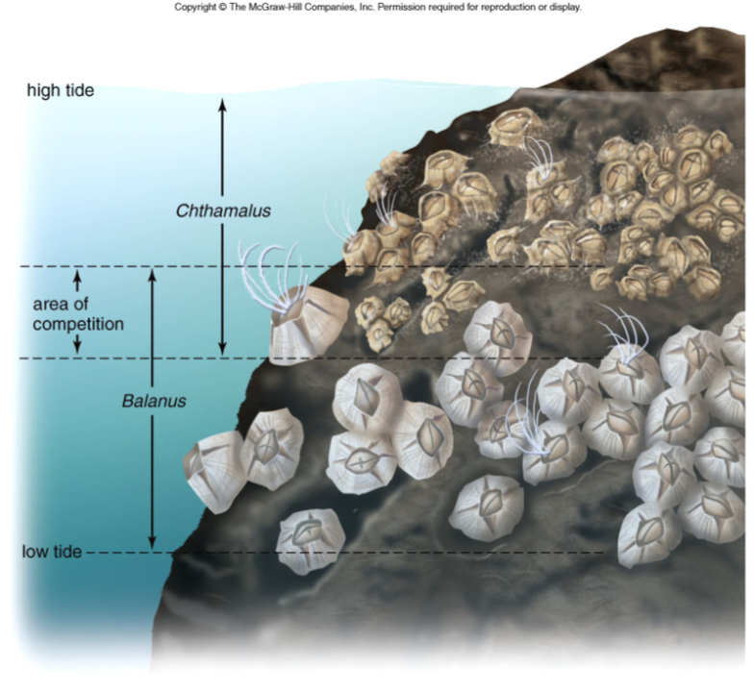
Figure 47.8

Slide 7
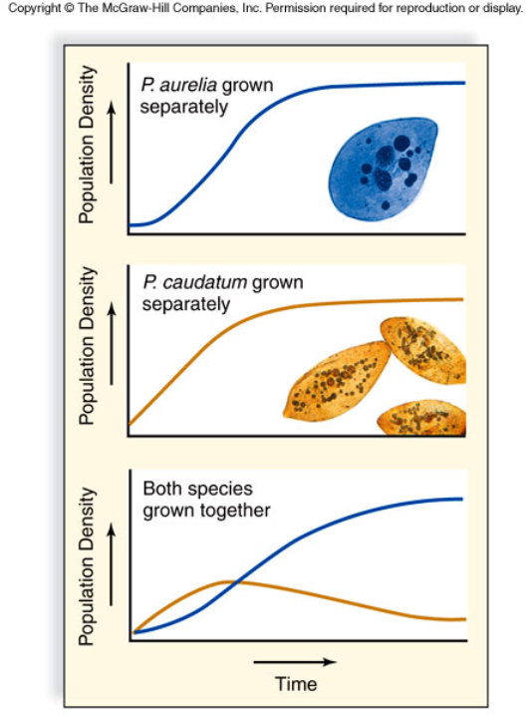
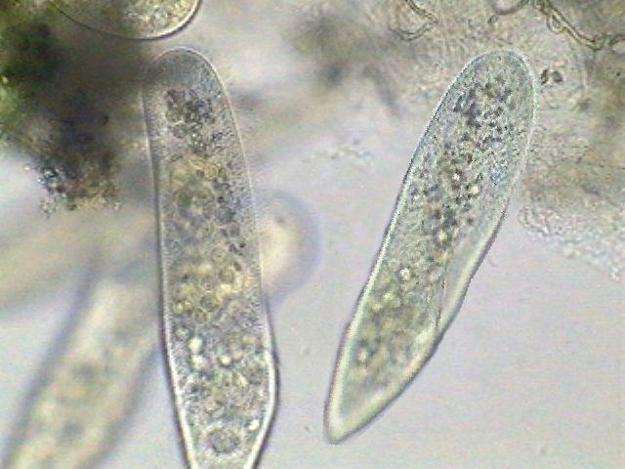
Lab: Population Biology
Graph illustrates what happens when you grow two different species of protists separately and in the same container (where competition can occur).
Summarize the results.

Slide 8
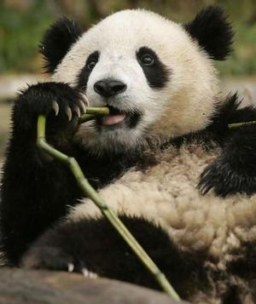
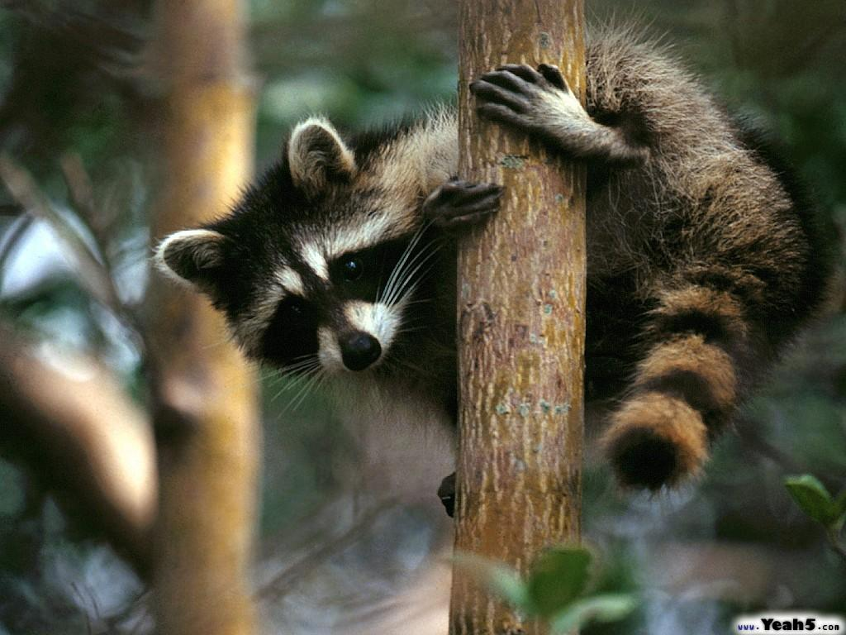
Generalist - eat different things, live in a variety of spaces (raccoon) Specialist - very specific needs (panda)

Slide 9
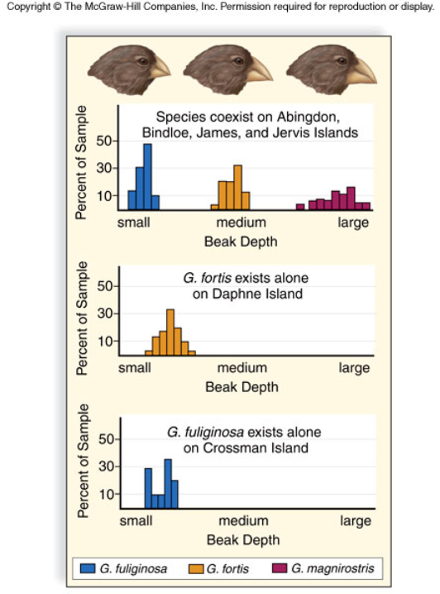
Another example of competitive exclusion and resource partitioning

Slide 10
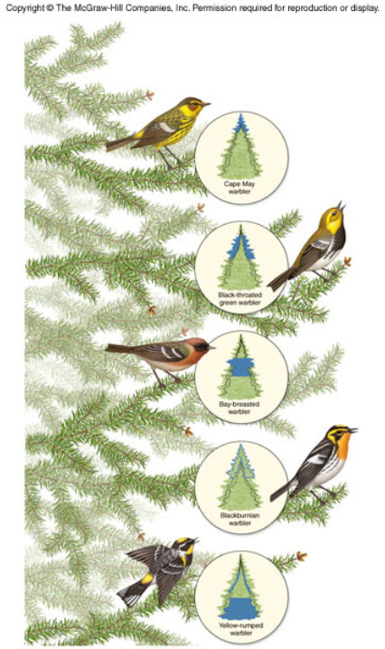
Another example of competitive exclusion

Slide 11
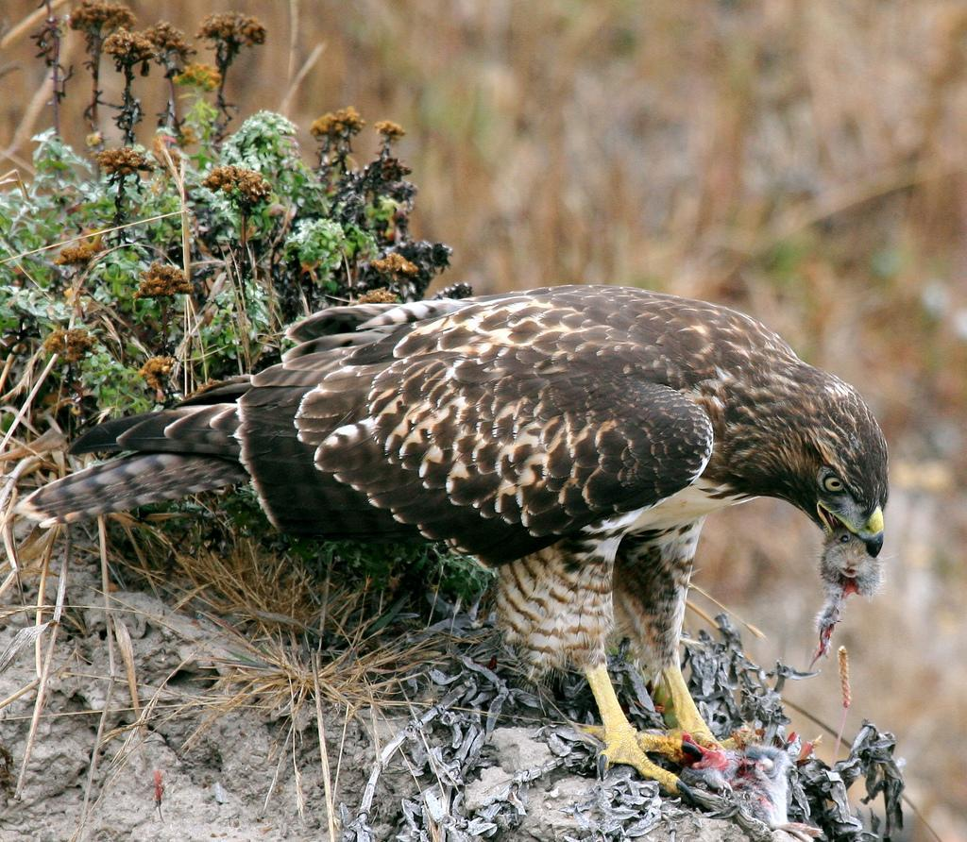
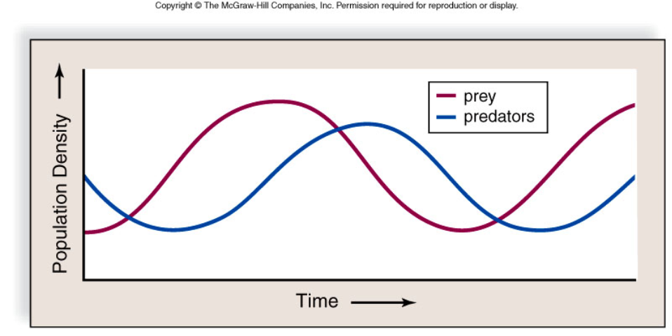
Predator Prey Interactions - communities follow this pattern. Prey species increase in number, followed by predator species. Then Prey species decline, followed by predator species decline. The cycle repeats.

Slide 12
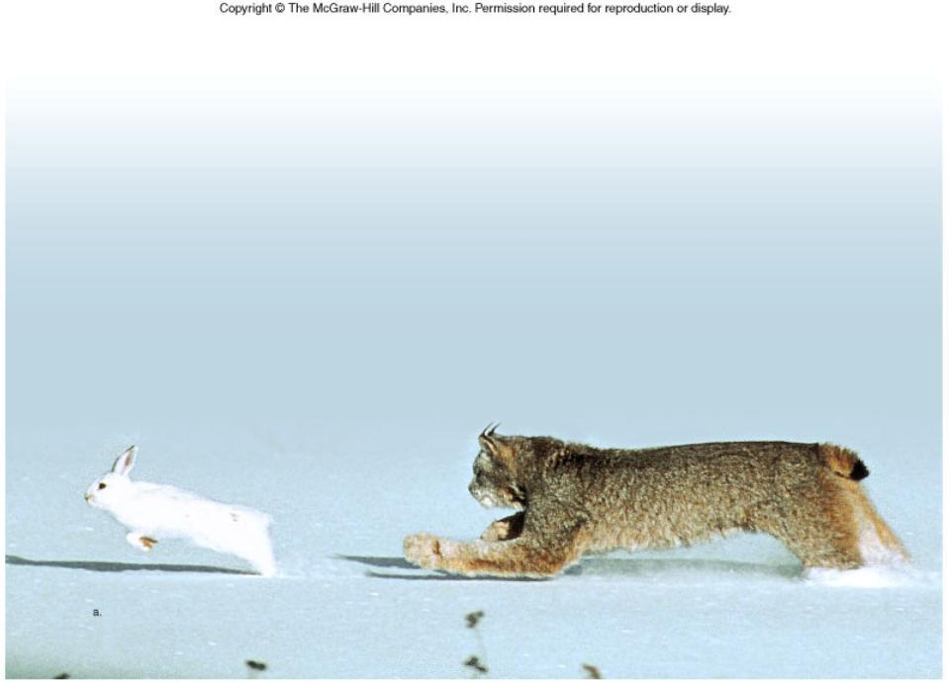
Classic Case of the Lynx and the Hare

Slide 13
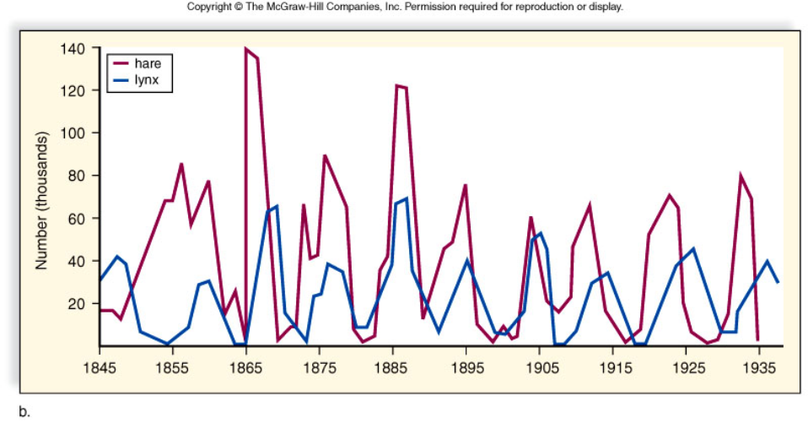

Slide 14
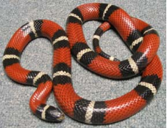
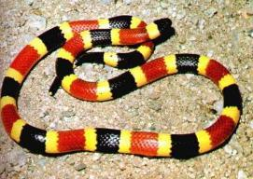
Prey Defenses
Camouflage (cryptic coloration) - blending in
Mimicry - one species resembles another as a defense (milk snake)

Slide 15
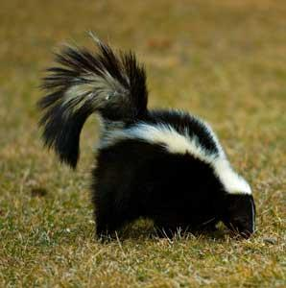
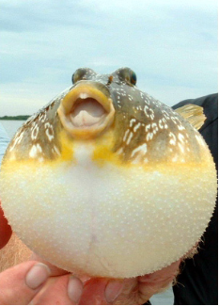
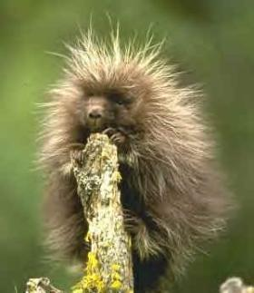
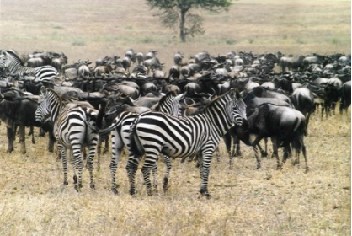
Other Defenses
Herding Behavior (zebra) Startle Behavior (blowfish) Anatomical defense (porcupine) Chemical defense (skunk)

Slide 16
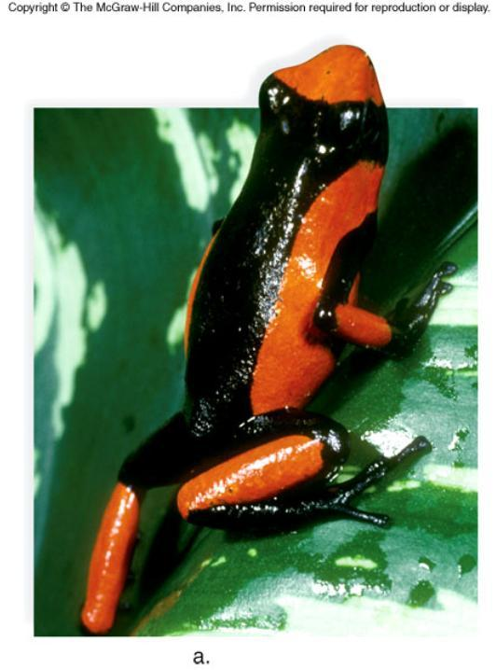
Figure 47.12a

Slide 17
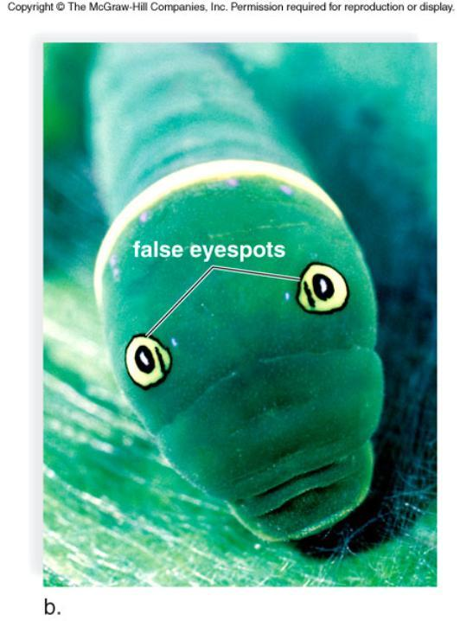
Figure 47.12b

Slide 18
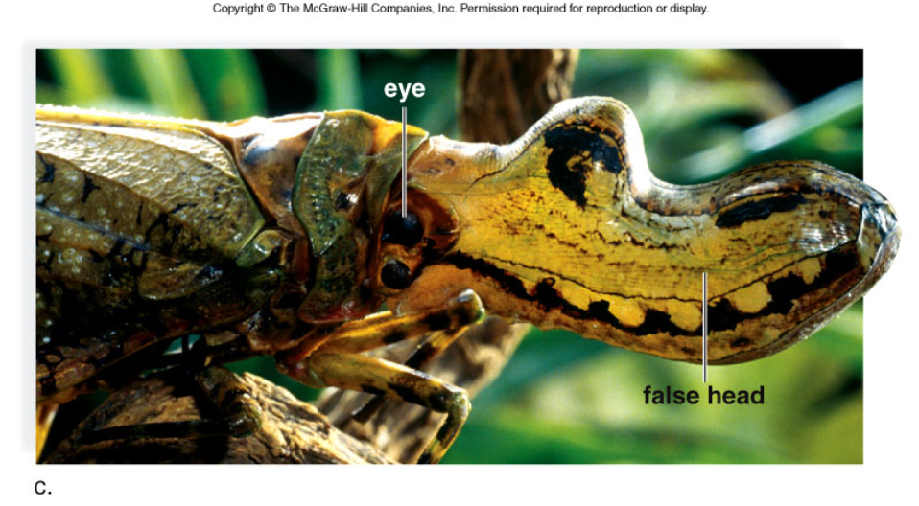
Figure 47.12c

Slide 19
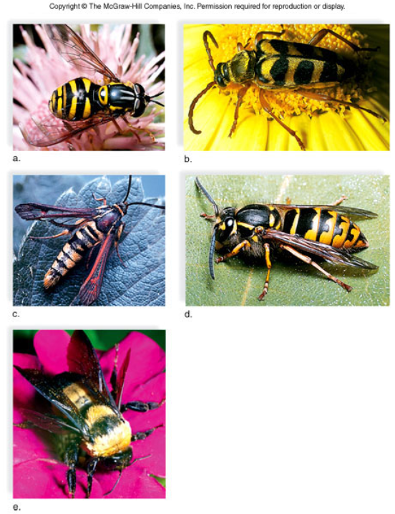
Mimicry

Slide 20
Symbiotic Relationships
Symbiosis - intimate relationship between two or more species
Parasitism - one individual is harmed, the other benefits (ticks & deer)
Mutualism - both benefit (flowers & honeybees)
Commensalism - one benefits, other is neither harmed or benefited (clown fish & sea anemone)

Slide 21
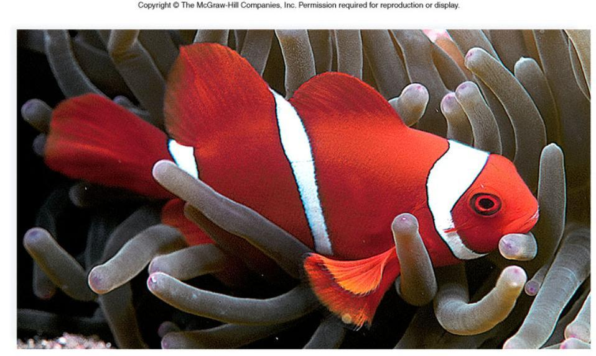
Commensalism

Slide 22
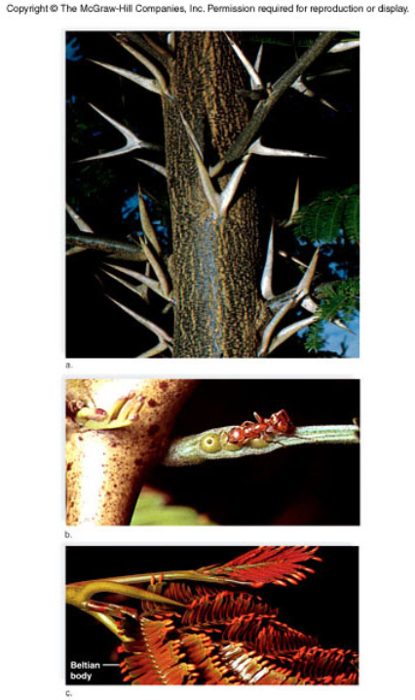
Mutualism

Slide 23
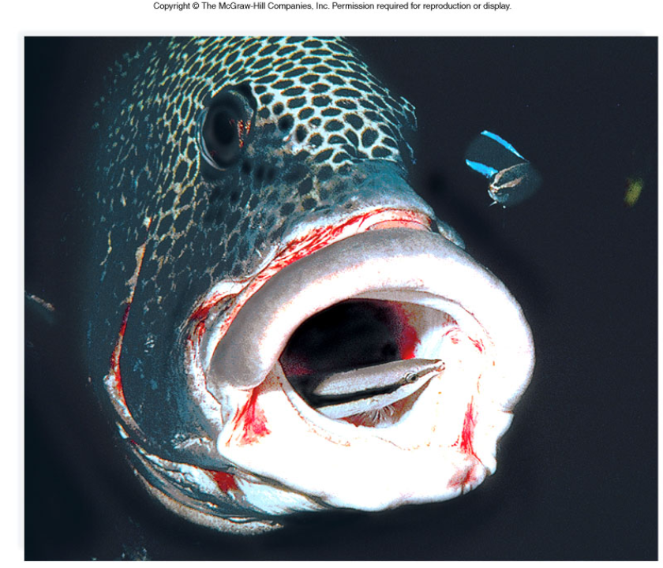
Figure 47.17

Slide 24
47.3 Community Development
Ecological Succession - involves a series of species replacements
Primary Succession - occurs where there is no soil formation (volcanic island)
Secondary Succession - occurs after an area is disturbed (prairie fire)
Pioneer Species - first species to inhabit an area
Climax Community - when the species replacement slows and the ecosystem stabilizes

Slide 25
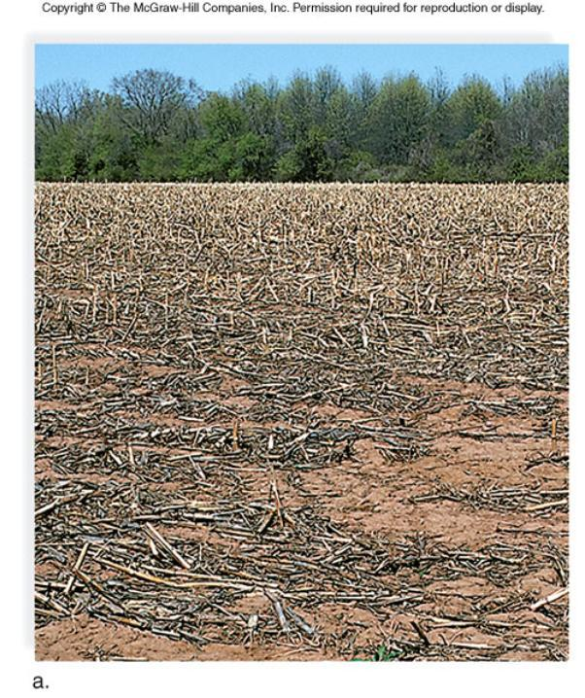
Figure 47.18a

Slide 26
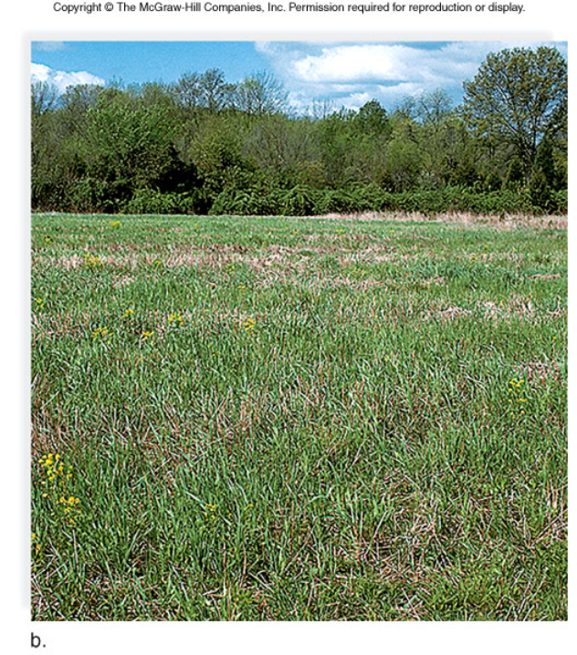
Figure 47.18b

Slide 27
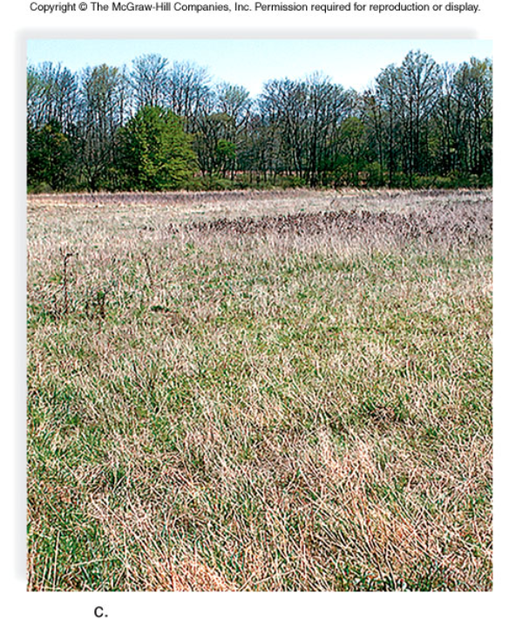
Figure 47.18c

Slide 28
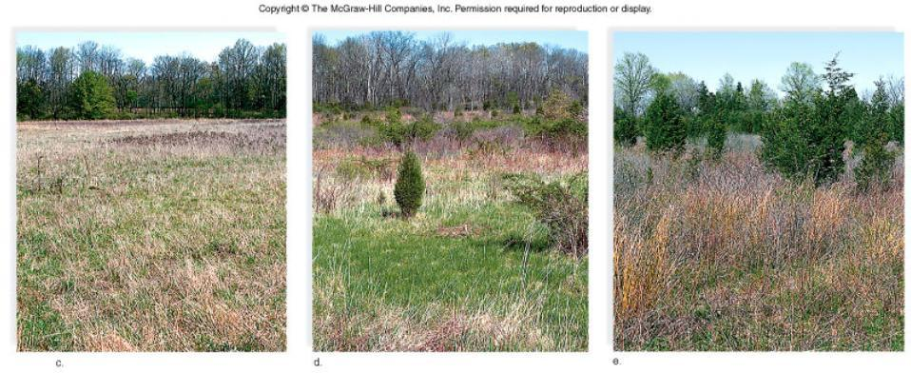
Figure 47.18cde

Slide 29
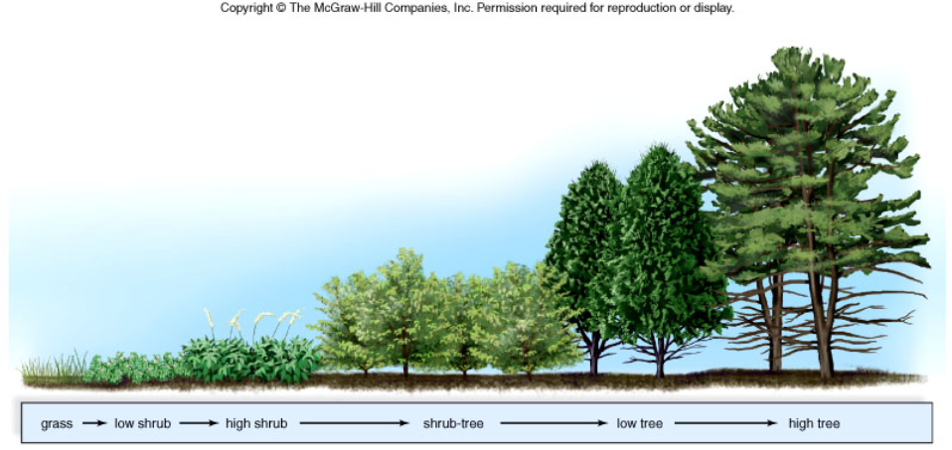
Worksheet: Succession

Slide 30
47.4 Community Biodiversity
Intermediate Disturbance Hypothesis - moderate disturbances in an ecosystem are necessary to maintain biodiversity
Keystone Species - needed to maintain biodiversity (often top predators)
Ex: Kelp, Sea otters, Sea urchins, Abalone - what happens when you remove the otters

Slide 31
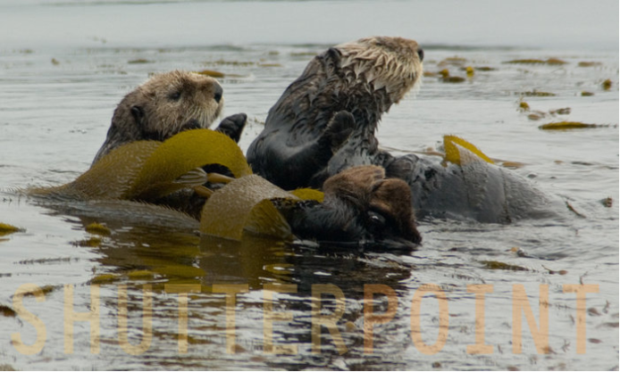
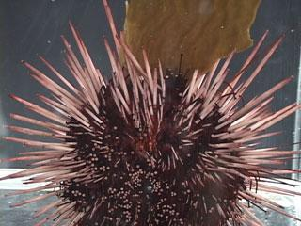
KEYSTONE SPECIES: SEA OTTER
Sea otters eat sea urchins Sea urchins eat kelp What happens when you remove the otters?
Case Studies in Keystone Species

Slide 32
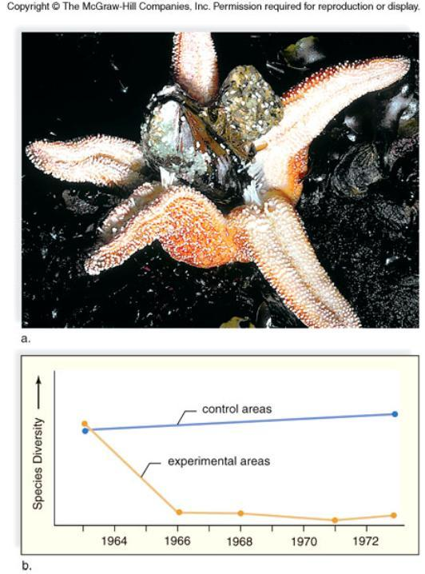
Carnivorous starfish Pisaster ochracceus, played a key role in maintaining the balance of all other species in the community. Paine observed that if Pisaster ochracceus was removed from the community, the populations of two mussel species within the community grew unchecked. Without a predator to control their numbers, the mussels soon took over the community and crowded out other species, greatly reduced the community's diversity.

Slide 33
Invasive and Parasitic Species
1
The interesting cases of:
1. Cuckoo and Cowbirds 2. Kudzu
3. Asian Carp
4. Snakehead catfish
5. Zebra mussels
*Each of these have a negative impact on the environment.

Slide 34
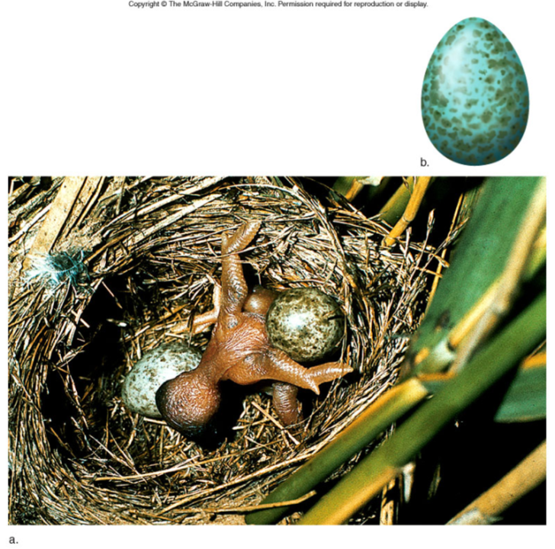
Parasitic Bird? Cowbirds (and cuckoos) lay their eggs in other bird’s nests.

Slide 35
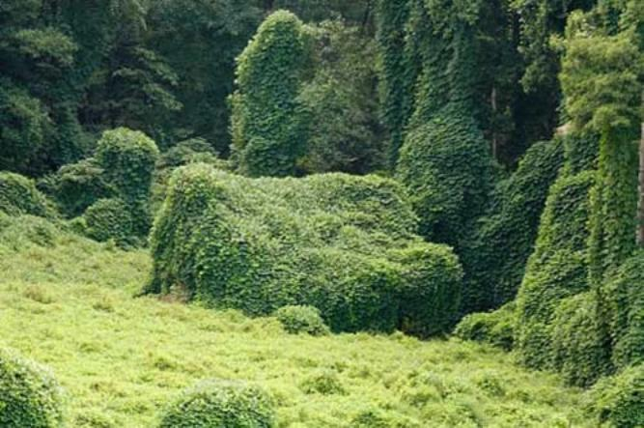
Kudzu
Invasive Species (exotics)

Slide 36
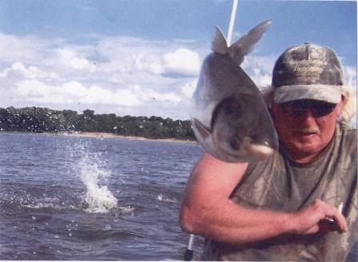
Asian Carp in the Mississippi (Video)
The problem being addressed is that the Asian Carp have started to take over the rivers and subsidiaries of our nations waterways. The Carp are voracious feeders that feed mostly on plankton. The problem with this is that the young offspring of the fish native to the rivers also feed on mostly plankton. If the carp are eating most of the plankton then it leaves very little for the offspring of native fish to feed on and they basically die of starvation. This means the carp are threatening the entire ecosystem of the riverways.
Source: http://asiancarp.net/dasblog/2009/1 /23/TheProblem.aspx

Slide 37
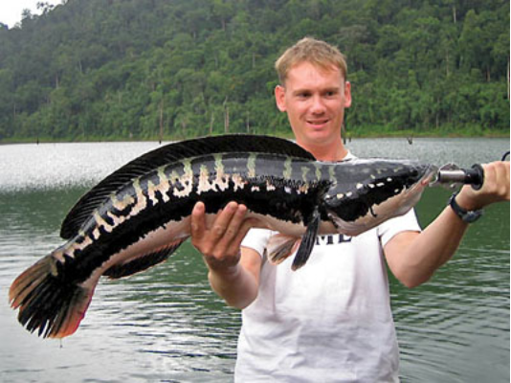
Snakehead Catfish

Slide 38
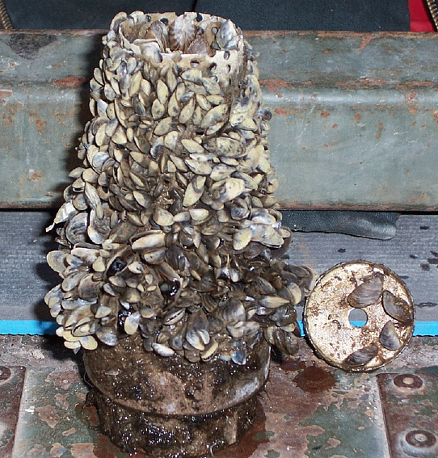
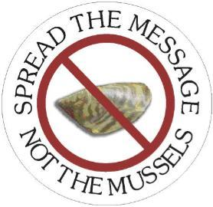
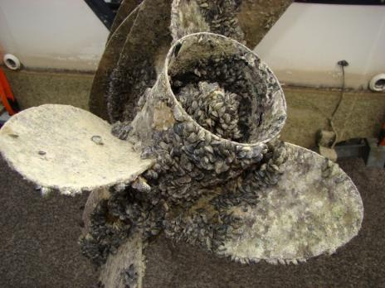
Zebra Mussels in the Great Lakes

Slide 39
Table 47.1

Slide 40
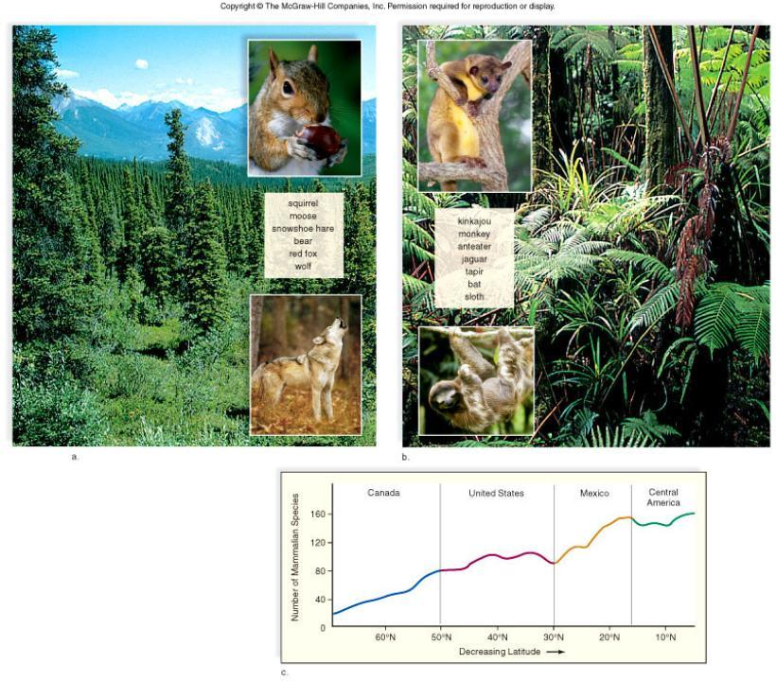
Figure 47.1

