Slide 1
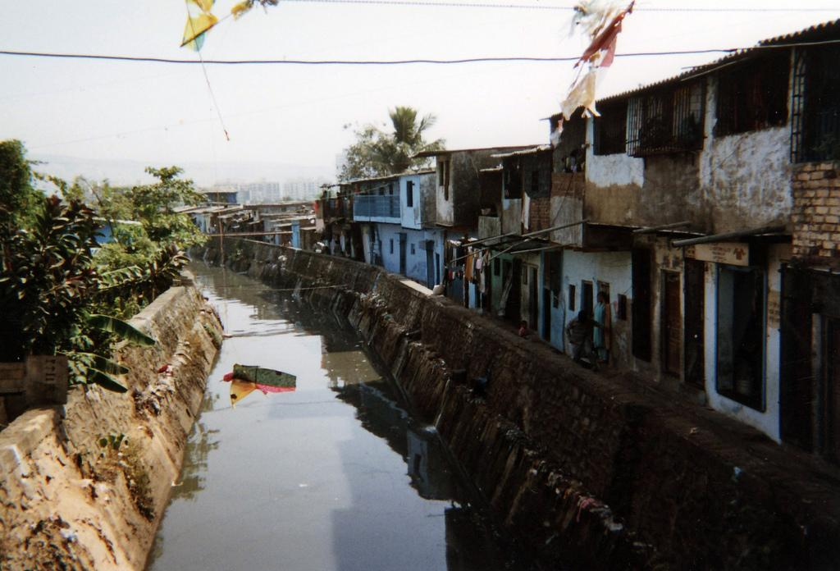
Chapter 48 - Ecosystems and Human Interference
Photo Credit: http://www.flickr.com/photos/wordcat/266452605/

Slide 2
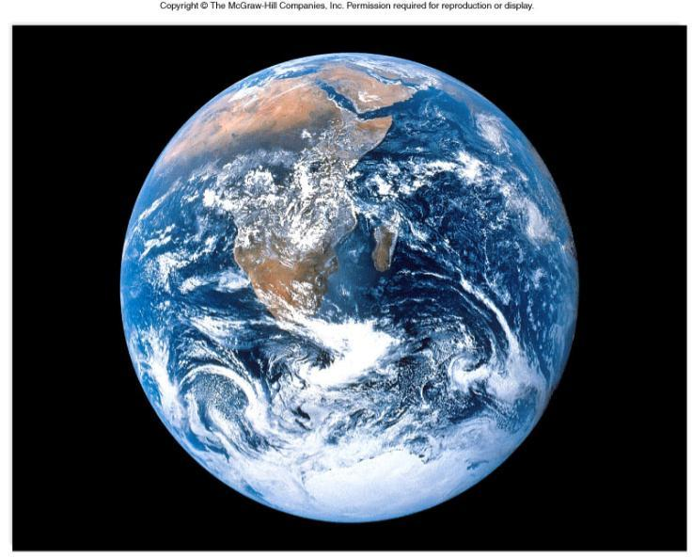
Biosphere - the part of the atmosphere that contains living things Ecosystem - all the organisms in an environment (community) plus the nonliving physical factors (temperature, soil.etc)

Slide 3
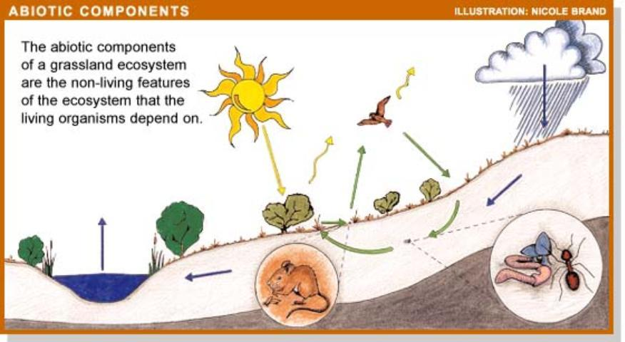
Biotic Components of an Ecosystem (living things) Abiotic components (nonliving things)

Slide 4
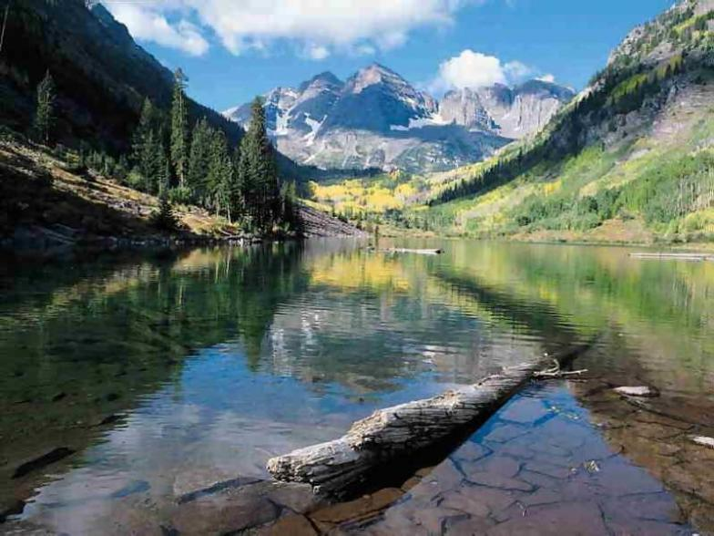
Can you list all the biotic and abiotic factors in this picture?

Slide 5
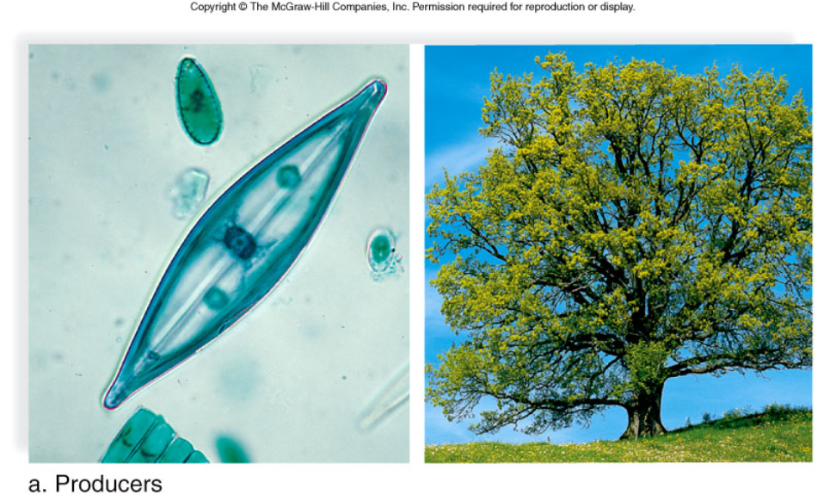
AUTOTROPHS (PRODUCERS) - synthesize food from sunlight or chemicals

Slide 6
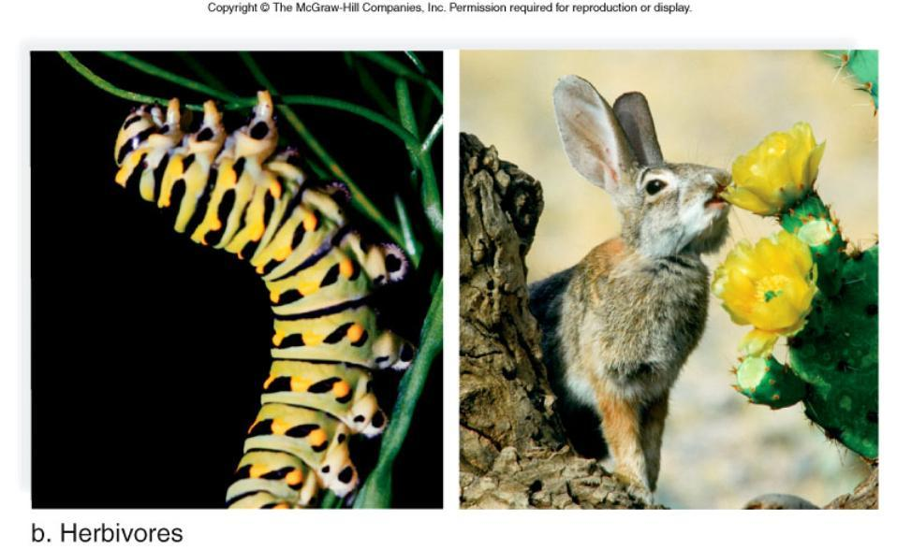
HETEROTROPHS (CONSUMERS) - gain energy from feeding on other organisms

Slide 7
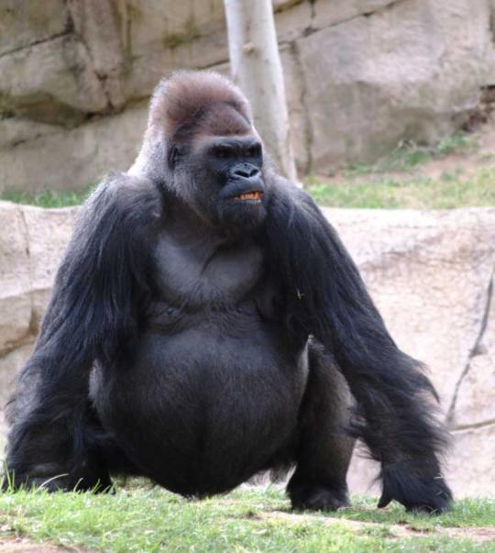
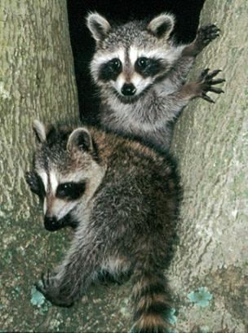
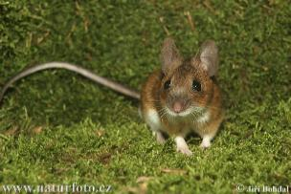
OMNIVORES

Slide 8
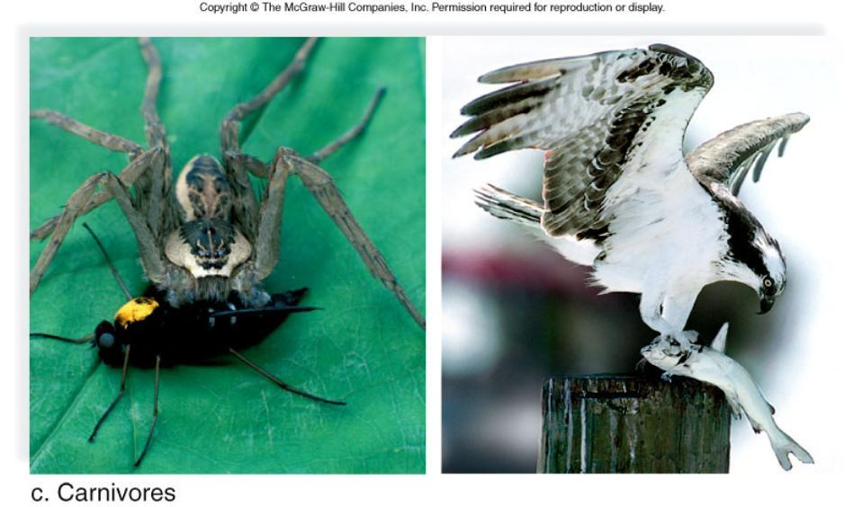
Figure 48.2c

Slide 9
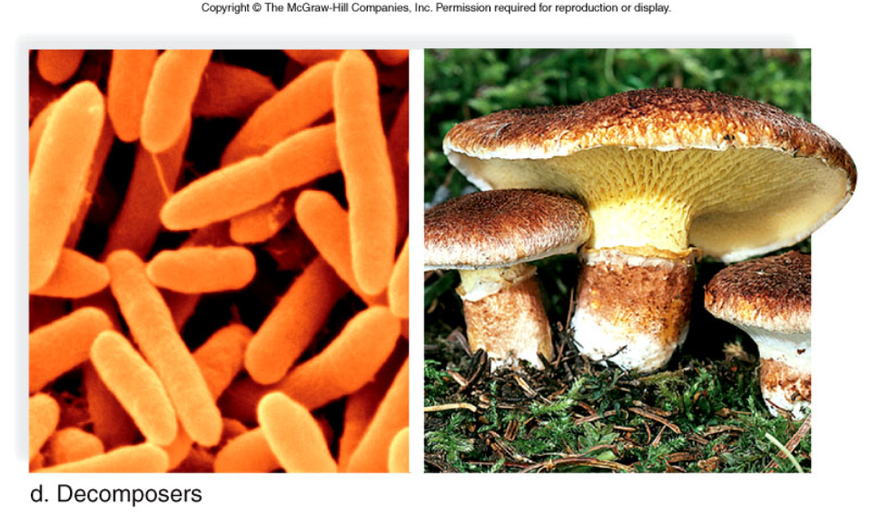
Detritivores

Slide 10
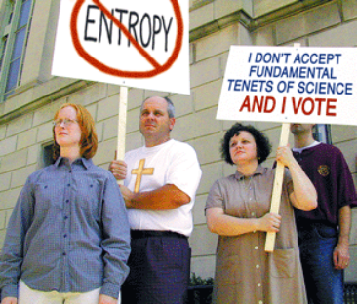
ENERGY FLOW
- energy flows through an ecosystem starting from the sun, then to the producers and consumers. At each level, some of the energy is lost as heat
LAW OF THERMODYNAMICS

Slide 11
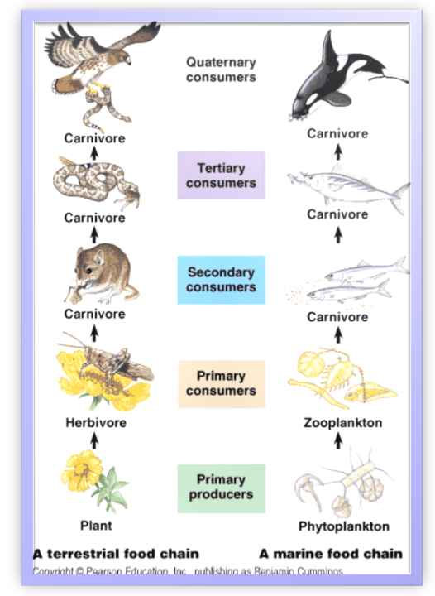
Food Webs (& Food Chains)
- illustrate flow of energy in a system
Plants → Caterpillars → Sparrows → Hawks
Trophic levels - the level of nourishment within a chain or a web, there should be fewer organisms as you go up each level

Slide 12
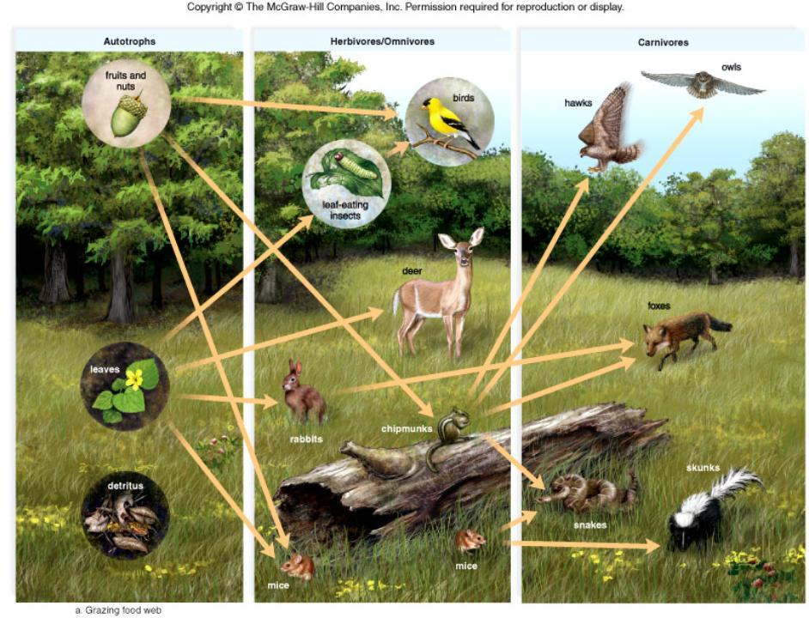
Figure 48.5a

Slide 13
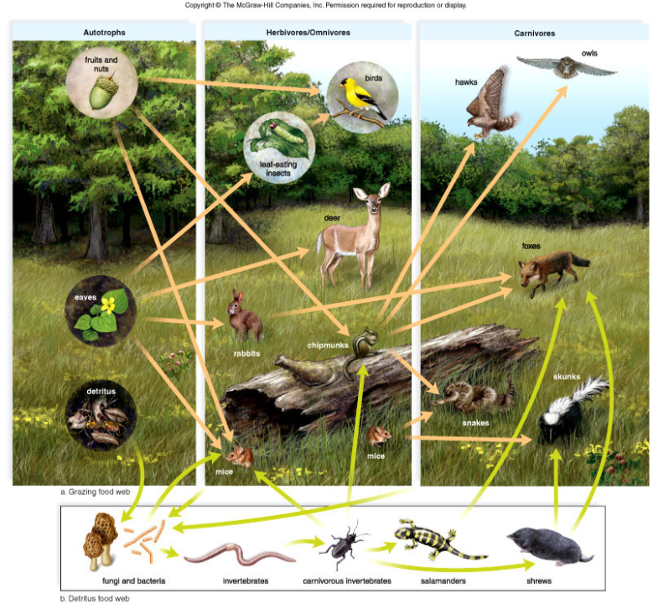
Figure 48.5

Slide 14
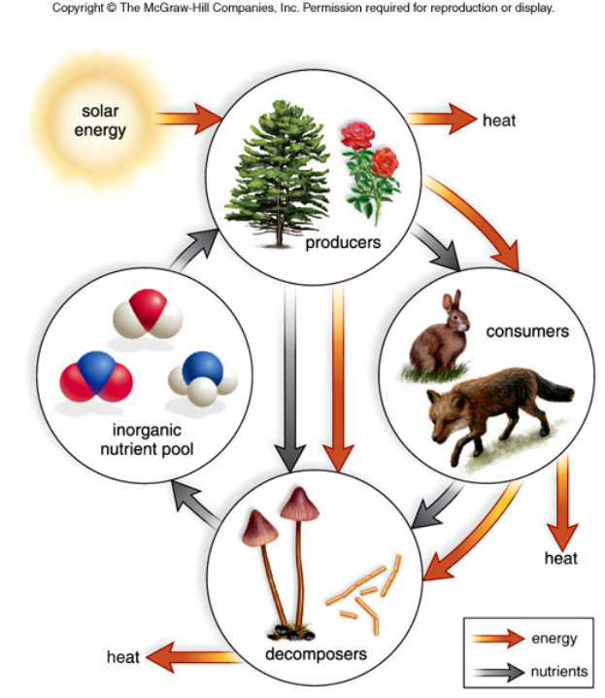
Figure 48.3

Slide 15
ECOLOGICAL PYRAMIDS
Pyramid of Numbers
Indicate individual numbers of a population

Slide 16
Pyramid of Biomass
Indicate weight (dry mass) of a population

Slide 17
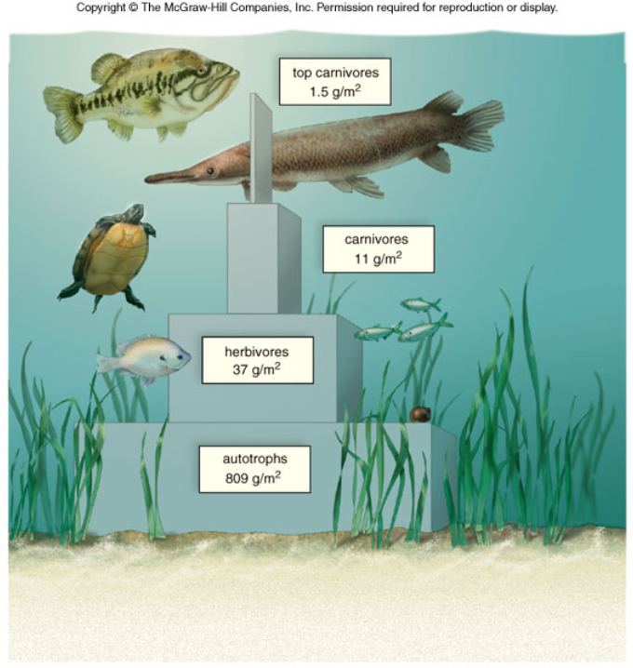
Figure 48.6

Slide 18
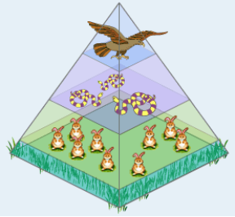
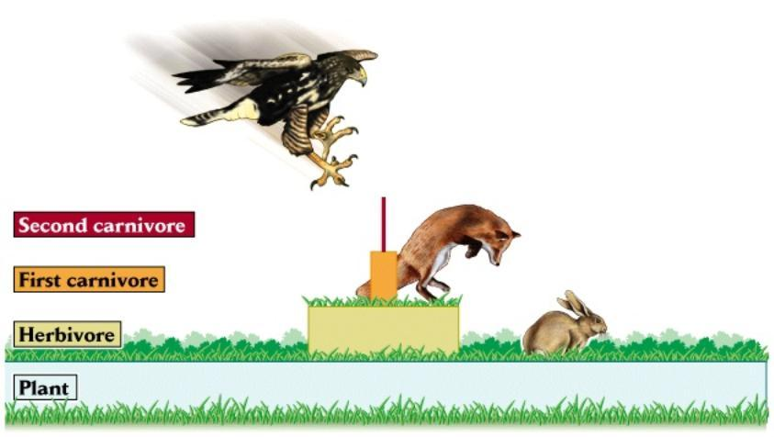
More Pyramids

Slide 19
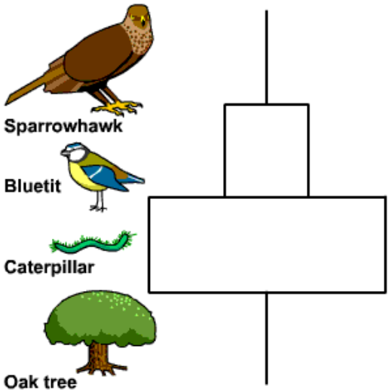
Is this a pyramid of numbers or biomass?

Slide 20
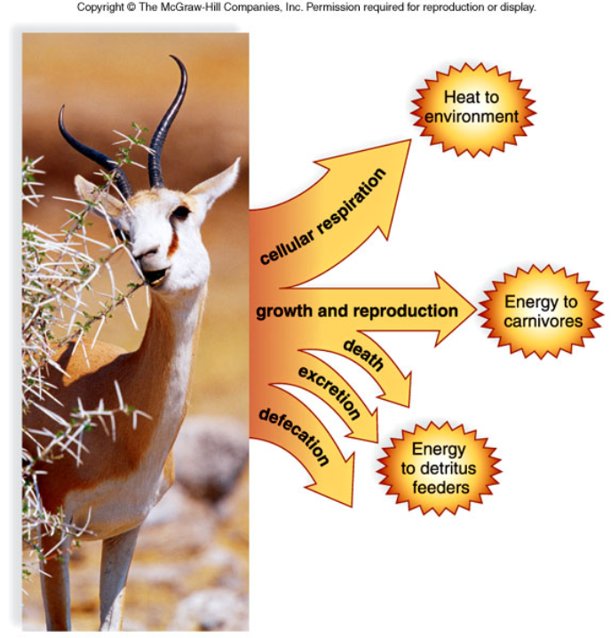
Figure 48.4

Slide 21
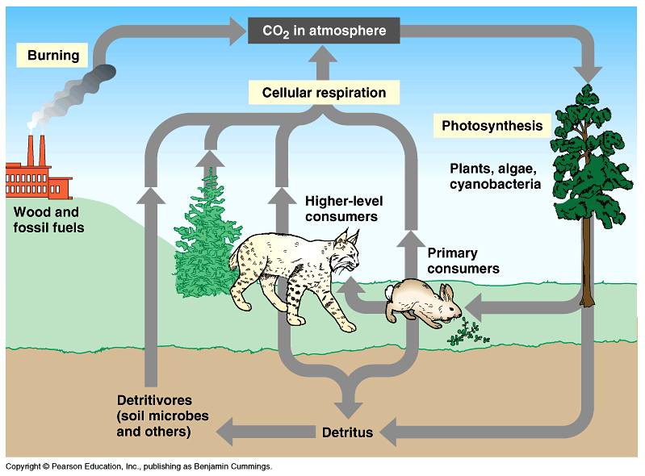
48.3 Biogeochemical Cycles
Carbon Cycle

Slide 22
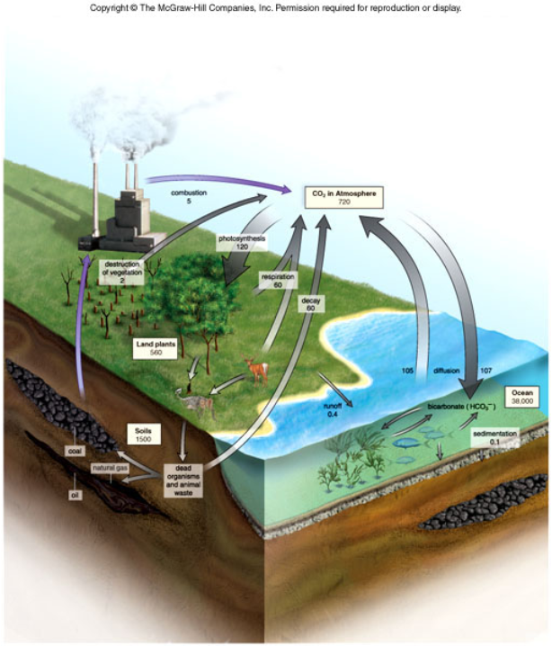
Figure 48.9

Slide 23
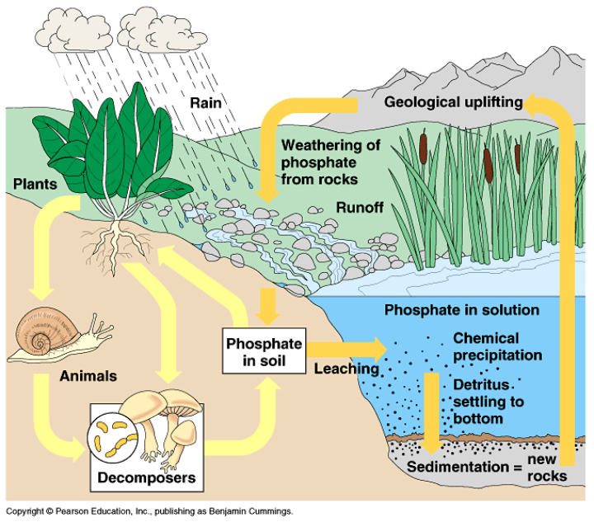
Phosphorous Cycle

Slide 24
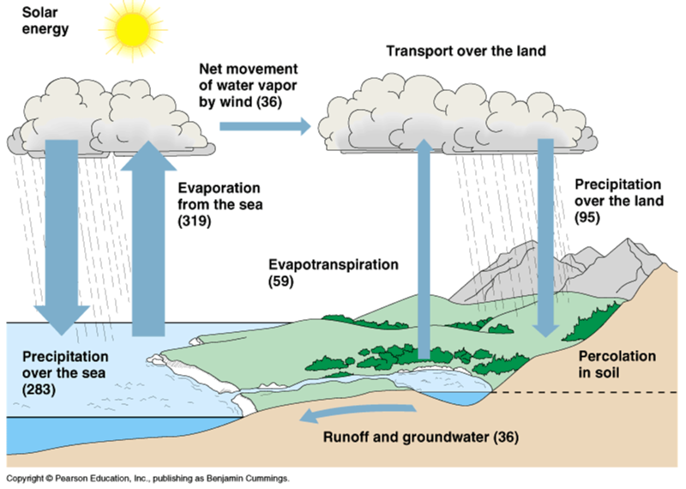
Water Cycle

Slide 25
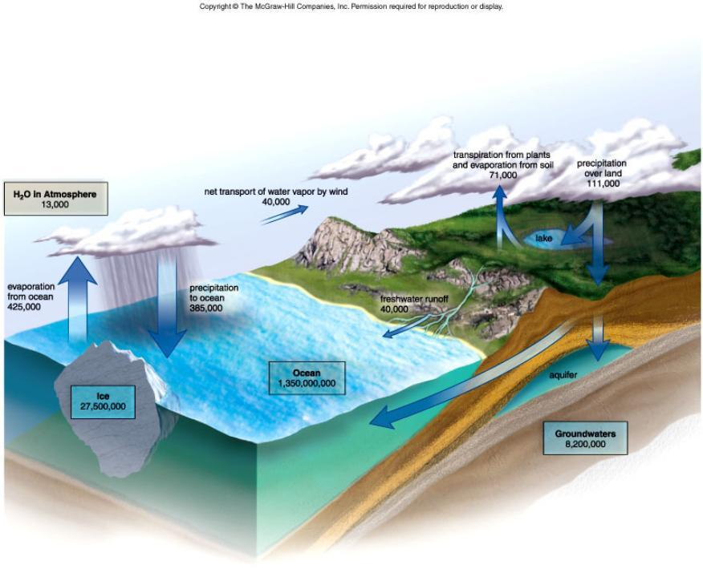
Figure 48.8

Slide 26
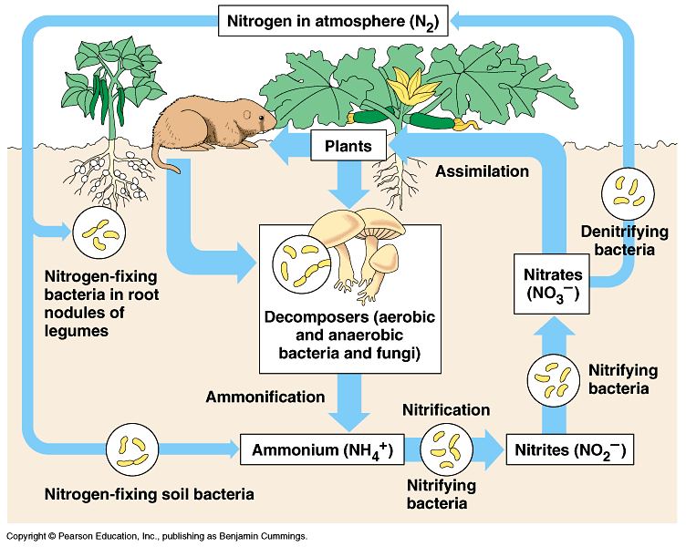
Nitrogen Cycle

Slide 27
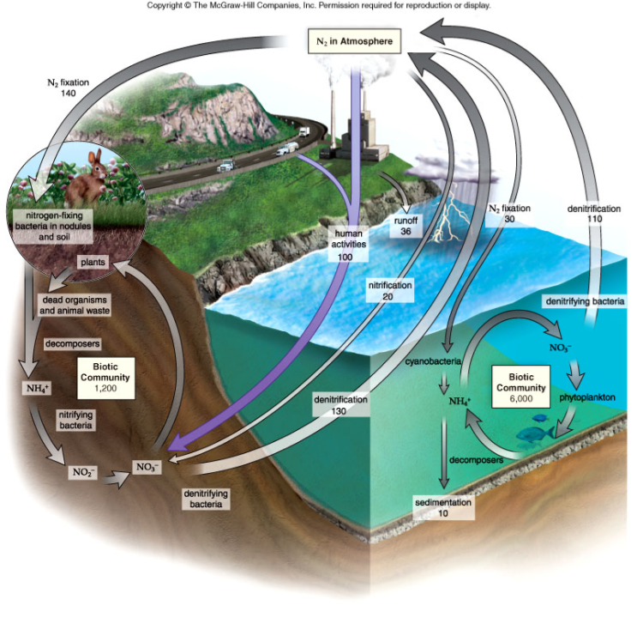
Figure 48.11

Slide 28
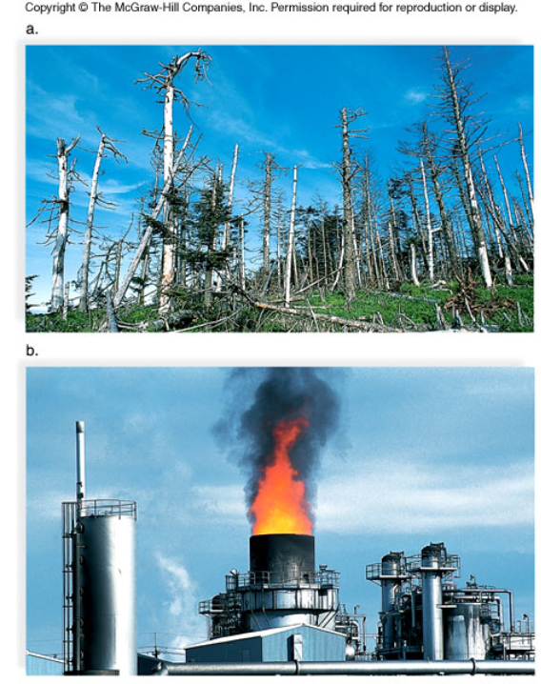
Human Effects on the Environment
Habitat Destruction
Air Pollution

Slide 29
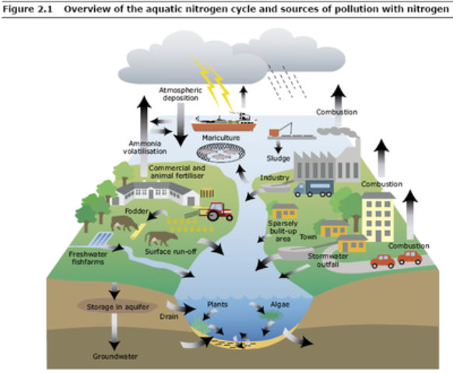
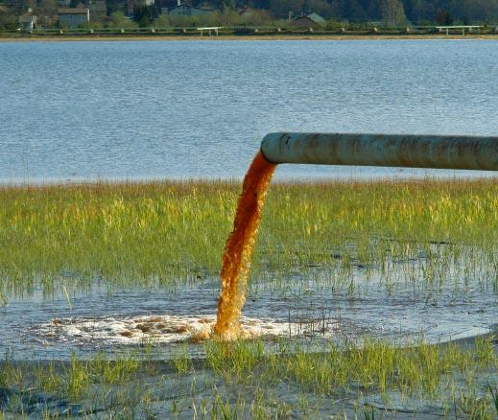
Water Pollution

Slide 30
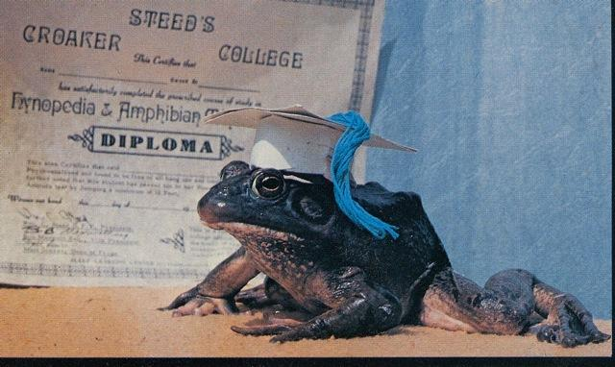
Frogs are BIOINDICATORS
The health of a frog population mirrors the health and pollution levels of the environment

Slide 31
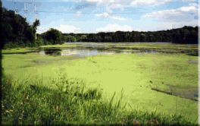
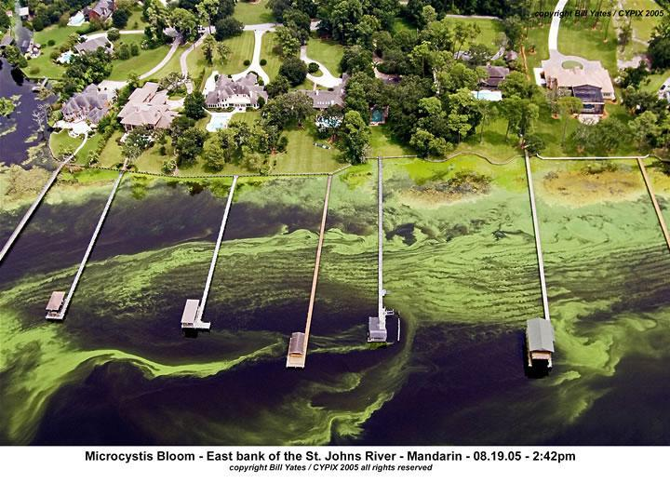
Eutrophication
Eutrophication Video

Slide 32
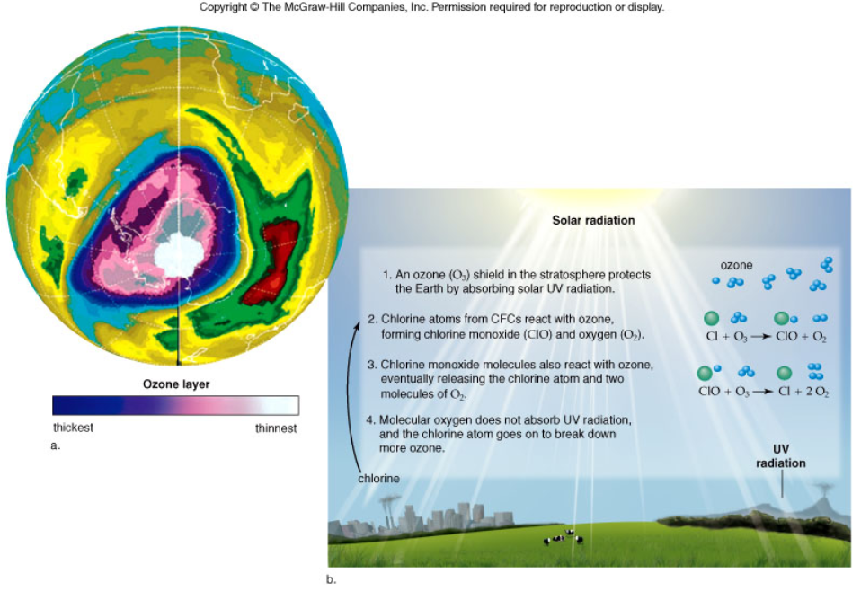
Air Pollution

Slide 33
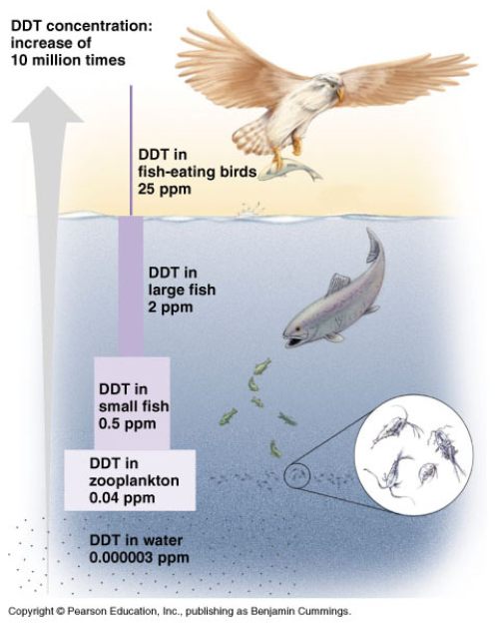
Biological Magnification

Slide 34
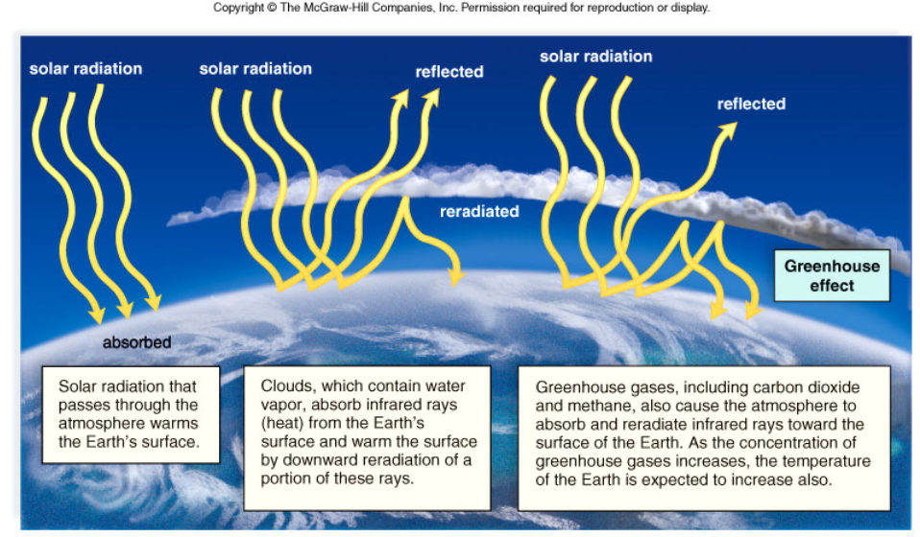
Greenhouse Effect

Slide 35
Climate Change
The temperature of the earth has changed since we have been recording weather data. The question is: Is the change part of a natural cycle, or is it caused by humans?

Slide 36
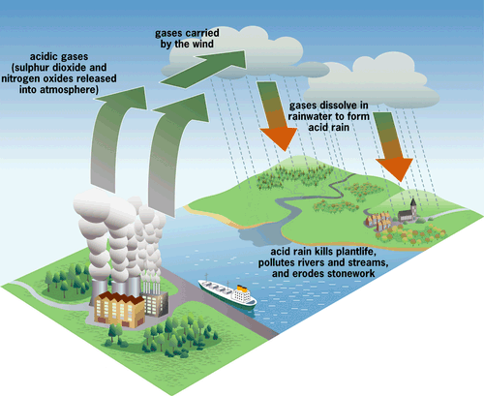
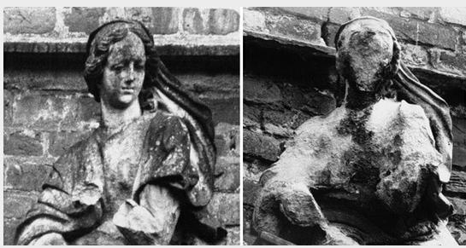
Other Issues
ACID RAIN - largely a result of pollution which caused water to become slightly acidic
emissions of sulfur dioxide (SO2) and oxides of nitrogen (NOx)react with atmospheric water and oxygen

Slide 37
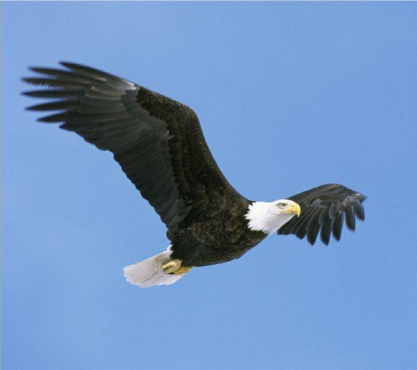
Loss of Diversity
The U.S. Endangered Species Act of 1973 attempted to identify and protect species that were on the verge of extinction
Recovery plans were enacted for many species and have seen success in some cases (Gray Wolf, Bald Eagle)
- all managed by the E.P.A
There are a lot of different names for this one:
- endangered species - habitat destruction - extinction

Slide 38
Environmental Protection Agency
Federal laws designed to protect the environment and manage wildlife resources
1. Endangered Species Act 2. Clean Air Act 3. Animal Welfare Act
The E.P.A. has often gone against other groups in the country, such as corporate industry, ranching, logging, and farming.
The current issues with climate change has the E.P.A. poised to limit carbon emissions. Good or bad idea?

Slide 39
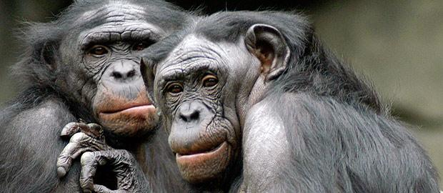
C.I.T.E.S.
Convention of International Trade in Endangered Species is an international organization that attempts to control the illegal export and import of endangered species.
It is illegal to import animals (or parts) of animals that have been identified by CITES. This includes
- ivory, feathers, rhino horns, or other parts that are sold on the black market - living specimens, baby orangutans, tigers...etc
Check out bagheera.com for information on world efforts to slow the extinction of species

Slide 40
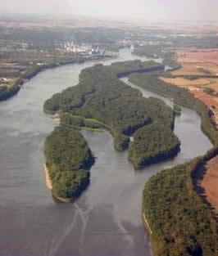
Department of Natural Resources
Each state manages its own natural resources, such as river systems, state parks, endangered wildlife. State systems also tend to work closely with education to support sustainable use of natural resources.
These departments are usually responsible for providing permits for fishing, hunting
Check out Illinois DNR for info on the services they offer

Slide 41
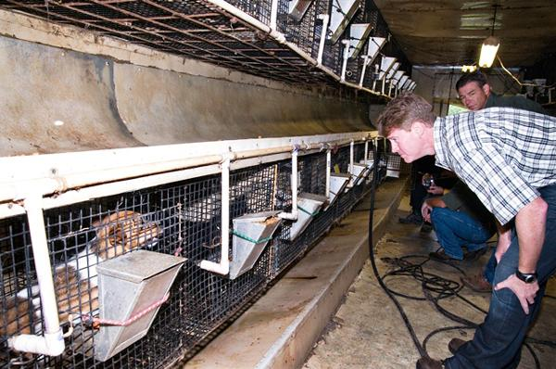
Companion Animal Management
Missouri Anti-Puppy Mill Law, Prop B
If you buy a puppy, you may be contributing to this problem. Be sure to find a reputable breeder and view their facilities before buying.
Or better yet, ADOPT from a local shelter, use petfinder.com to help you find the perfect companion.
A puppy mill, sometimes known as a puppy farm, is a commercial dog breeding facility that is operated with an emphasis upon profits above animal welfare and is often in substandard conditions regarding the well-being of dogs in their care.

Slide 42
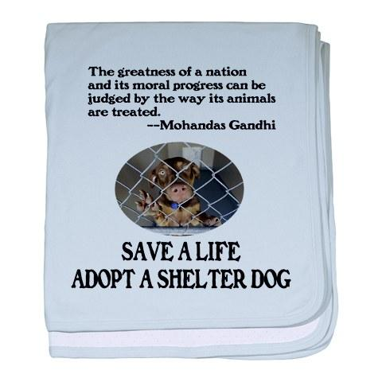
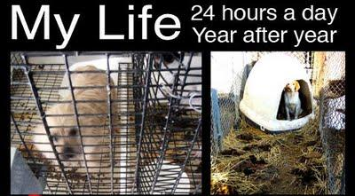

Slide 43
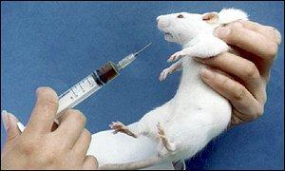
The Animal Welfare Act was signed into law in 1966. It is the only Federal law in the United States that regulates the treatment of animals in research, exhibition, transport, and by dealers.
Animal Cruelty Laws vary by state
Read law cases at
animallaw.com
Law in Illinois
Neglect of Owner's Duties: Fine up to $1500, imprisonment up to 6 months Cruel Treatment: Fine up to $2500, imprisonment under 1 year. Aggravated Cruelty: Fine up to $25,000, imprisonment from 1-3 years, 1 year probation. Animal Torture: Fine up to $25,000, imprisonment from 2-5 years, 1 year probation.

Slide 44
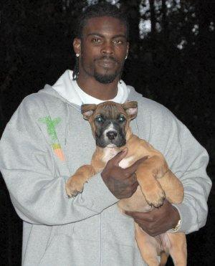
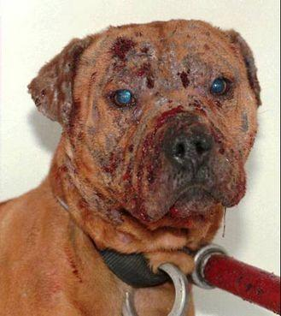
In 1976, Congress outlawed interstate promotion of animal fights and the transportation of animals across state lines for fighting, with penalties of up to a year in prison and a $5,000 fine. The fine was later increased to $100,000.

Slide 45
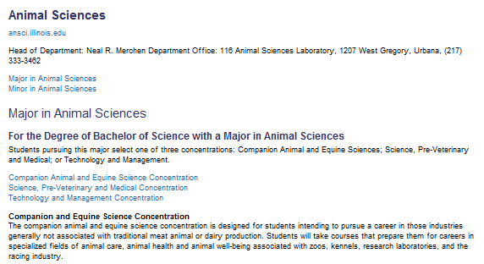
U of I Course Information: Animal Sciences

