Slide 1
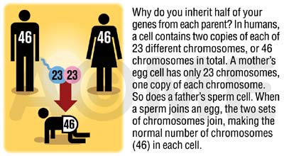
Concept Review
Homozygous: Two of the ______ allele
Ex: (TT) homozygous __________ or (tt) homozygous ___________
Heterozygous: Two _______ alleles
Tt
One allele must come from the mother and one comes from the father
The actual allele is decided through haploid _____ (sperm and egg) formation during meiosis
A zygote is the result of sperm fertilizing an _____

Slide 2
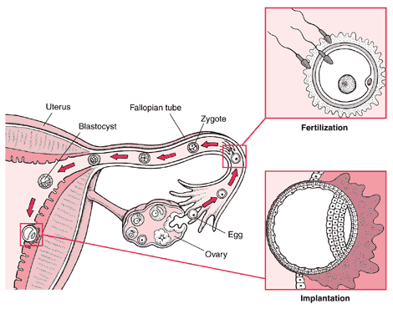
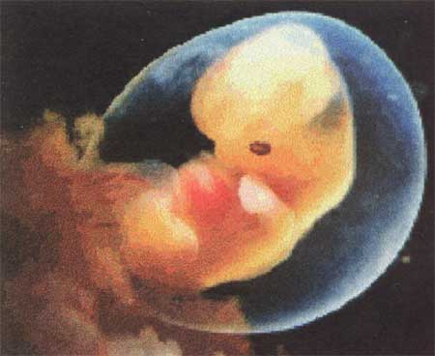
Fertilization
Fertilization: sperm and egg ______
Zygote: fused sperm and egg after ________
Embryo: First appearance of ______shape after around ___weeks
Fetus: the baby is called this at the ___ week after fertilization

Slide 3
Autosome: one of the 22 pairs of __-___ chromosomes
Sex Chromosome: The 23rd pair of chromosomes which may be __or __
Autosomal disorder- a disorder caused by _____ found on one of the first 22 chromosomes
Pedigree- A chart that shows the relationships within a ______

Slide 4
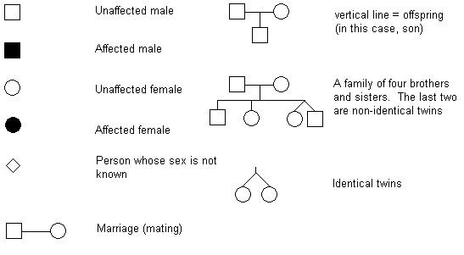
Common Pedigree Symbols

Slide 5
Mode of Inheritance
Most human genes are inherited in a Mendelian manner. Probabilities can be calculated with a _______ ________.
We are usually unaware of their existence unless a variant form is present in the population which causes an ________ (or at least different) phenotype.
We can follow the inheritance of the abnormal phenotype and deduce whether the variant allele is _______or ________.

Slide 6
Autosomal Dominant
autosomal dominant
A dominant condition is transmitted in unbroken descent from each generation to the next. There would be no carriers. Individuals that are _________ dominant or __________ would show the disorder
Could be NN or ___
Homozygous recessive genotype (___)

Slide 7
Autosomal Recessive
A recessive trait will only manifest itself when __________. (example: nn)
If it is a severe condition it will be unlikely that homozygotes will live to _________ and thus most occurences of the condition will be in matings between two heterozygotes (or carriers).
Carrier- Has an allele for a recessive trait but does not ______ the phenotype.
An autosomal recessive condition may be transmitted through a long line of carriers before, by ill chance two ________ mate. Then there will be a ____ chance that any child will be affected.

Slide 8
Autosomal Recessive
An autosomal recessive condition may be transmitted through a long line of carriers before, by ill chance two carriers mate. Then there will be a ___ chance that any child will be affected.
These must be ____
N
n
N
NN
Nn
n
Nn
nn

Slide 9
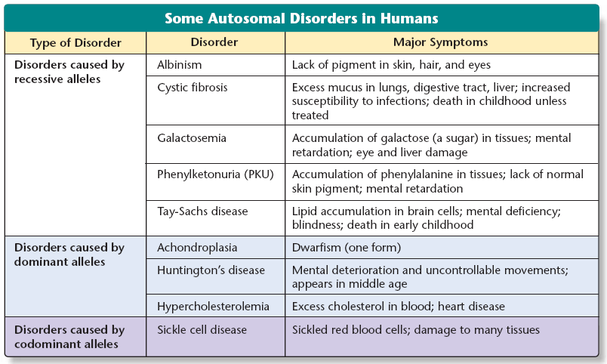

Slide 10
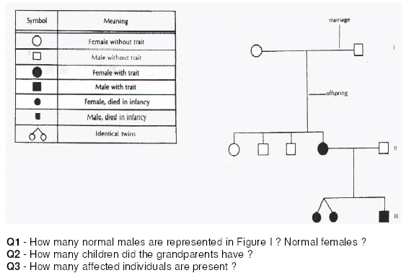
From your worksheet

Slide 13
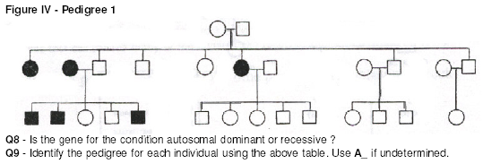

Slide 15
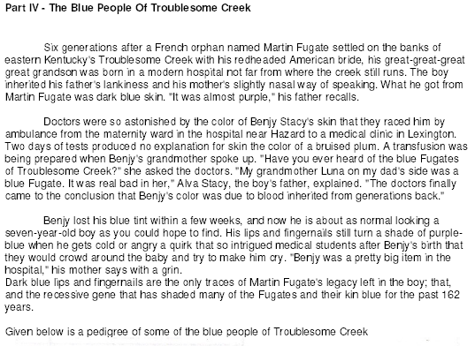

Slide 17
