Slide 1
Respiratory Quiz
8th Period

Slide 2
What respiratory structure connects the nasal passages and the mouth?
What structure separates the nasal passages and the mouth?

Slide 3
How does exercise affect pH/temperature/ heart rate/ respiratory rate/ hemoglobin binding?

Slide 4
How is oxygen transported in the blood?
How is carbon dioxide transported in the blood?

Slide 5
When you inhale, how does the diaphragm and intercostal muscles move?
When you exhale, how does the diaphragm intercostal muscles move?

Slide 6
Which structures comprise the conducting zone of the respiratory system?
Which structures comprise the respiratory zone of the respiratory system?

Slide 7
In negative pressure breathing, what causes inhalation?
Discuss atmospheric pressure and thoracic pressure.

Slide 8
When you exhale, air flows through the respiratory system in what sequence?
Alveolus pharynx larynx bronchiole
trachea bronchi nares alveolar duct

Slide 9
What cell type covers the lining of the alveoli?

Slide 10
Which chemical reactions occur in RBCs traveling through pulmonary capillaries?

Slide 11
Respiratory gases move along their concentration gradient to enter and leave the cells.
Air breathed into the lungs must have a ________ concentration of O2 and a(n) ______ concentration of CO2 compared to the blood in the lungs.

Slide 12
When you hold your breath, what change first leads to the urge to breath?

Slide 13
Define
expiratory reserve volume
inspiratory reserve volume
internal respiration
external repiration
tidal volume
pulmonary ventilation
respiratory gas transport

Slide 14
BONUS
How does breathing affect acid- base balance of the blood? (Normal blood pH is 7.4)

Slide 15
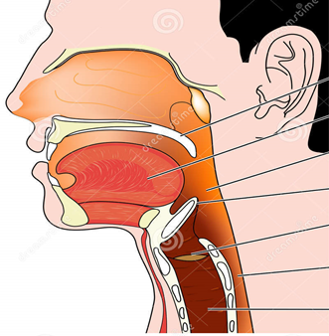

Slide 16
